Slide 1
Flex robotics: a versatile sample changer for macromolecular crystallography applications
Control software and MxCube integration

Slide 2
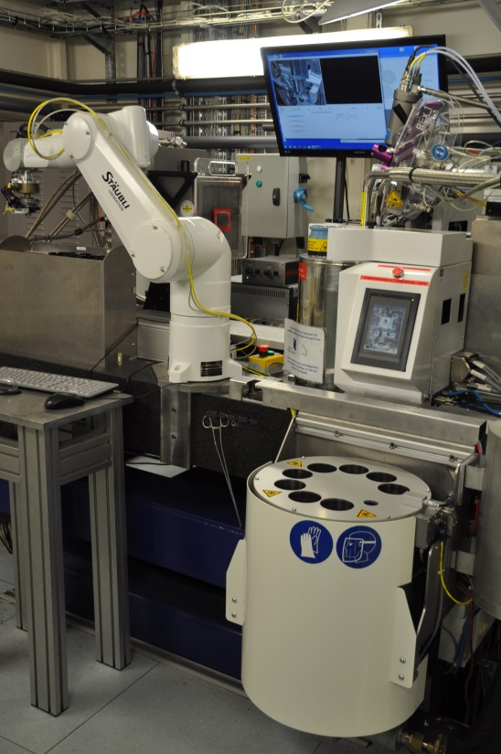
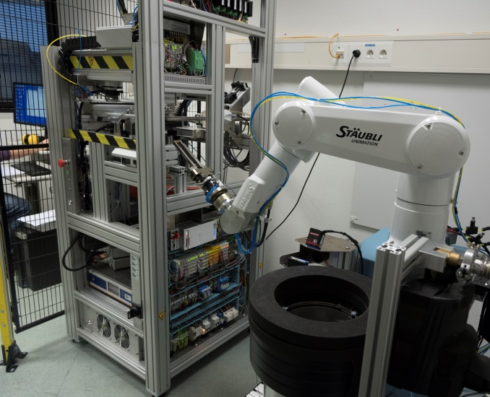
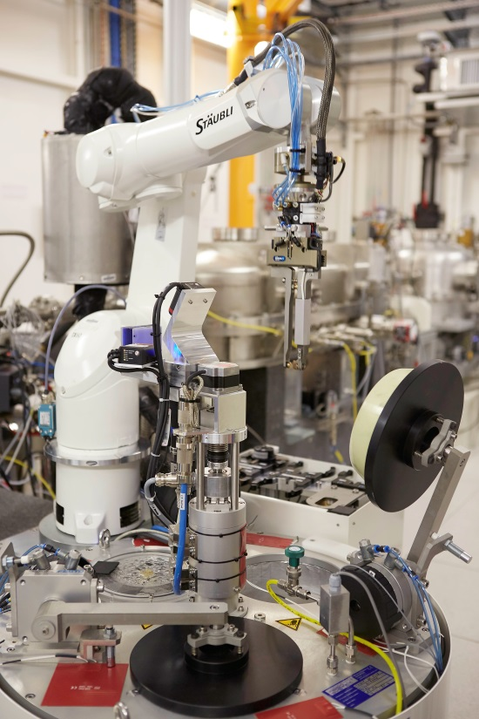
Flex robotics variants
FlexED8
FlexED3
FlexHCD
ED3 : EdgeDewar3
ED8 : EdgeDewar8
HCD : High Capacity Dewar

Slide 3
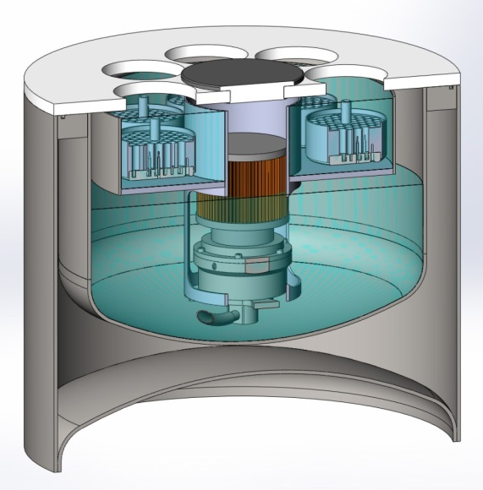
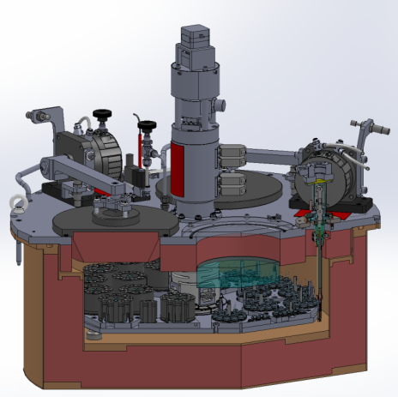

Dewars
ED8: EdgeDewar8
  Patented EMBL design
  Open (no ports)
  Self cleaning
  Permits short dewar access
  Eight uni-puck footprint slots
  ProxiSens puck detection system
HCD: High Capacity Dewar
  Modified ESRF design
  12 SC3 puck footprint & 12 uni-puck puck footprint
  ProxiSens puck detection system

Slide 4




Control software architectures
Two ≠ software architecture with same StaubCom device server
MxCube
Java high level control software
StaubCom
low level server
Exporter
protocol
StaubCom
protocol
Python client
StaubCom protocol

Slide 5

StaubCom generic device server and API for Staubli robots
Socket based Ethernet communication with clients
Core Features:
  Keep-alive messages
  Update and log messages about robot status
  Dynamic loading of custom movement sequences and custom PLCs
The API permits to implement custom:
  Movement sequences
  PLCs
  Variable and IO state notification to the client
  Initialization and termination scripts
  Log and error messages
software.embl-em.de

Slide 6
Control software architecture
MxCube
Java high level control software
StaubCom
low level server
Exporter
protocol
StaubCom
protocol
Python client
StaubCom protocol

Slide 7
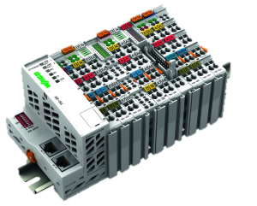
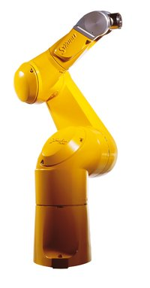
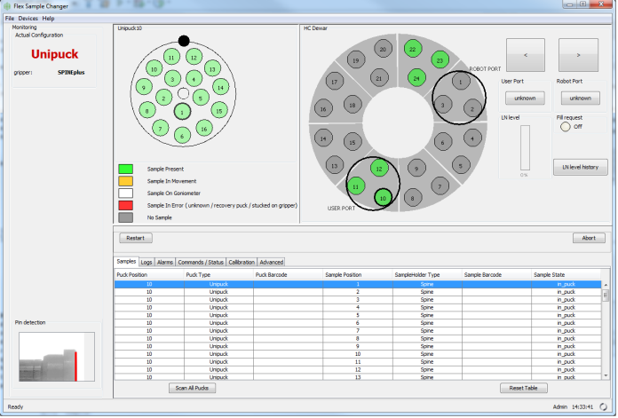
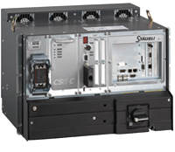
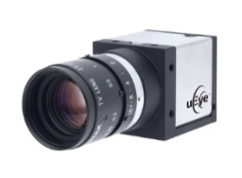
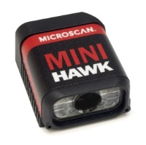
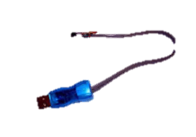
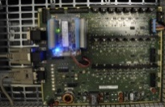

Flex robotics control architecture with Java
beamline control software (e.g.: MxCube)
VAL3 StaubCom server
Tango, Tine, Exporter, WebServices, Epics, …
IO management
Modbus
(Ethernet)
StaubCom
Protocol
Socket
(Ethernet)
VAL3
PLCs for low level regulation tasks
movement sequences:
Loading
Unloading
…
Camera + image processing:
Gripper calibration
Pin detection
DM reader
OneWire:
Gripper identification
ProxiSense Card:
Puck presence & type detection

Slide 8
Control software architecture
MxCube
Java high level control software
StaubCom
low level server
Exporter
protocol
StaubCom
protocol
Python client
StaubCom protocol

Slide 9
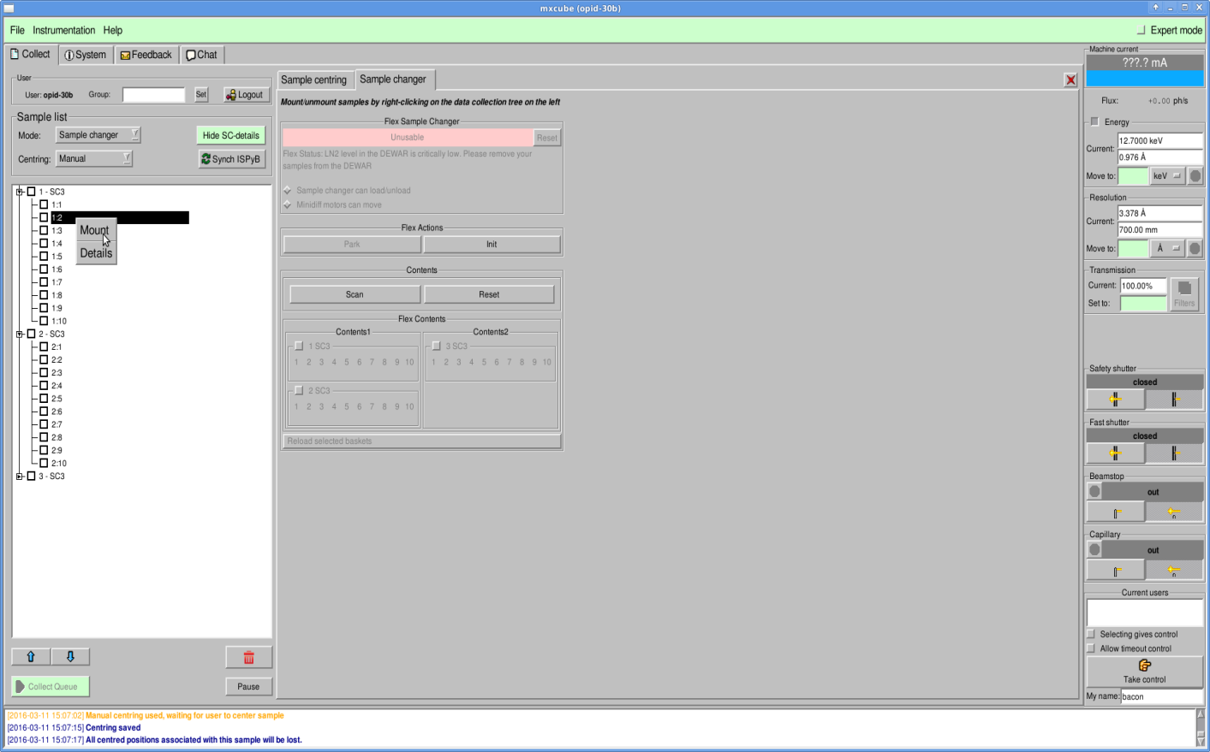
Flex robots MxCube integration
Based on the GenericSampleChanger class (Alaxandre Gobbo)
Development done by Akim Khadrouche (former BM14 technician)
Communication using Exporter protocol (JLib)
Supports events
Error and log messages
Robot status

Slide 10
Sample changers with Java control software & StaubCom device server / API
Flex robots
  FlexHCD : ID30B - ESRF
  FlexED8 : BM14 (dismanteled) - ESRF
  FlexED3 : HTXLab – EMBL
Other sample changers
  RoboDiff : Massif 1 - ESRF
  NSLS-II Sample Changer: 17.ID.1 & 17.ID.2 - BROOKHAVEN

Slide 11
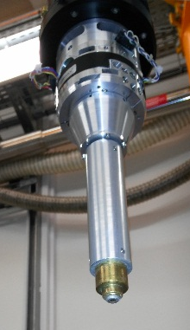
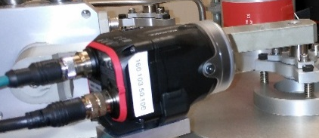
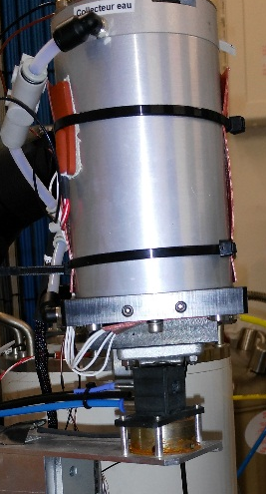
RoboDiff and ESRF-Flex-HCD
RoboDiff (Massif-1)
  SPINE Sample Changer
  Diffractometer
  VAL3 integration of external devices
ESRF-FlexHCD
  Versatile sample changer
  External devices helping the sample handling

Slide 12

ESRF-FlexHCD Control software architecture
StaubCom device server
Python client integrated in a Bliss device server
MxCube
Java high level control software
StaubCom
low level server
Exporter
protocol
StaubCom
protocol
Python client
StaubCom protocol

Slide 13
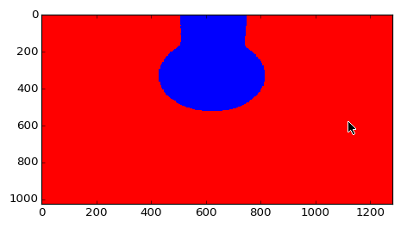
ESRF-FlexHCD Control software architecture
StaubCom device server
Python client integrated in PyFlex BLISS controller :
      Trajectories handling :
            Ueye camera image analysis (Lima library)
            Microscan Data matrix reading (Ethernet socket)
            Cached variable updates
      External device :
            1-wire memory reading (pyowfs)
            Proxisense card (serial line socket)
      Logging of StaubCom and PyFlex + Command line debugging option
      No GUI
      automatically exported as a generic TANGO server

Slide 14
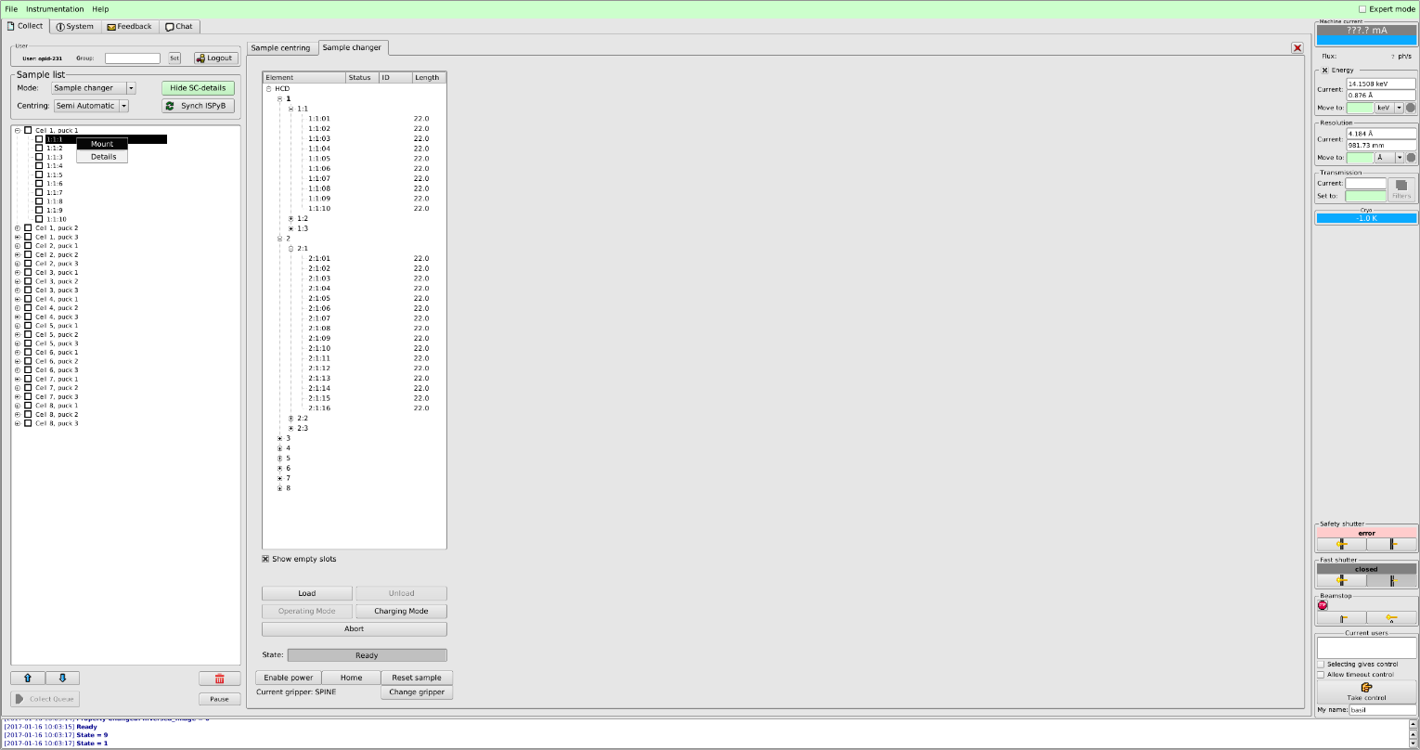
ESRF-FlexHCD integrated in MX-CuBE2
Sample Changer Tab using the generic sample changer Class :
  Sample position list
  Basic commands:
    Loading / unloading
    change gripper
    Sample reset
    Abort
Data collection list:
    Chained loading
    Automatic processing

Slide 15
Acknowledgements
EMBL:
  Gergely PAPP
  Marcos LOPEZ-MARRERO
  Christopher ROSSI
  Robert JANOCHA
  Franck FELISAZ
  Clement SOREZ
  Florent Cipriani
  Andrew MC CARTHY
  Hassan BELRHALI
  Akim KHADROUCHE
  Babu MANJASETTY
  Stephen CUSACK
ESRF:
  Didier Nurizzo
  Matias Guijarro
  Antonia Beteva
  Fabien Dobias
  Hugo Caserotto
  Thierry Giraud
  Pascal Theveneau
  Gordon Leonard

