Slide 1
Status report
Notes:
1
1

Slide 2
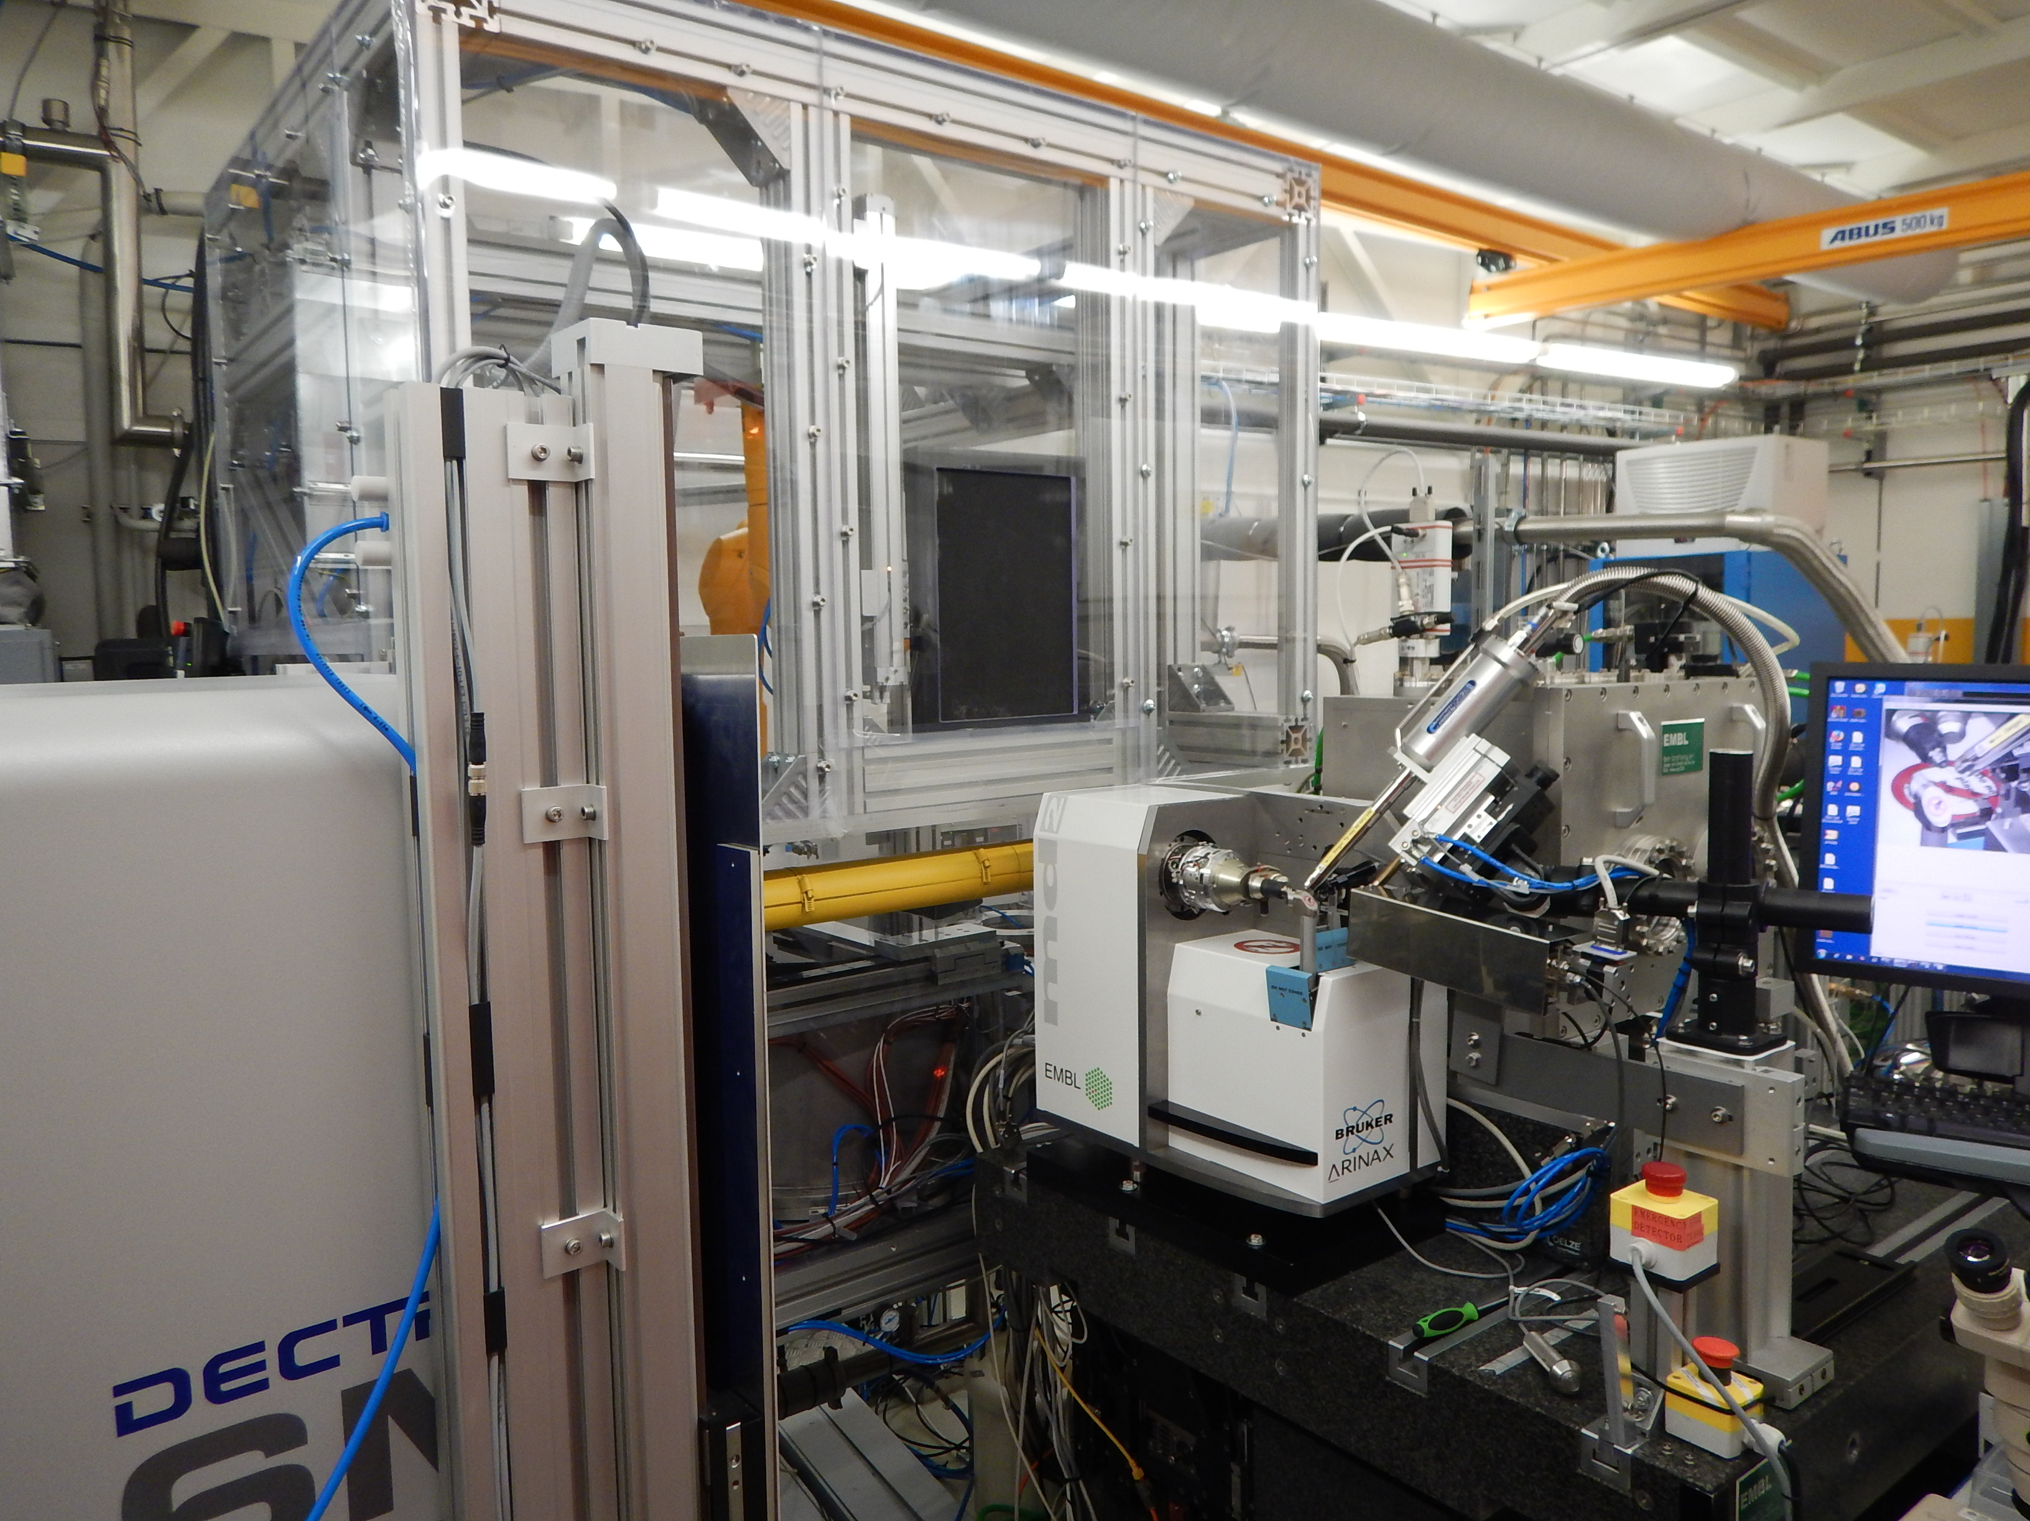
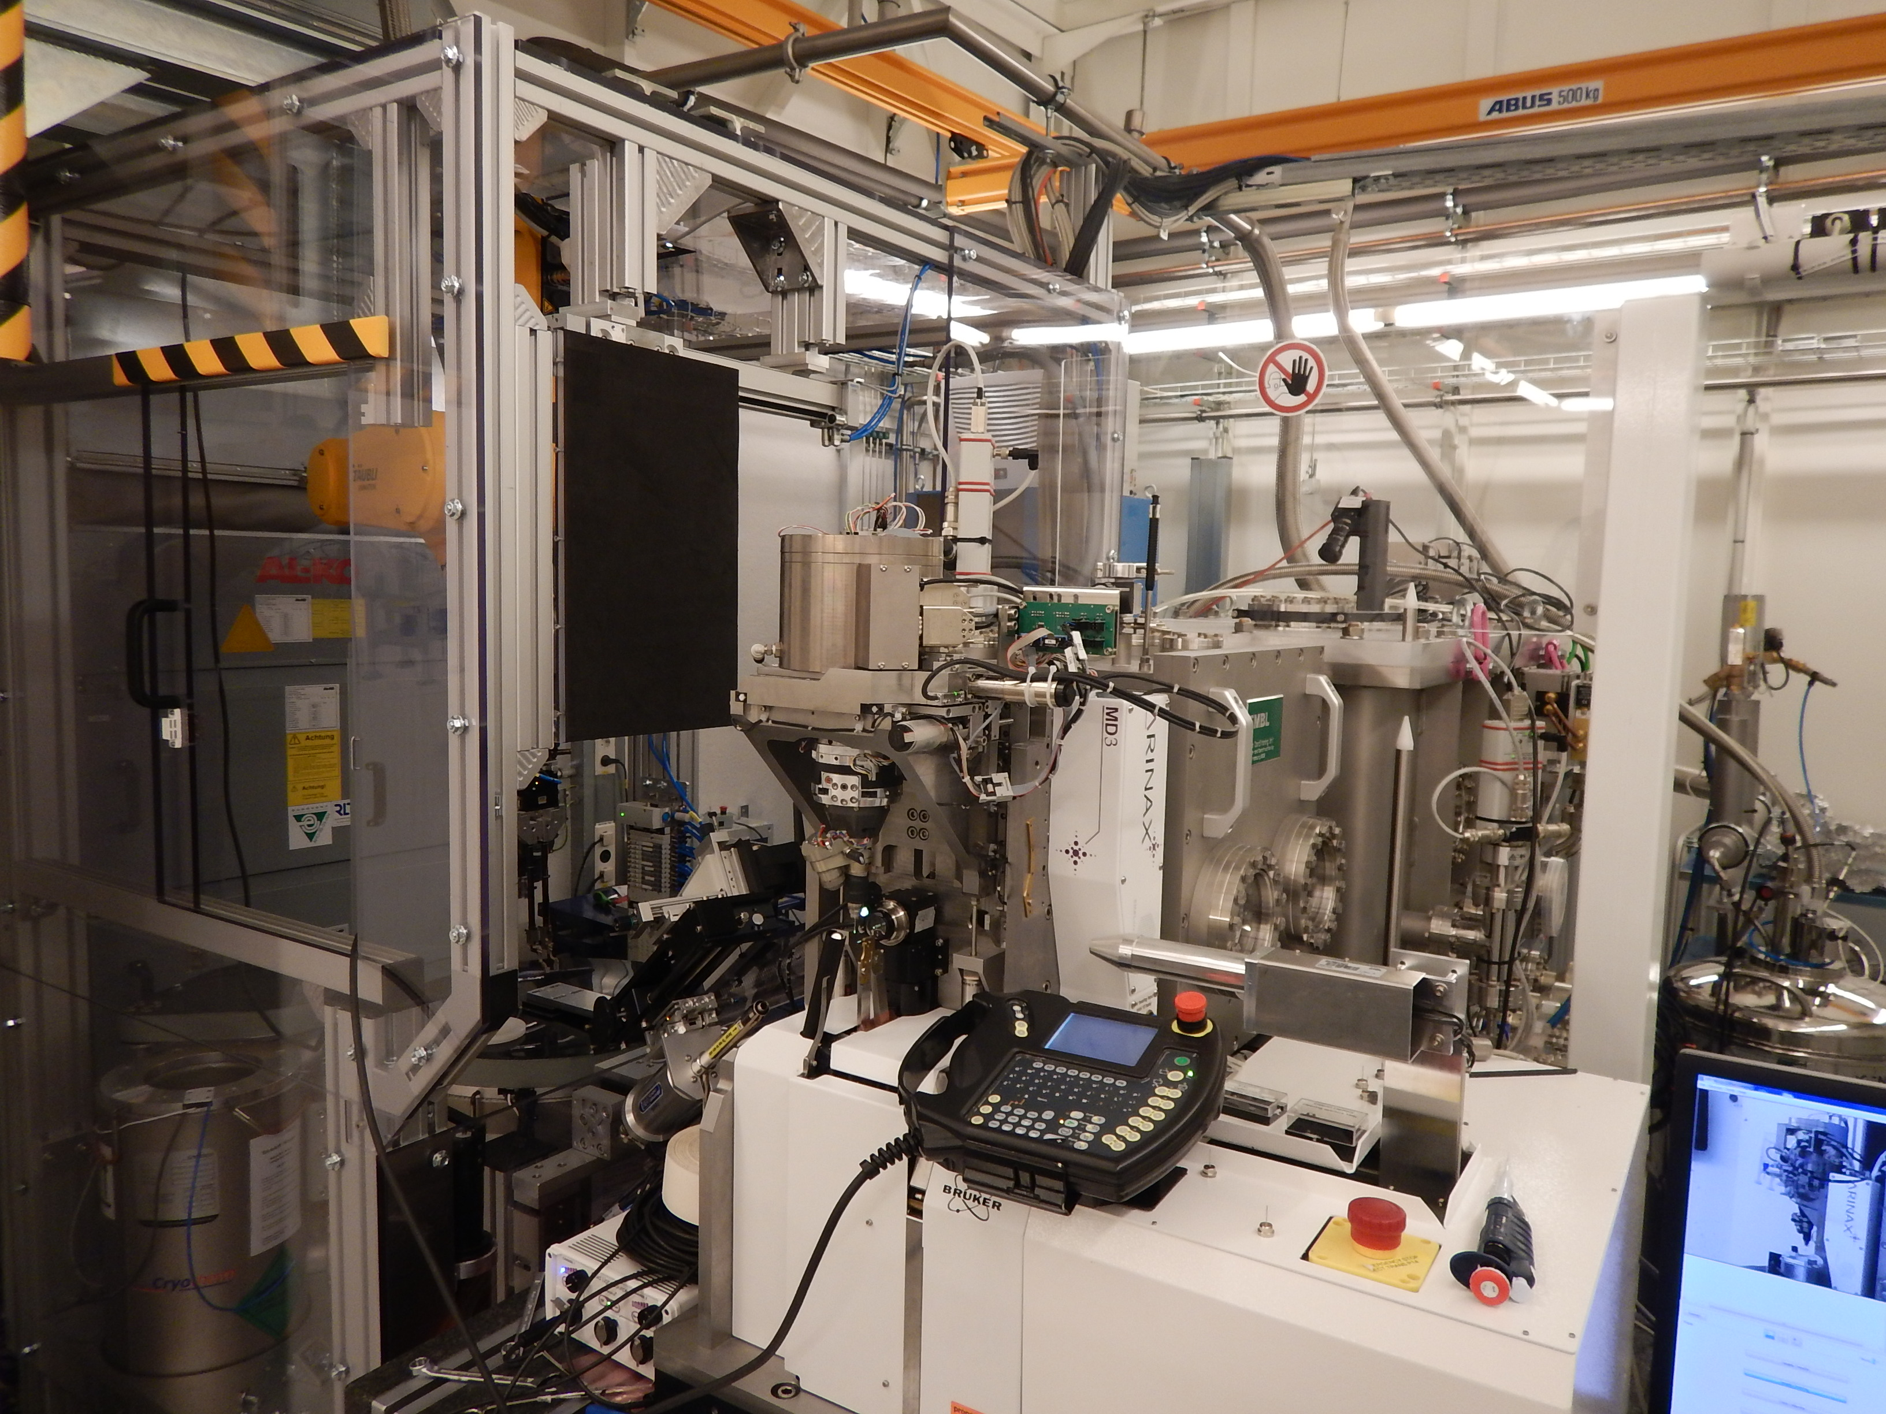
MX beamlines P13 and P14
- Variable beam size and high flux
- Tunable energy between 4.5 and 17.5 KeV
- MD2 diffractometer and Pilatus6MF
- EMBL Marvin sample changer with 16 pucks
- Micro-beam conditions with 5 x 5 micron beam
- On the fly changeable focusing of the beam
- Tunable energy and CRLs (ESRF/CINEL)
- MD3 diffractometer and Eiger16M
- EMBL Marvin sample changer with 16 pucks
- Plate scanning possibilities
Joint MXCuBE/ISPyB meeting
Notes:
2

Slide 3
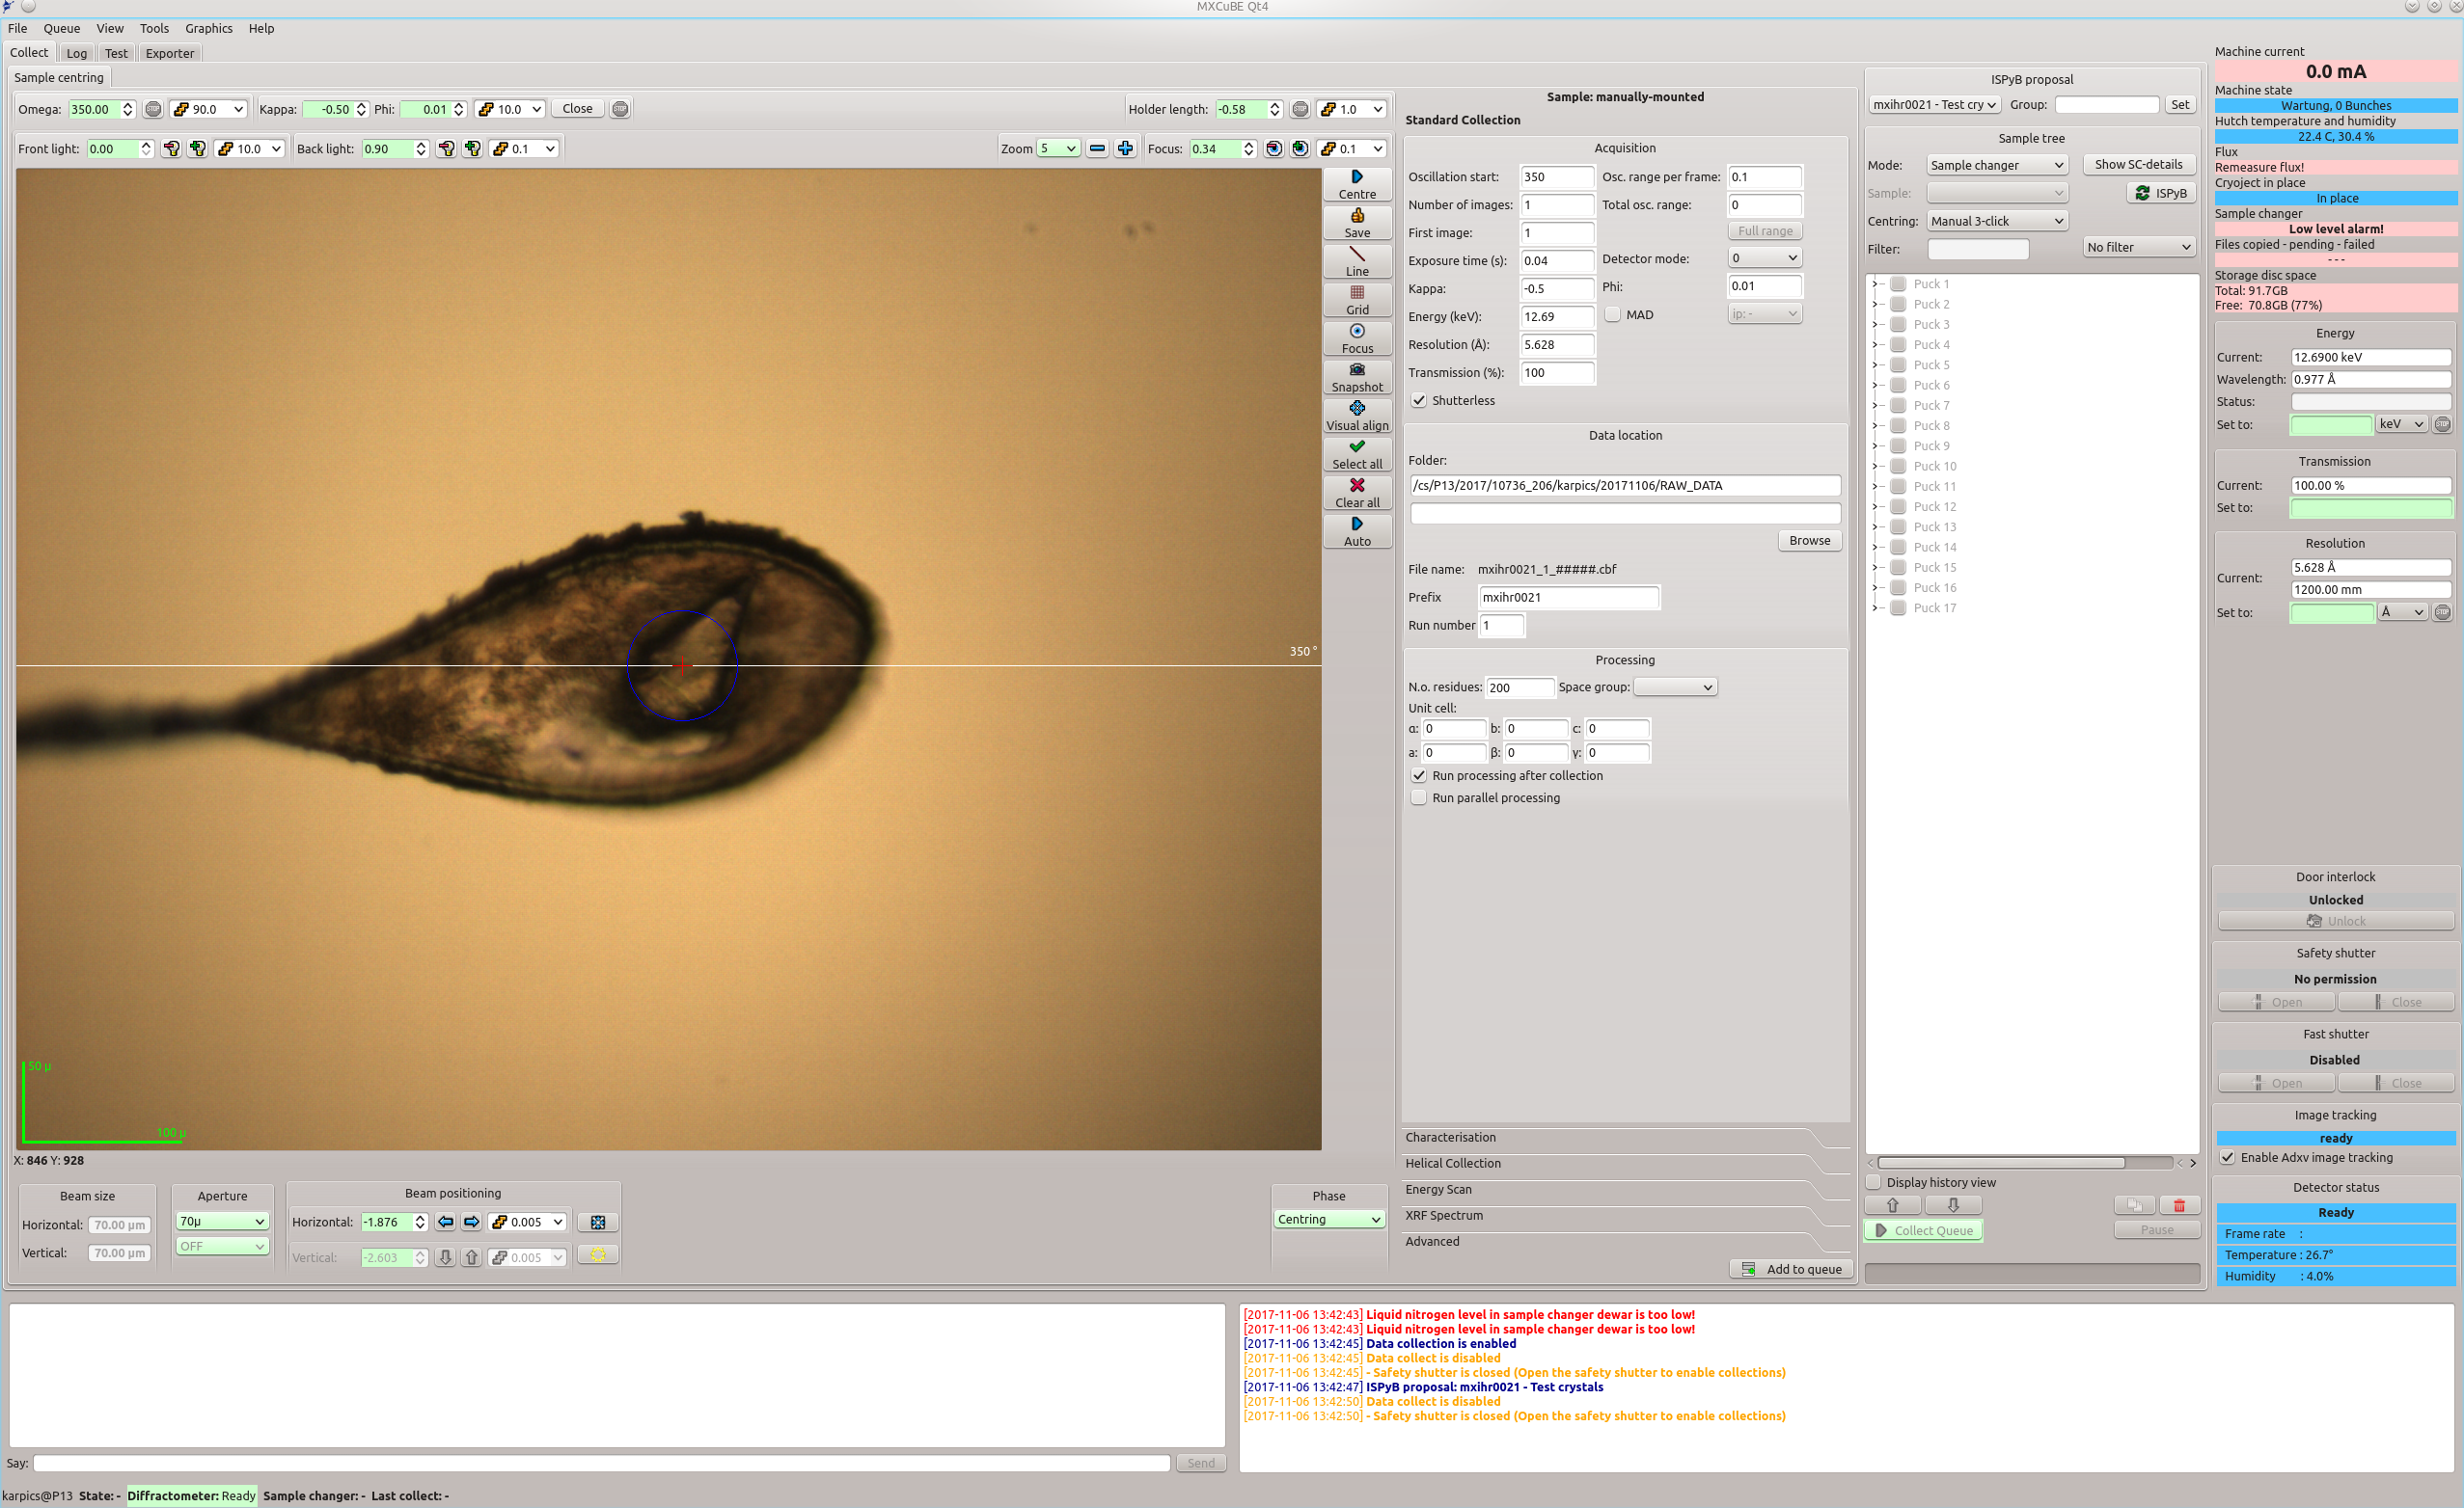
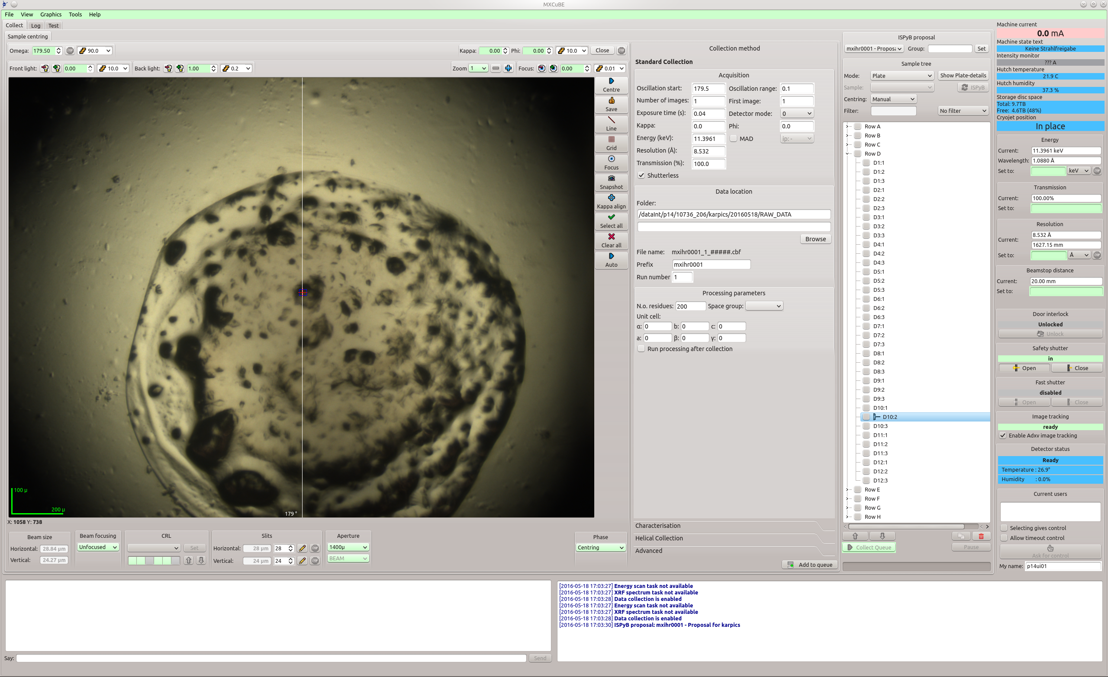
MXCuBE
Both beamlines use MXCuBE Qt4 from the master branch.
Last 4 months a feature freeze and stability improvements (two reasons for segmentation faults eliminated).
Currently moving to ubuntu 16 and deploying a set of new features (see next presentation about the new features in the Qt).
Joint MXCuBE/ISPyB meeting
Notes:
3

Slide 4
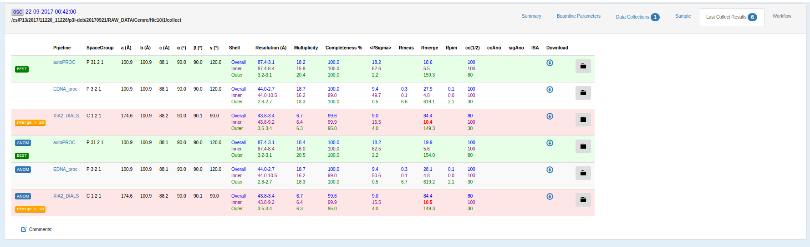
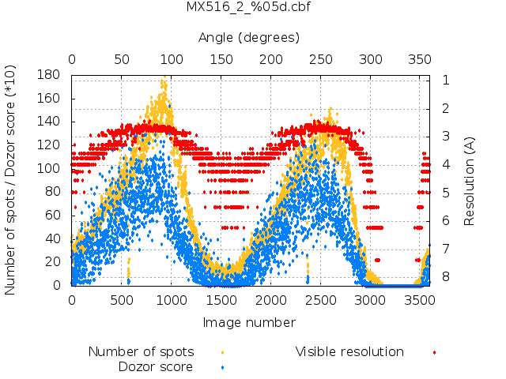
MX pipeline and current developments
Mesh scans and serial crystallography data collections are used daily.
Autoprocessing queue with EDNAproc, AutoProc, Xia2Dials, XDSapp and Dozor.
Continue to develop more friendly and rich GUIs for SSX.
Deploy a generic state persistence and monitoring to ease the interactivity with a user:
1. A Finite State Machine (FSM) model presented in the last MXCuBE meeting and at ICALEPCS 2017 (http://icalepcs2017.vrws.de/papers/tupha187.pdf)
2. Implemented as a hardware object.
3. Connection with the GUI is in the development.
Joint MXCuBE/ISPyB meeting
Notes:
4

Slide 5
Some discussion points
A separate developers meeting to merge 2.2 and master is urgent to avoid deeper branching.
Code refactoring would help to develop new coding guidelines.
Sort out the licensing issue. Maybe MXCuBE do not need a license at all?
Joint MXCuBE/ISPyB meeting
Notes:
5

Slide 6
Thank you for your attention!
Notes:
6

