Slide 1
MXCuBE-related developments at GPhL: their basis in GDA-related transferable developments
Gerard Bricogne,
Claus Flensburg, Wlodek Paciorek,
Peter Keller, Rasmus Fogh, Clemens Vonrhein
Global Phasing Ltd., Cambridge, UK

Slide 2
Introducing Transferable Expertise into Automated Data Collection
The ever-increasing speed of MX beamline instrumentation is leading to ever-stronger emphasis being placed on brevity of execution as the main design goal for data collection protocols, often to the exclusion of other criteria that would aim at achieving higher data quality. This can be counter-productive, especially, but not only, for phasing experiments.
Global Phasing, among others, has been interested in bucking that trend by creating combined capabilities for the fast design of optimal strategies and the direct supervision of their execution on an actual beamline.
Our approach has been to aim for a full "third-party design and control" capability rather than for separate add-on programs that would need to be invoked by local software on each specific beamline or group of beamlines running under the BCS.
To make this capability as transferable as possible across the broad diversity of beamline instruments and BCSs, finding the correct level of abstraction for all the components and processes involved is of paramount importance.

Slide 3
An unlikely opportunity to “push the frontiers”: the Diamond I23 long-wavelength beamline (Armin Wagner)
In vacuo operation
Wavelengths 1.5-4.5A and perhaps beyond
Half-cylindrical Pilatus 12M detector
Full kappa goniometer

Slide 4
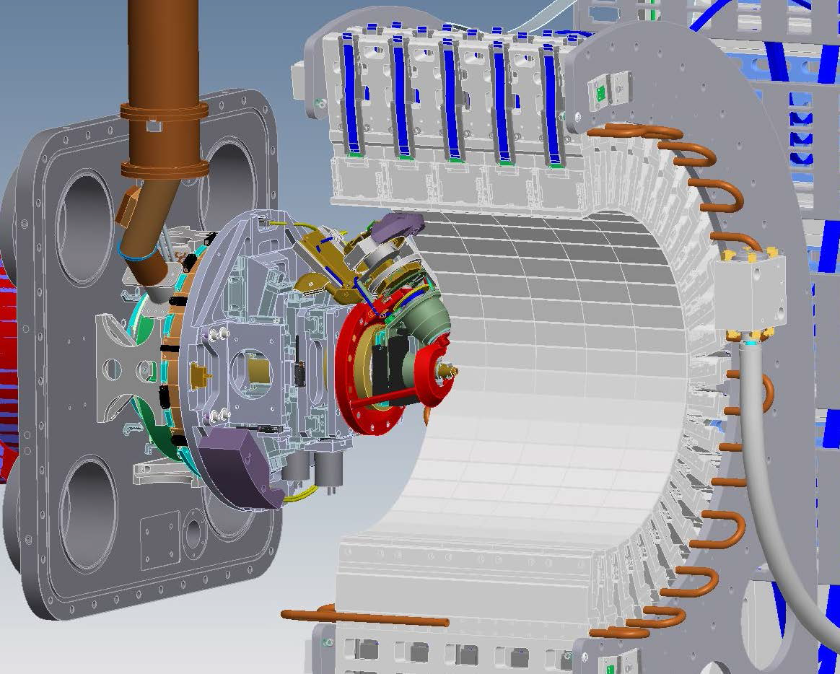
The ATC Kappa goniometer

Slide 5
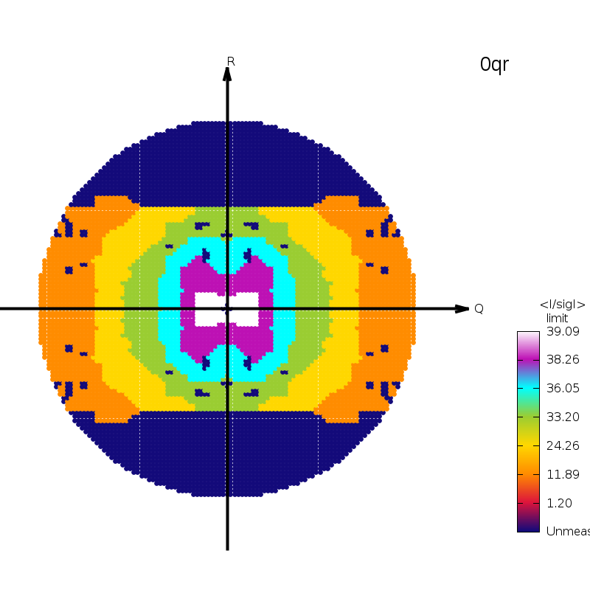
S-SAD in C2: sweep 1 (κ=0,φ=0)

Slide 6
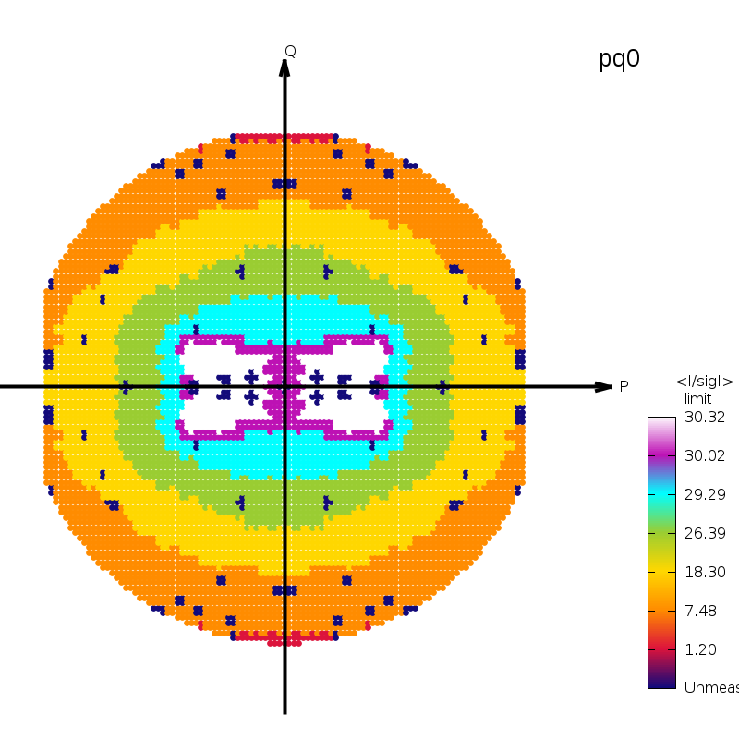
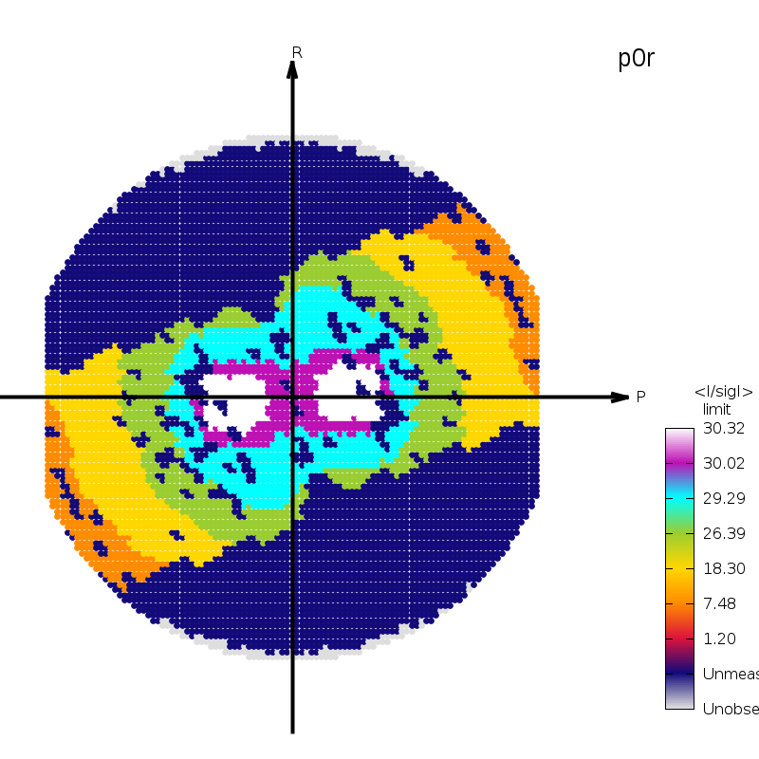
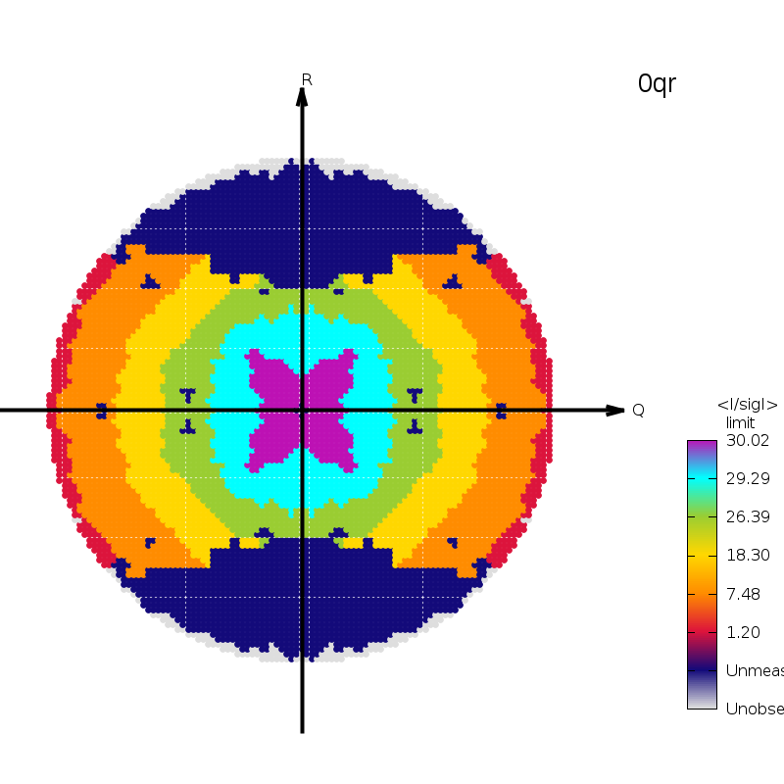
S-SAD in C2: sweep 2 (κ=-10,φ=70)

Slide 7
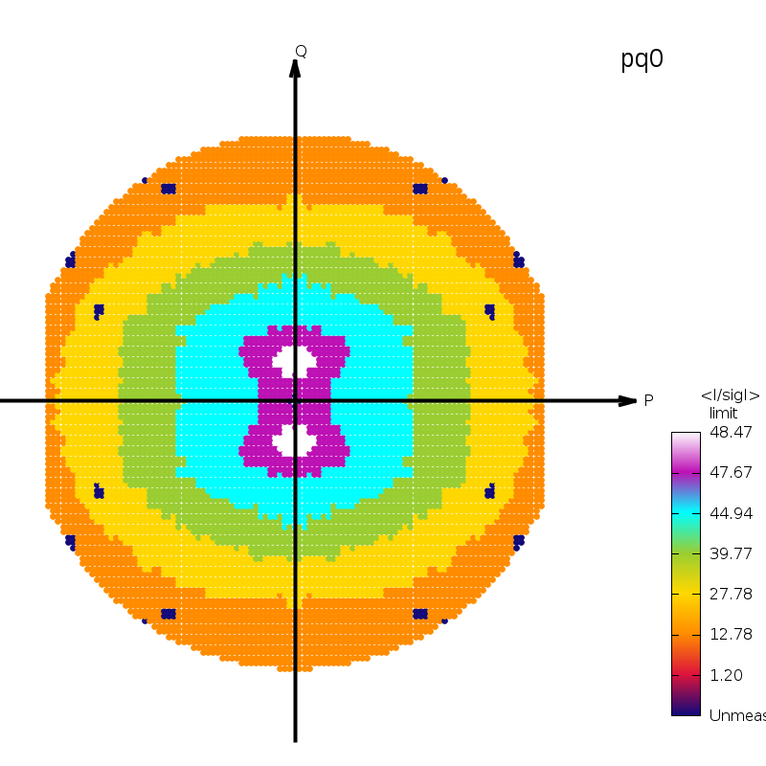
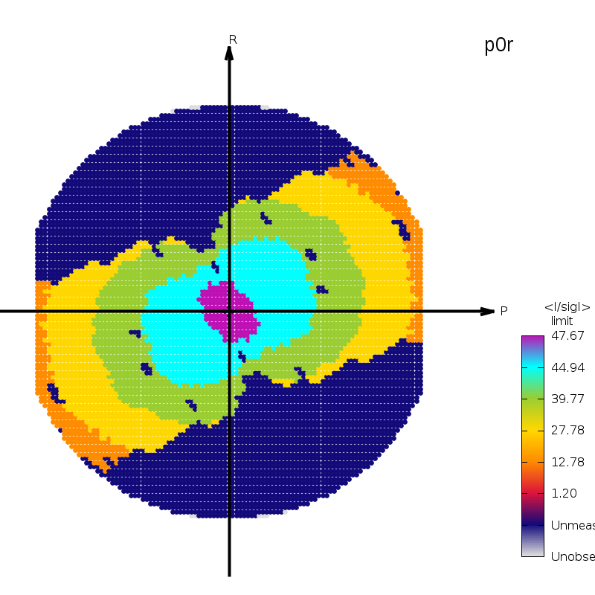
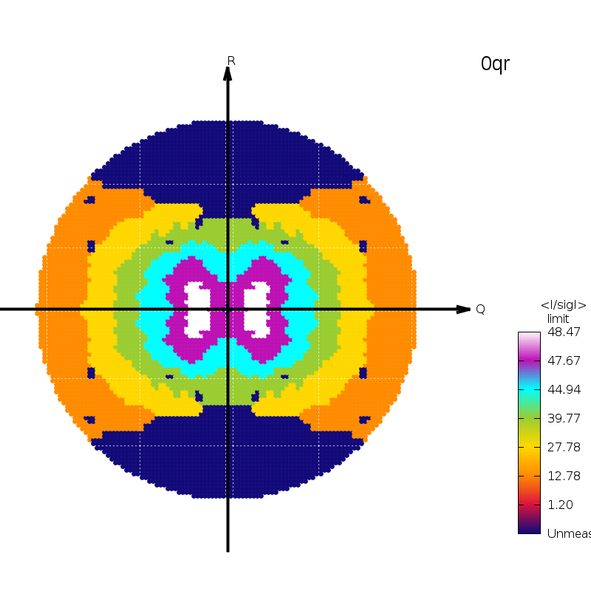
S-SAD in C2: sweeps 1 and 2 merged

Slide 8
Software requirements
Design of multi-orientation strategies to achieve completeness, under constraints / restraints from
collision avoidance
shadowing anticipation and mitigation
Expert use of an "inverse-kappa" goniostat
need to anticipate recentring translations required when changing orientation
Interleaving capabilities to improve the signal/noise ratio of the phasing signal(s)
alignment of 2-fold axes or inverse-beam technique for anomalous signal
wavelength interleaving for dispersive signal

Slide 9
(a) Traditional κ system: a 3D centring stage is located after the φ motor and places the sample at the centre of the goniometer; (b) Inverse κ system: a 2D centring stage is located between the ω and κ motors and places the sample on the ω axis.

Slide 10
Any change of orientation requires a re-centring translation

Slide 11
Collision maps (calculated by WP from data by Vinay Grama) underline the current importance of predictive recentring
Recentering mode
Data collection mode

Slide 12
Translational Calibration (TC) Workflow
collision map *with*
OAV & backlight
Operator
Note: use a restricted TC design to get rough TC parameters, then use ReCen
to pre-calculate recentring translations for a finer TC design to eliminate the need for zooming in/out
GDA
TC design
(list of orientations)
Messagebus
list of orientations &
recentring translations
Start TC workflow
Collect all TC measurements
Transcal
updated TC
parameters
predicted
recentring
translation
orientation in
TC design
Update beamline config
ReCen
workflow
previous
beamline
config
updated
beamline
config
activity
previous TC
parameters
program
data
i/o
key

Slide 13
Translational Calibration update
Two-stage procedure works very well
Much better consistency between TC measurements once thermal dilation and contraction effects have subsided
SoC reduction by “active compensation” suspect for high Kappa values – needs revisiting

Slide 14
Calculate geometric strategy: detail
proposed
orientation
in strategy
current RC
parameters
stratcal
internal call
ReCen
current TC
parameters
collision map
check
range
predicted
recentring
translation
Calculate geometric strategy
Messagebus
Check centring
workflow
activity
program
data
i/o
key

Slide 15
Rotational Calibration (RC) Workflow
collision map *without*
OAV & backlight
GDA
RC design ¹
(list of sweeps)
Messagebus
images for
all sweeps
Start RC workflow
Collect all RC sweeps
XDS COLSPOT
consolidated
spot list
rough RC
parameters
XCalibra
Note ¹: for orientations in RC design, use current TC parameters & ReCen
to pre-calculate recentring translations
refined RC
parameters
Update beamline config
workflow
activity
previous
beamline
config
updated
beamline
config
program
data
i/o
key

Slide 16
Rotational Calibration update
Old results (3 October 2016) xc-23-33.png
New data collection (27 November 2017)
Prior TC and Recen enabled
Unattended collection of 22 sweeps, with automated recentring after each change of orientation
Diffuse components of the shadows (plus powder rings) from the sample holder, have complicated the analysis
Minor problems with post-processing because of access to DLS cluster, permissions, ACLs, etc.

Slide 17
Workflow with beamline (v2)
User input
Collect images
Select lattice
simcal_predict
Visualisation
Messagebus
Generate predictions
Start workflow
Collect reference images
Index
stratcal
ReCen
Persistence layer
Calculate geometric strategy
Messagebus
Apply interleaving
Check centring
note: see separate diagram detail
Data processing
Main data collection
Messagebus
Collect images

Slide 18
30 Sep 2016: I04, Diamond, viewed from Sheraton House (GPhL)

Slide 19
Workflow initialisation

Slide 20
User choice of indexing solution

Slide 21
View of StratCal output

Slide 22
Recentring for new orientation

Slide 23
…
Our MX Experimental Workflow went on to execute an interleaved 3-wavelength MAD experiment on a thaumatin crystal with a 4-fold symmetry axis aligned along the Omega axis using the mini-kappa of the I04 beamline via our strategy program StratCal.

Slide 24
Experimental Workflow update on I23
Various initial confusions
Removal of beamstop from BL but not from the collision model given to StratCal
Interleaving order on DLS side
Once these were understood, the WF worked
Post-processing: again, access to cluster, permissions, ACLs etc. had to be learned
Issue of making the data and the results (e.g the autoPROC summary.html) visible via ISPyB

Slide 25
Transfer to MXCuBE
See Rasmus’s talk …

Slide 26
Acknowledgements
Wlodek Paciorek and Claus Flensburg (simulation, prediction of spot shape, prediction of shadowing, collision prevention, strategy design, translational and rotational calibration)
Peter Keller (persistence layer, workflow, message bus)
Rasmus Fogh (connection of workflow to MXCuBE)
Clemens Vonrhein and Claus Flensburg (autoPROC, feature integration, testing, processing, rotation calibration analysis)
The Global Phasing Consortium for funding
The Diamond Light Source for supplementary funding and for the opportunity to build a complete experimental workflow for I23
Armin Wagner & colleagues on I23, Dave Hall & colleagues on I04

