Slide 1
Integration and deployment of
GΦL workflows in MXCuBE
Rasmus Fogh
Global Phasing Ltd, Cambridge, UK
Gleb Bourenkov
EMBL Hamburg, DE
MXCuBE meeting, virtual Hamburg
May 2021

Slide 2
Introduction – the problem
The GΦL Workflow and its capabilities
Deployment and tests
Workflow at P14 (Gleb Bourenkov)

Slide 3
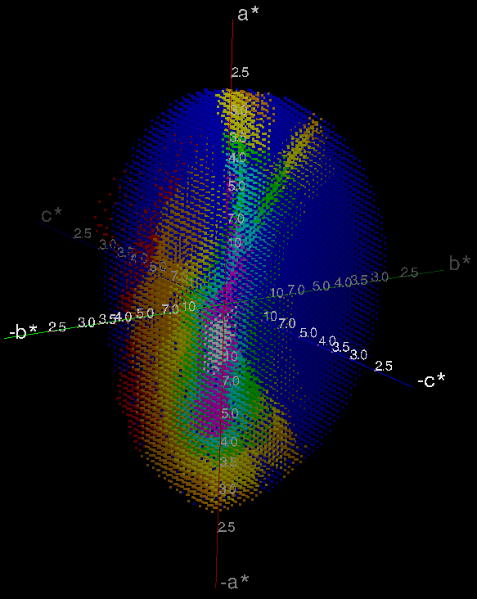
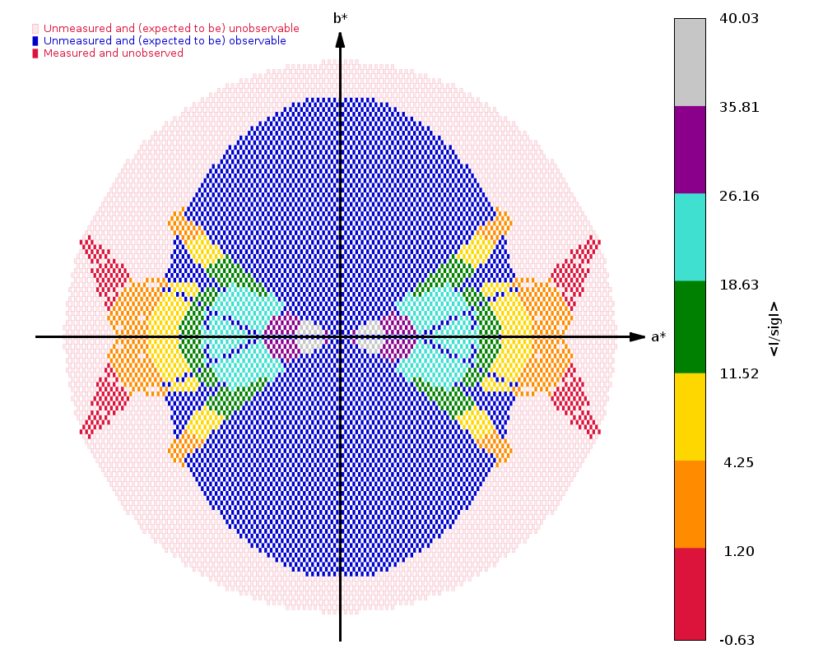
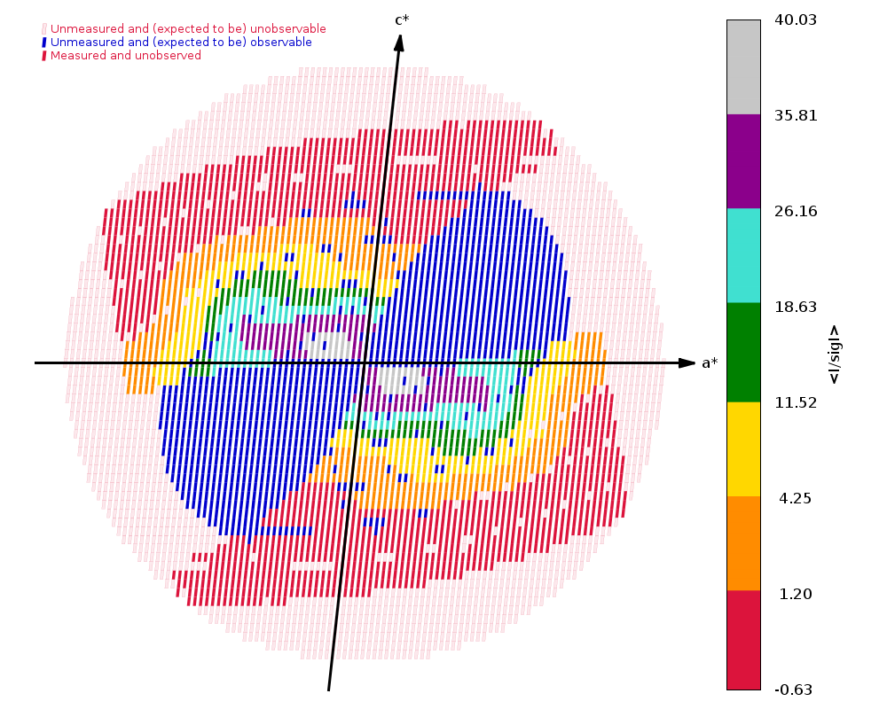
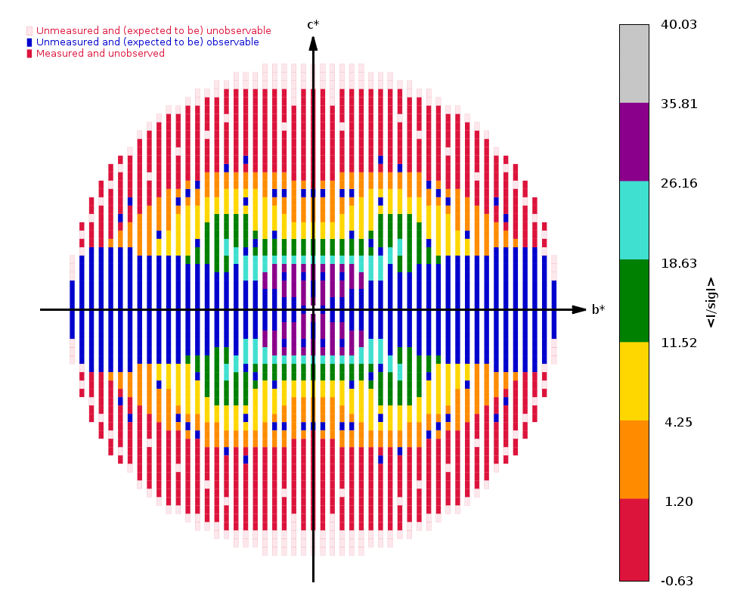
How bad can it get?
Pilatus6 3M detector - min 0.04s / image.
100s acquisition time (one centring took 235s)
Alternative strategy, collecting 400˚ in 4000
images: 200s acquisition at 50% transmission.
Blue = not measured but expected to be observable
Covid-related deposition (6W9C, 01/04/2020), C2, 2.7Å.
57% complete, 2.5 redundancy, (highest shell : 38%, 1.9)
2 sweeps, 70˚+ 30˚ (overlapping), 200 images
0.5˚,0.5s per image; high background, ca. 40 counts.
100% transmission; strong radiation damage.

Slide 4
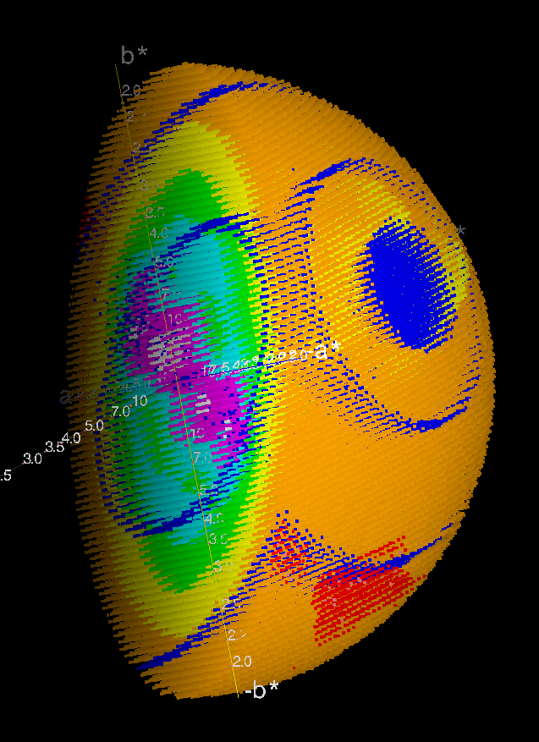
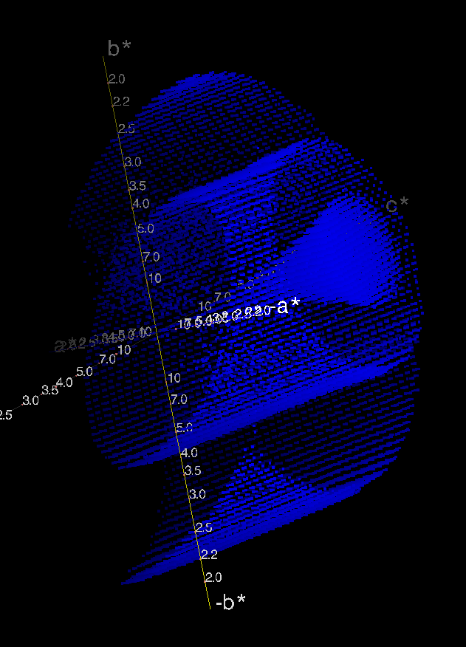
P1: Cusp and detector module gaps (4CY8)

Slide 5
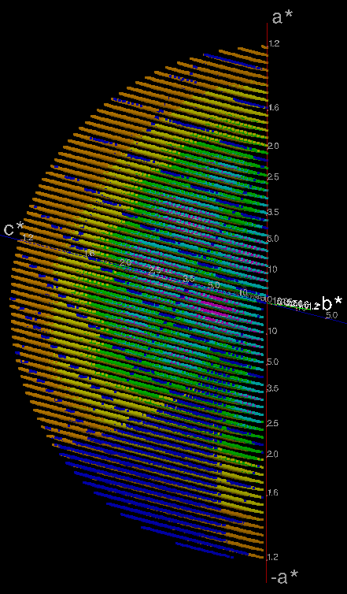
Unfortunate orientations
6R6F
P21
93% complete, redundancy 6
(highest shell: 90%, 6.1)
1.20Å resolution
Missing observations (blue) from module gaps and cusp

Slide 6
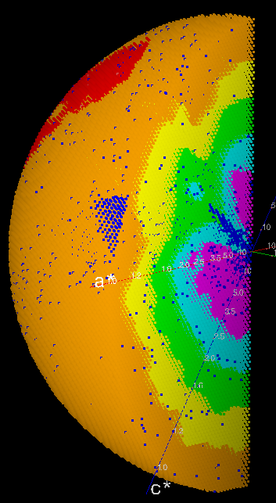
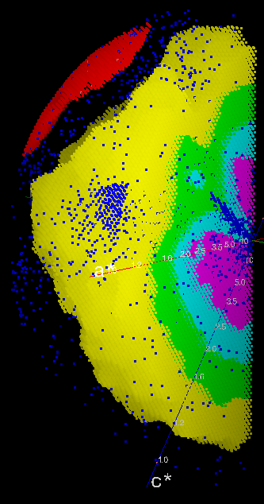
Cusp imprint in complete data
Reduced S/N ratio (I/σ) resulting from reduced redundancy caused by cusp in a high-quality data set.
4KXX, C2, 1.20Å.
99% complete,
redundancy 3.
(highest shell: 99%, 2.33)
Orange points removed

Slide 7
Introduction – the problem
The GΦL Workflow and its capabilities
Deployment and tests
Workflow at P14 (Gleb Bourenkov)

Slide 8
On-line strategy calculation and execution
Calculation of optimised multi-sweep acquisition strategies in real-time, from characterisation results
Workflow* includes characterisation, indexing,
pre-centring, parameter setting, and data acquisition
Choice of strategies
  Full, for high-quality data
  OR quick, for fast-but-guaranteed complete data
Integrated into MXCuBE, with Qt4 interface components
* With acknowledgements to the EDNA precursors

Slide 9
Workflow capabilities
Goniostat calibration, subsequently used for automatic pre-centring when orientation changes
Native, MAD or SAD collection strategies
  Adapted to resolution, symmetry, crystal orientation, and accessible (re)orientations on the available goniostat
  Use full range of κ values while avoiding goniostat shadowing
Set default transmission*, depending on resolution
  Uses pre-calculated radiation sensitivity values
  Assumes B-factor increase of 1Å²/MGy
  ‘Top hat’: Based on mean flux density = flux / beam area
* With acknowledgements to the EDNA precursors

Slide 10
Strategy types
Native, full
  Optimised for even distribution of redundancy
  360-960°, 2-4 orientations, depending on symmetry
Native, quick or minimal
  Optimised for speed and completeness (avoiding cusps)
  180-360°, 1-2 orientations, includes characterisation
Phasing
  Alignment of an even-order symmetry axis, or use of inverse beam, for clean Bijvoet pairs
  SAD, 360-540°, up to 4 orientations
  MAD, 180-360°, up to 3 orientations, wavelength interleaving

Slide 11
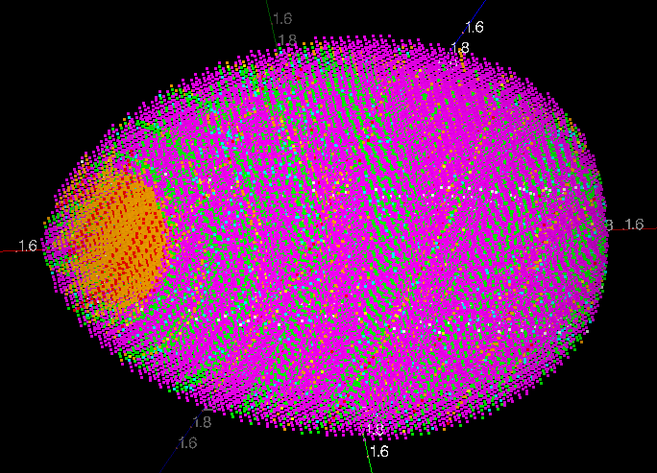
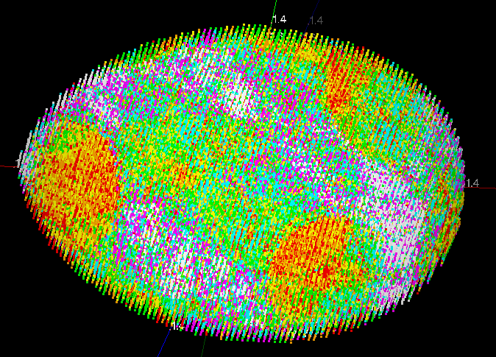
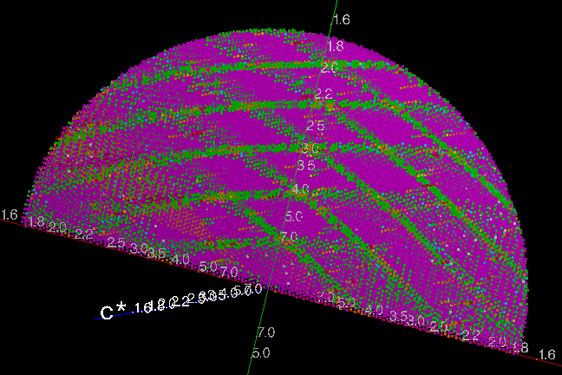
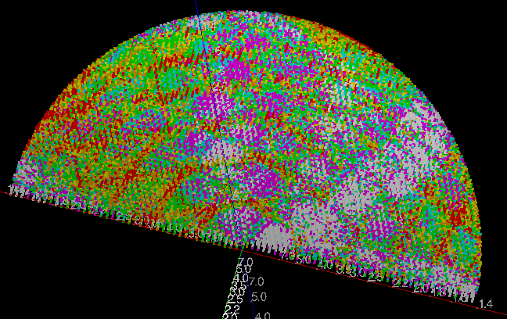
Monoclinic native - redundancy
Redundancy
Red 2
^{…… aa}
Purple 8
Redundancy
Red 13
^{…… aa}
White 19
Reflections for 1 * 360° strategy (left) v. 4 * 220° strategy (right)

Slide 12
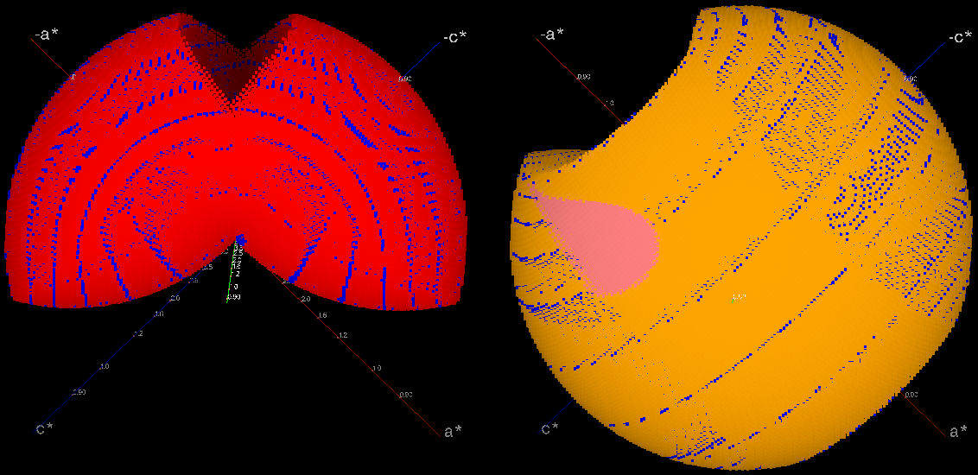
Orthorhombic phasing strategy
90° and 180 ° sweeps, aligned on different axes for mutual cusp-filling

Slide 13
Orthorhombic phasing strategy
Goniostat shadow
90° and 180 ° sweeps, aligned on different axes for mutual cusp-filling

Slide 14
Workflow integration with MXCuBE
MX
MXCuBE
GΦL HardwareObjects
Java
GΦL
Controller
Message handling
Execution
GΦL
Connection
Java
Python
GΦL
Workflow
Data
persistence
Py4J
Messages
ABI objects
Function calls
ABI objects
Transcription
Fortran
Queue
Model
Objects
XDS
SimCal
StratCal
…
Data, formatting
MXCuBE Queue
Execution
User interface
Generic I/O Popups
Parameter queries
Display and review

Slide 15
Workflow steps
Centre sample at arbitrary initial orientation
Characterisation
  Acquire 5 * 1.2° wedges with 0.1° image width (configurable)
  Short XDS run
  Select indexing solution
Calculate strategy
  Requires wavelength, resolution, crystal symmetry and crystal orientation
Present strategy to the user and confirm parameters
Generate and execute acquisition sequence
  (Re)centre sample as needed after each reorientation
Automatically trigger (typically multi-sweep) data processing
Note: Designed strategies need at least one additional orientation

Slide 16
Introduction – the problem
The GΦL Workflow and its capabilities
Deployment and tests
Workflow at P14 (Gleb Bourenkov)

Slide 17




Where are we in terms of deployment?
Workflow installed on P14 at PETRA III
and tested live by advanced users
Workflow installed on BL13 at ALBA
under testing by beamline scientists
Preparing for installation at SOLEIL
Working with MASSIF 1 on integrating
GΦL experimental workflow with
MASSIF 1 EDNA automation workflow

Slide 18
Result of user feedback – P14
Improved usability of GΦL-specific user interface:
  widget layout and behaviour
  sequencing of parameter settings
Multi-trigger characterization on Eiger detectors:
  each thin wedge would normally require re-arming the detector
  with multi-triggering, multiple wedges are handled in a single operation
  we hope to extend this to e.g. inverse beam and
  wavelength-interleaved data collection.

Slide 19
Extended user session on P14
28-hour non-stop user session on P14
Ashwin Chari and co-workers, with Gleb Bourenkov
No Global Phasing personnel involved, not even remotely
GΦL full native strategies used throughout
  when WF was not successful, fall back to non-WF single-sweep acquisition
High resolution crystals, monoclinic, orthorhombic, and tetragonal space groups.

Slide 20
Sample success rate
Result | Samples loaded | <duration> (s) | Total time (s) | total time %
No data | 188 | 163.0 | 30640 | 25.9
Non-WF data | 4 | 601.0 | 2404 | 2.0
WF incomplete | 42 | 457.4 | 19213 | 16.2
WF success | 83 | 797.2 | 66168 | 55.9
Total sample loads: 317
No data: Sample did not diffract
Non-WF data: Only single-sweep data collected
WF incomplete: Resolution too low / no indexing solution / WF failure
WF success: WF data acquired (possibly after more than one try)

Slide 21
Workflow step timings
Median time required for individual steps
Load and centre | 128 s
Characterisation | 110 s
Acquire and process |  | 27 s
UI popups |  | 38 s
Calculations |  | 30 s
Stratcal | 4 s
Confirmation popup | 13 s
One extra centring | 47 s
One sweep | 43 s
Acquisition time for one sweep will vary with parameter settings

Slide 22
Estimated strategy timings
Centring count | Centring time (s) | Sweep count | Sweep time (s) | Total time (s) | Symmetries
+3 | 140 | 4 | 172 | 568 | P1, monoclinic
+3 | 140 | 3 | 129 | 524 | 222
+2 | 93 | 3 | 129 | 478 | Trigonal, tetragonal
+2 | 93 | 2 | 86 | 435 | 32, hexagonal
+1 | 47 | 2 | 86 | 389 (340) | 422, 622
0 / +1 | 0 / 47 | 2 | 90 | 345/392 | Quick (any symmetry)
0 / +1 | 0 / 47 | 1 | 43 | 298/345 | Minimal (any symmetry
Strategy time requirements, based on median duration for individual steps.
The centring count is in addition to the initial centring
Quick and minimal strategies use either one or two orientations, depending on the initial crystal orientation
340s for 422 is from later thaumatin tests (Gleb Bourenkov)

Slide 23
Acknowledgements
Global Phasing colleagues
  Peter Keller
  Rasmus Fogh
  Wlodek Paciorek
  Claus Flensburg
  Clemens Vonrhein
  Andrew Sharff
  Ian Tickle
  Gerard Bricogne
Diamond Light Source
  Funding under Collaboration Agreement COL0044 re. I23
  Armin Wagner
  Kamel El Omari
EMBL-Hamburg / PETRA III
  Gleb Bourenkov
  Ivars Karpics
ALBA synchrotron
  Roeland Boer
  Jordi Andreu
Max Planck Institute, Göttingen
  Ashwin Chari
EMBL-Grenoble
  Josan Marquez
  Irina Cornaciu
The MXCuBE Collaboration
The Global Phasing Consortium
  Funding and much more

Slide 24
Introduction – the problem
The GΦL Workflow and its capabilities
Deployment and tests
Workflow at P14 (Gleb Bourenkov)

Slide 25
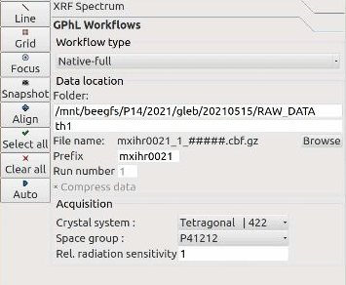
Start GΦL Workflow

Slide 26
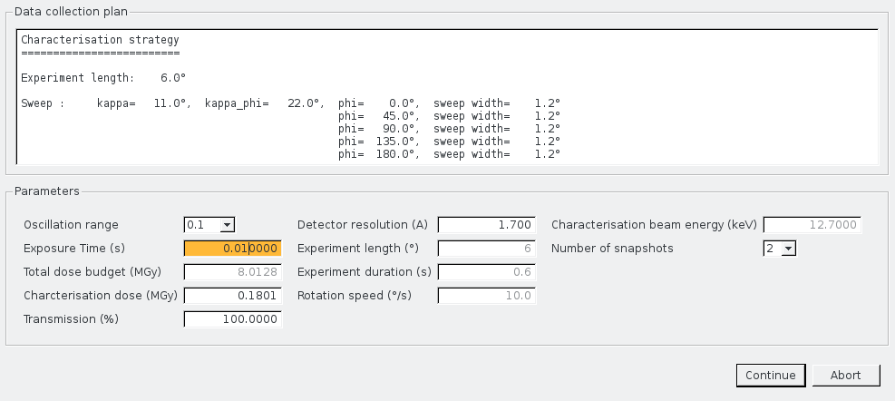
Confirm Characterisation

Slide 27
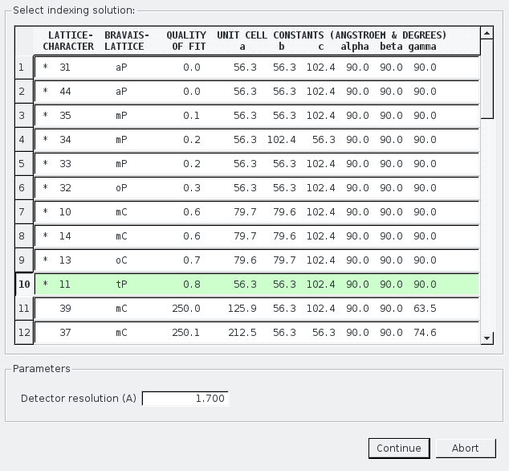
Indexing solution UI

Slide 28
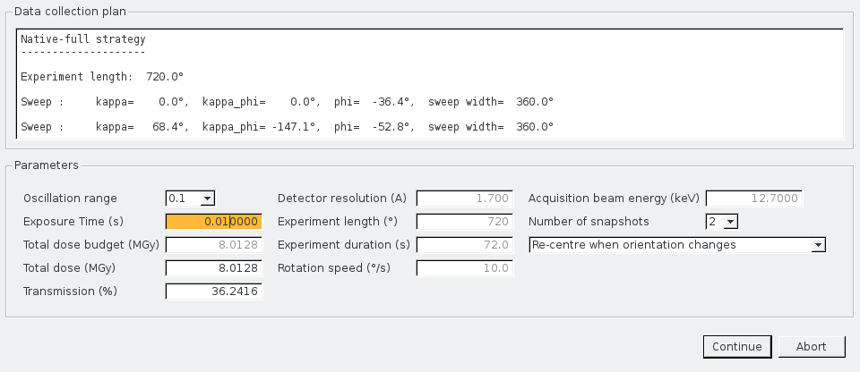
Confirm acquisition UI

