Slide 1
MXCuBE Status Report
Isidro Crespo
Jordi Andreu
Roeland Boer

Slide 2
Staff changes
Changes in MX support groups
  Jordi Andreu left the controls support group to work elsewhere
    Currently no informatics support from ALBA, beamline team is now involved
  Dani Sanchez and Dani Salvat, supporting ISpyB have also left ALBA
    New head is Beatriz Lorenzo, support of ISpyB by Marc Armenter
  A new section, Scientific Data Management, was formed
    Headed by Nicolas Soler, beamline support from Emilio Centeno

Slide 3
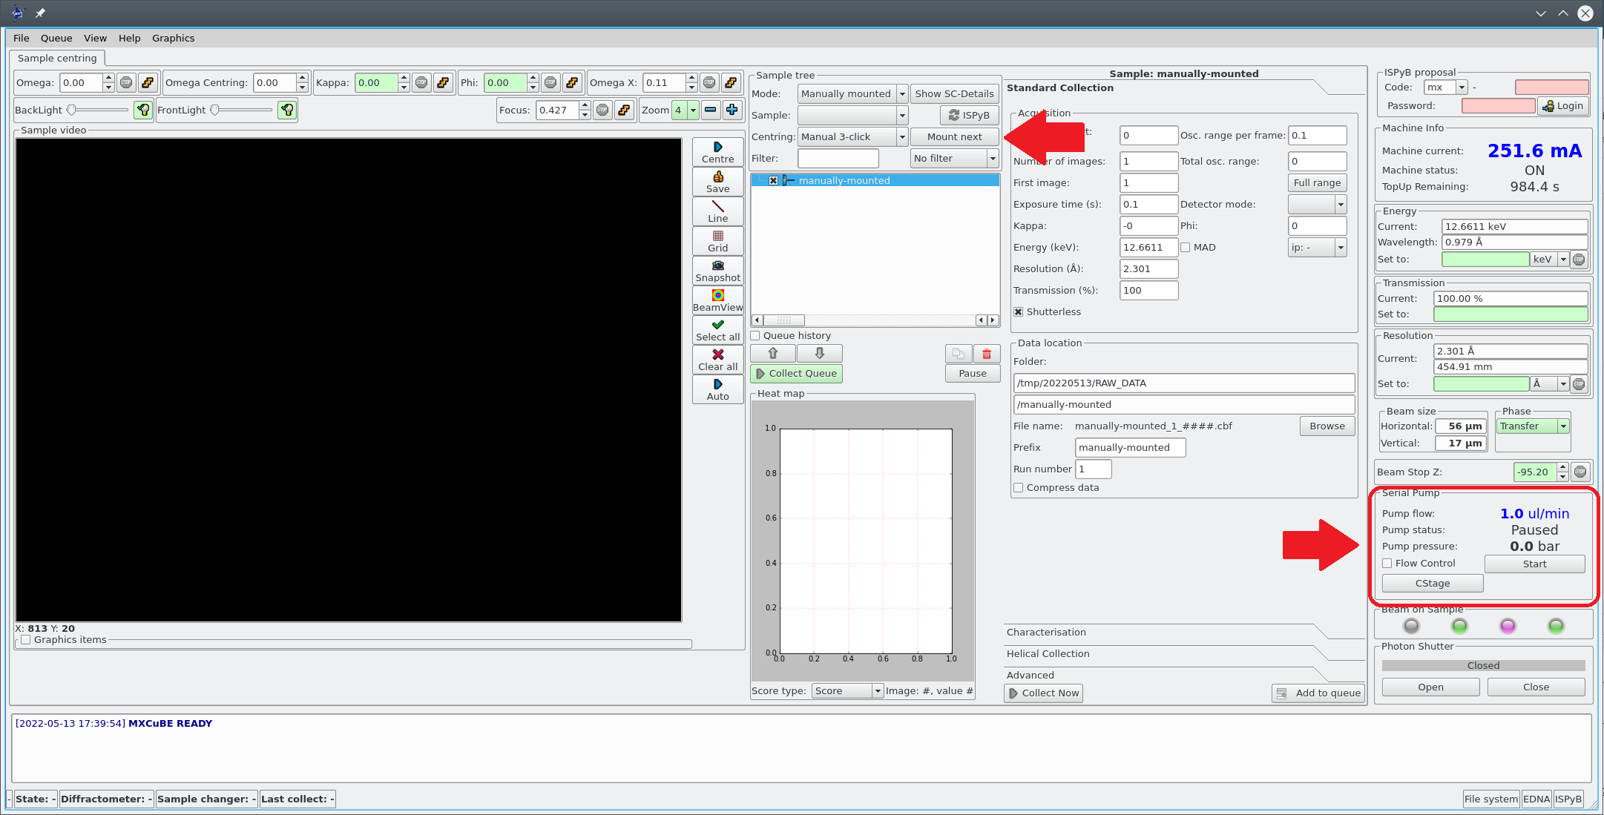
Current projects
Refactoring of MXCuBE
  Currently running MXCuBE Qt4
  User version expected in June, pending minor bug fixes before presentation to users
Addition of new features:
  Pick function mounting using CATS double gripper
  Implementation of XIA2 processing and Dimple
  Pump control for jet extrusion for SSX
  Small molecule processing
Change to MXCuBE3?
Beamline upgrades
New detector
Sample changer?

