Slide 2
AbstractLims
AbstractLims
ICAT and SSO integration

Slide 3
AbstractLims on GitHub
Documentation - GitHub and ReadTheDocs
The pull requests and the documentation can be found on GitHub:
PR # 1079: https://github.com/mxcube/mxcubecore/pull/1079
PR # 1492: https://github.com/mxcube/mxcubeweb/pull/1492
Documentation on read the docs:
https://mxcubecore--1079.org.readthedocs.build/en/1079/dev/lims_integration.html#ispybabstractlims

Slide 4

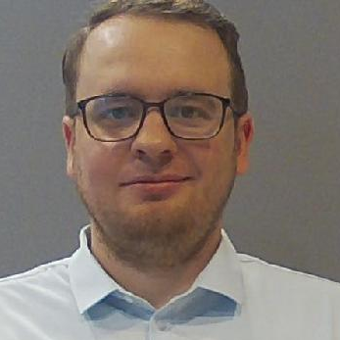
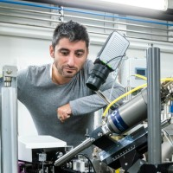

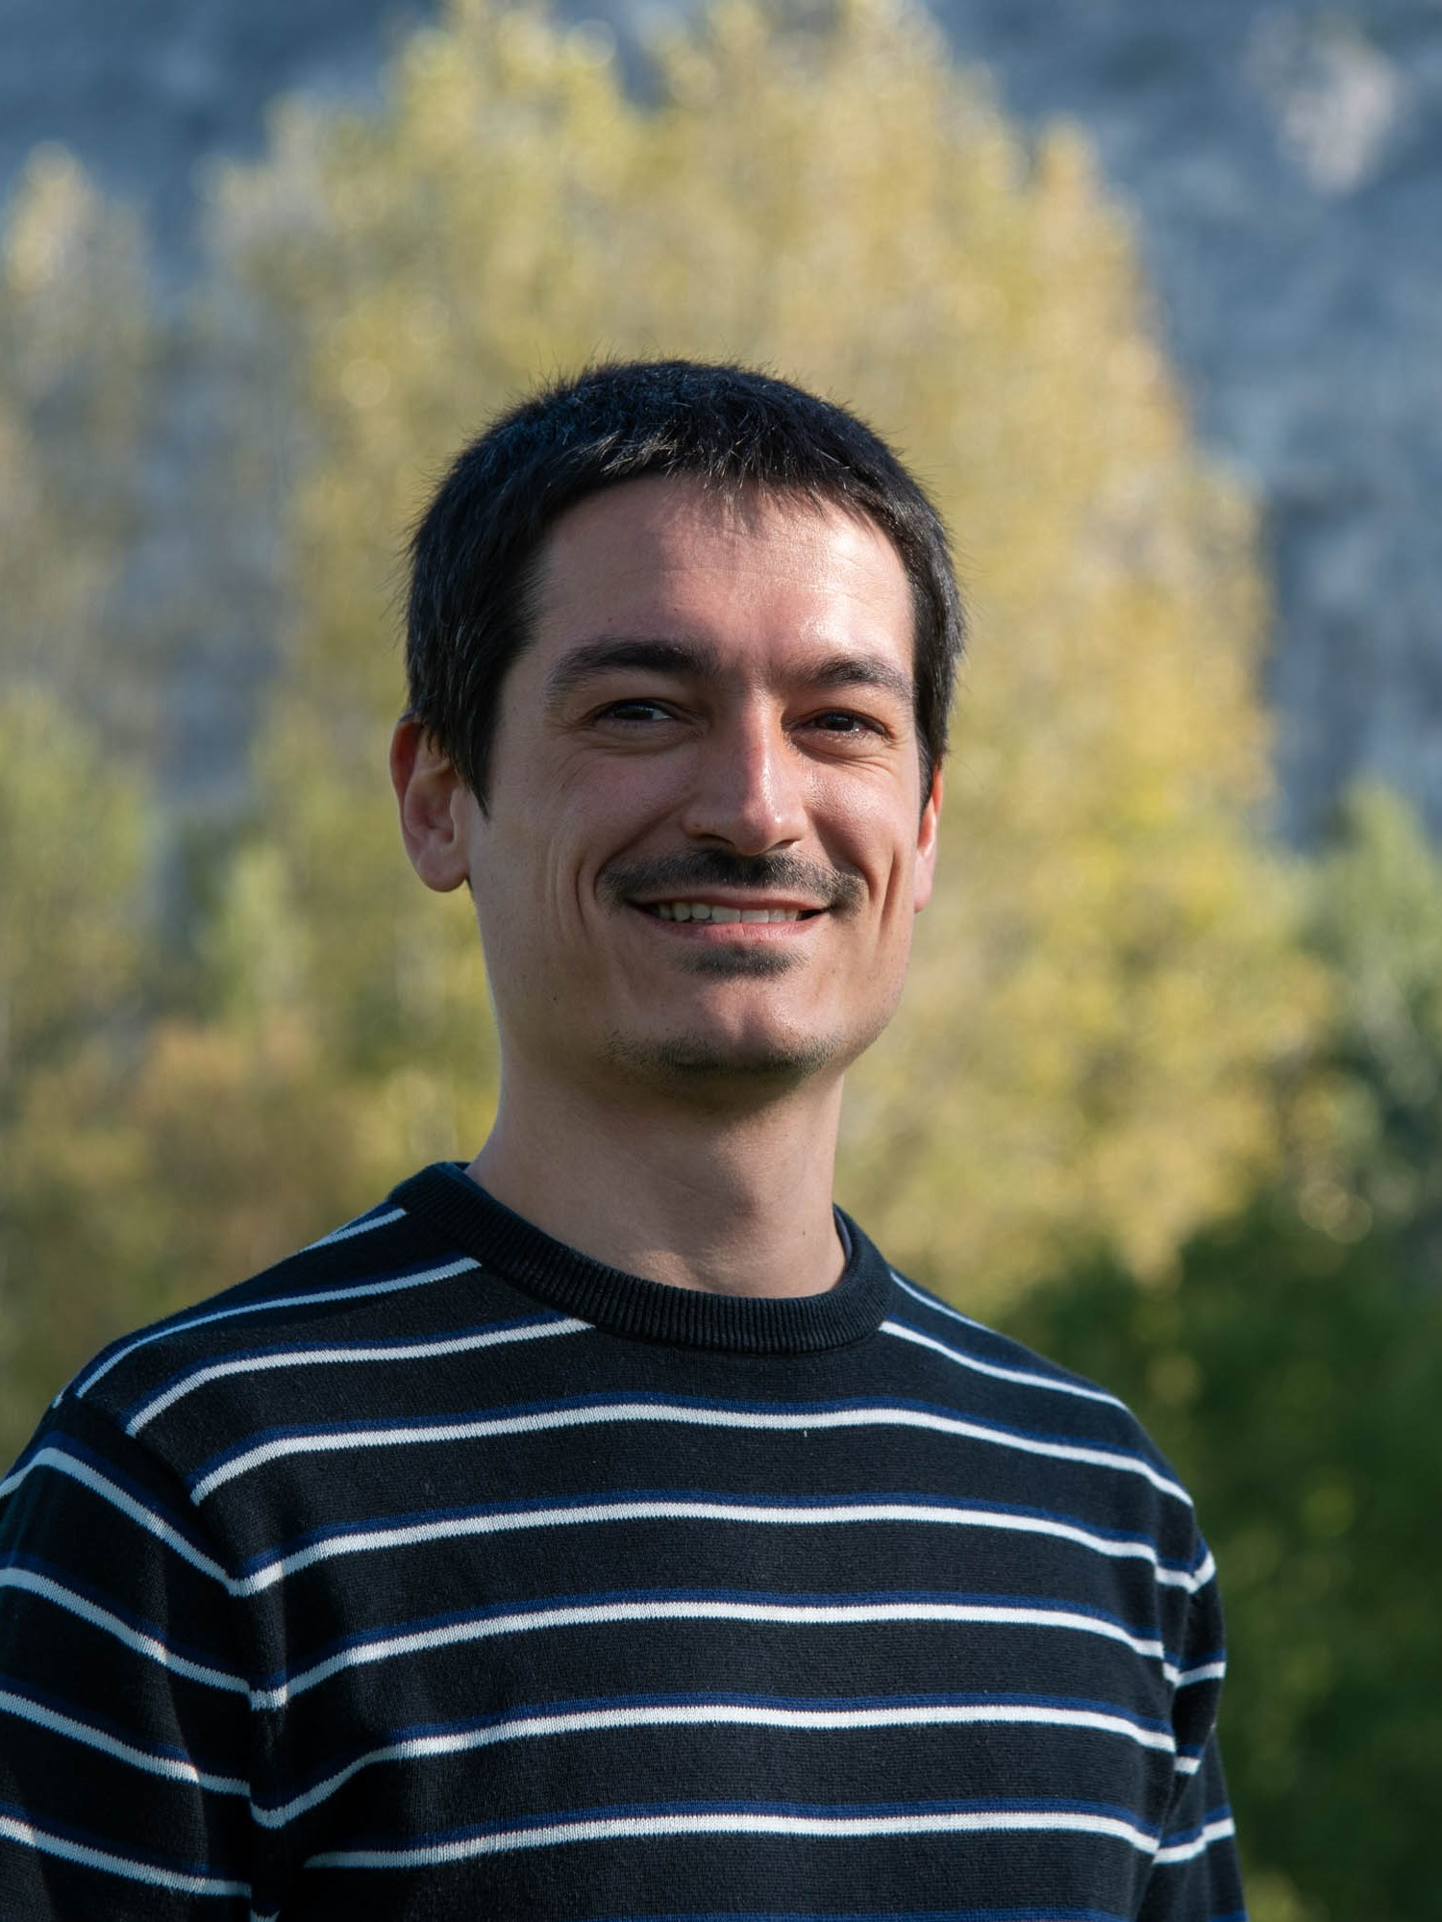
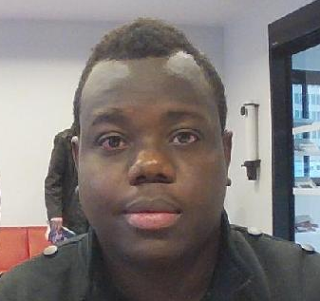
Acknowledgement
Antonia Beteva
Yan Walesch
Since June 2024
Daniele De Sanctis
Alejandro De Maria
Axel Bocciarelli
Jean-Baptiste Florial
EMBL
And of course the SB and BCU group, and you guys !

Slide 5
Background
Current status
The work have been tested and validated on the ESRF MX beamlines the last 6-8 months. Most of that work is to make sure that systems (User portal, ICAT, ISPyB, MXCuBE) involved work as expected for synchronization of, users, sessions etc.
SSO and ICAT tested on MASSIF1 during spring and deployed since August.
ICAT integration with proposal login deployed on all other MX beamlines since beginning of October. Switch to SSO will be done in January 2025

Slide 6
Background
Background
ISPyB is no longer the standard LIMS, need for LIMS Abstraction as more sites use other systems
At ESRF we needed a solution where we could synchronize to and from both ISPyB and ICAT
At ESRF, retrieving session information for a user is done via ICAT thus a requirement for SSO

Slide 7
AbstractLims
AbstractLims
Cleanup and merging of ISPyBClient and ISPyBRestClient have resulted in a new AbstractLims, very similar to the previous ISPyBClient (for now)
Structures exchanged between AbstractLims and the internals of MXCuBE documented, to be modeled in a next iteration

Slide 8
AbstractLims
AbstractLims
inherits
ISPyBAbstractLims
ICATLIMS
ESRFLIMS
inherits
UserTypeISPyB
ProposalTypeISPyB
has
has
ISPyBDataAdapter
ISPyBClient have been split into two classes ProposalTypeISPyB and UserTypeISPyB
Introduction of adapter to abstract communication technology, such as SOAP and REST
ICATLIMS for ICAT and ESRFLIMS for ICAT and ISPyB

Slide 9
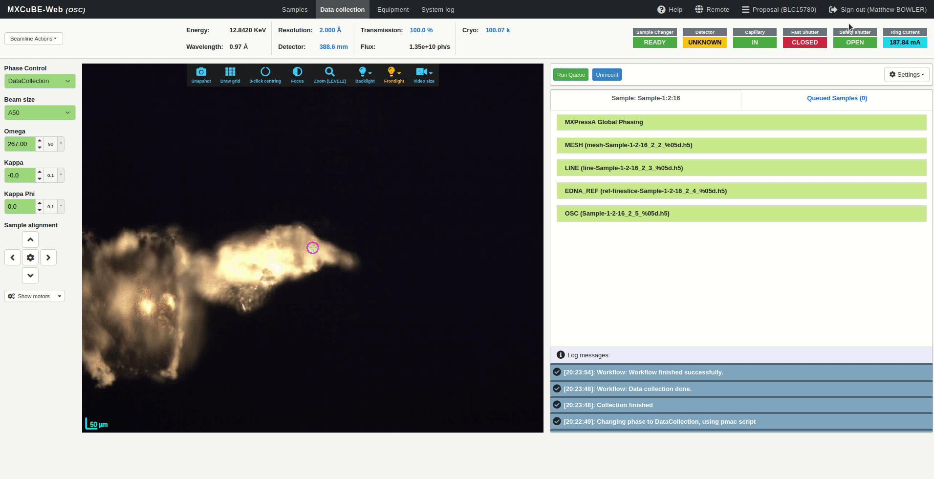
AbstractLims
Selecting a session

Slide 10

AbstractLims
Synchronizing with LIMS - ISPyB or DRAC

Slide 11
AbstractLims
Future work
Further refinement of AbstractLims and creating models for the data exchanged, internally, between AbstractLims and MXCuBE
mxcubeweb - UserManager:
  Keep the existing UserManager as it is (proposal and user based login)
  Create a new UserManager only for user based login
  Remove proposal login completely ?

Slide 12

Questions
Thank you for your attention

