Slide 1
MAX IV MXCuBE Status Report
MXCuBE / ISPyB meeting
Jie Nan on behalf of the MX-group
2024 May 29th

Slide 2
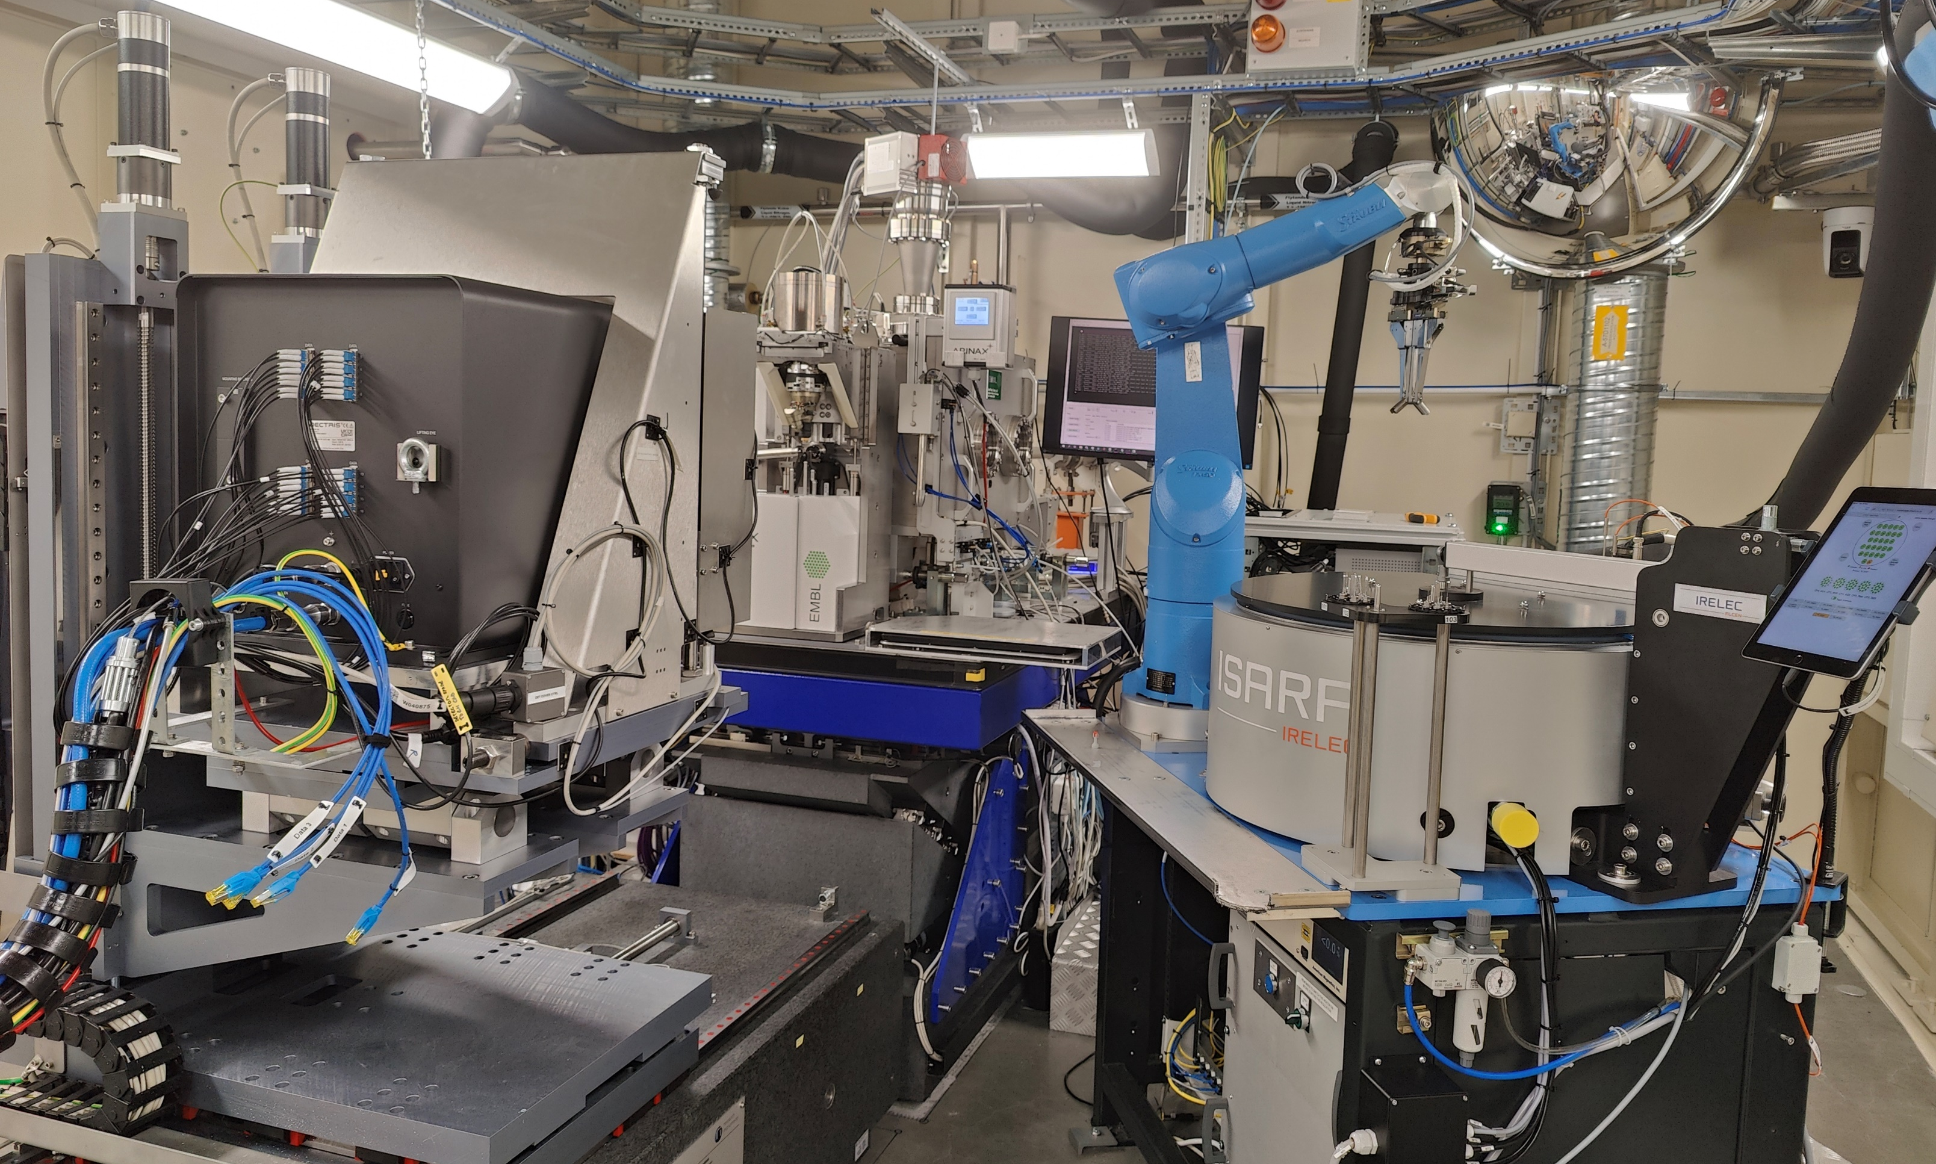
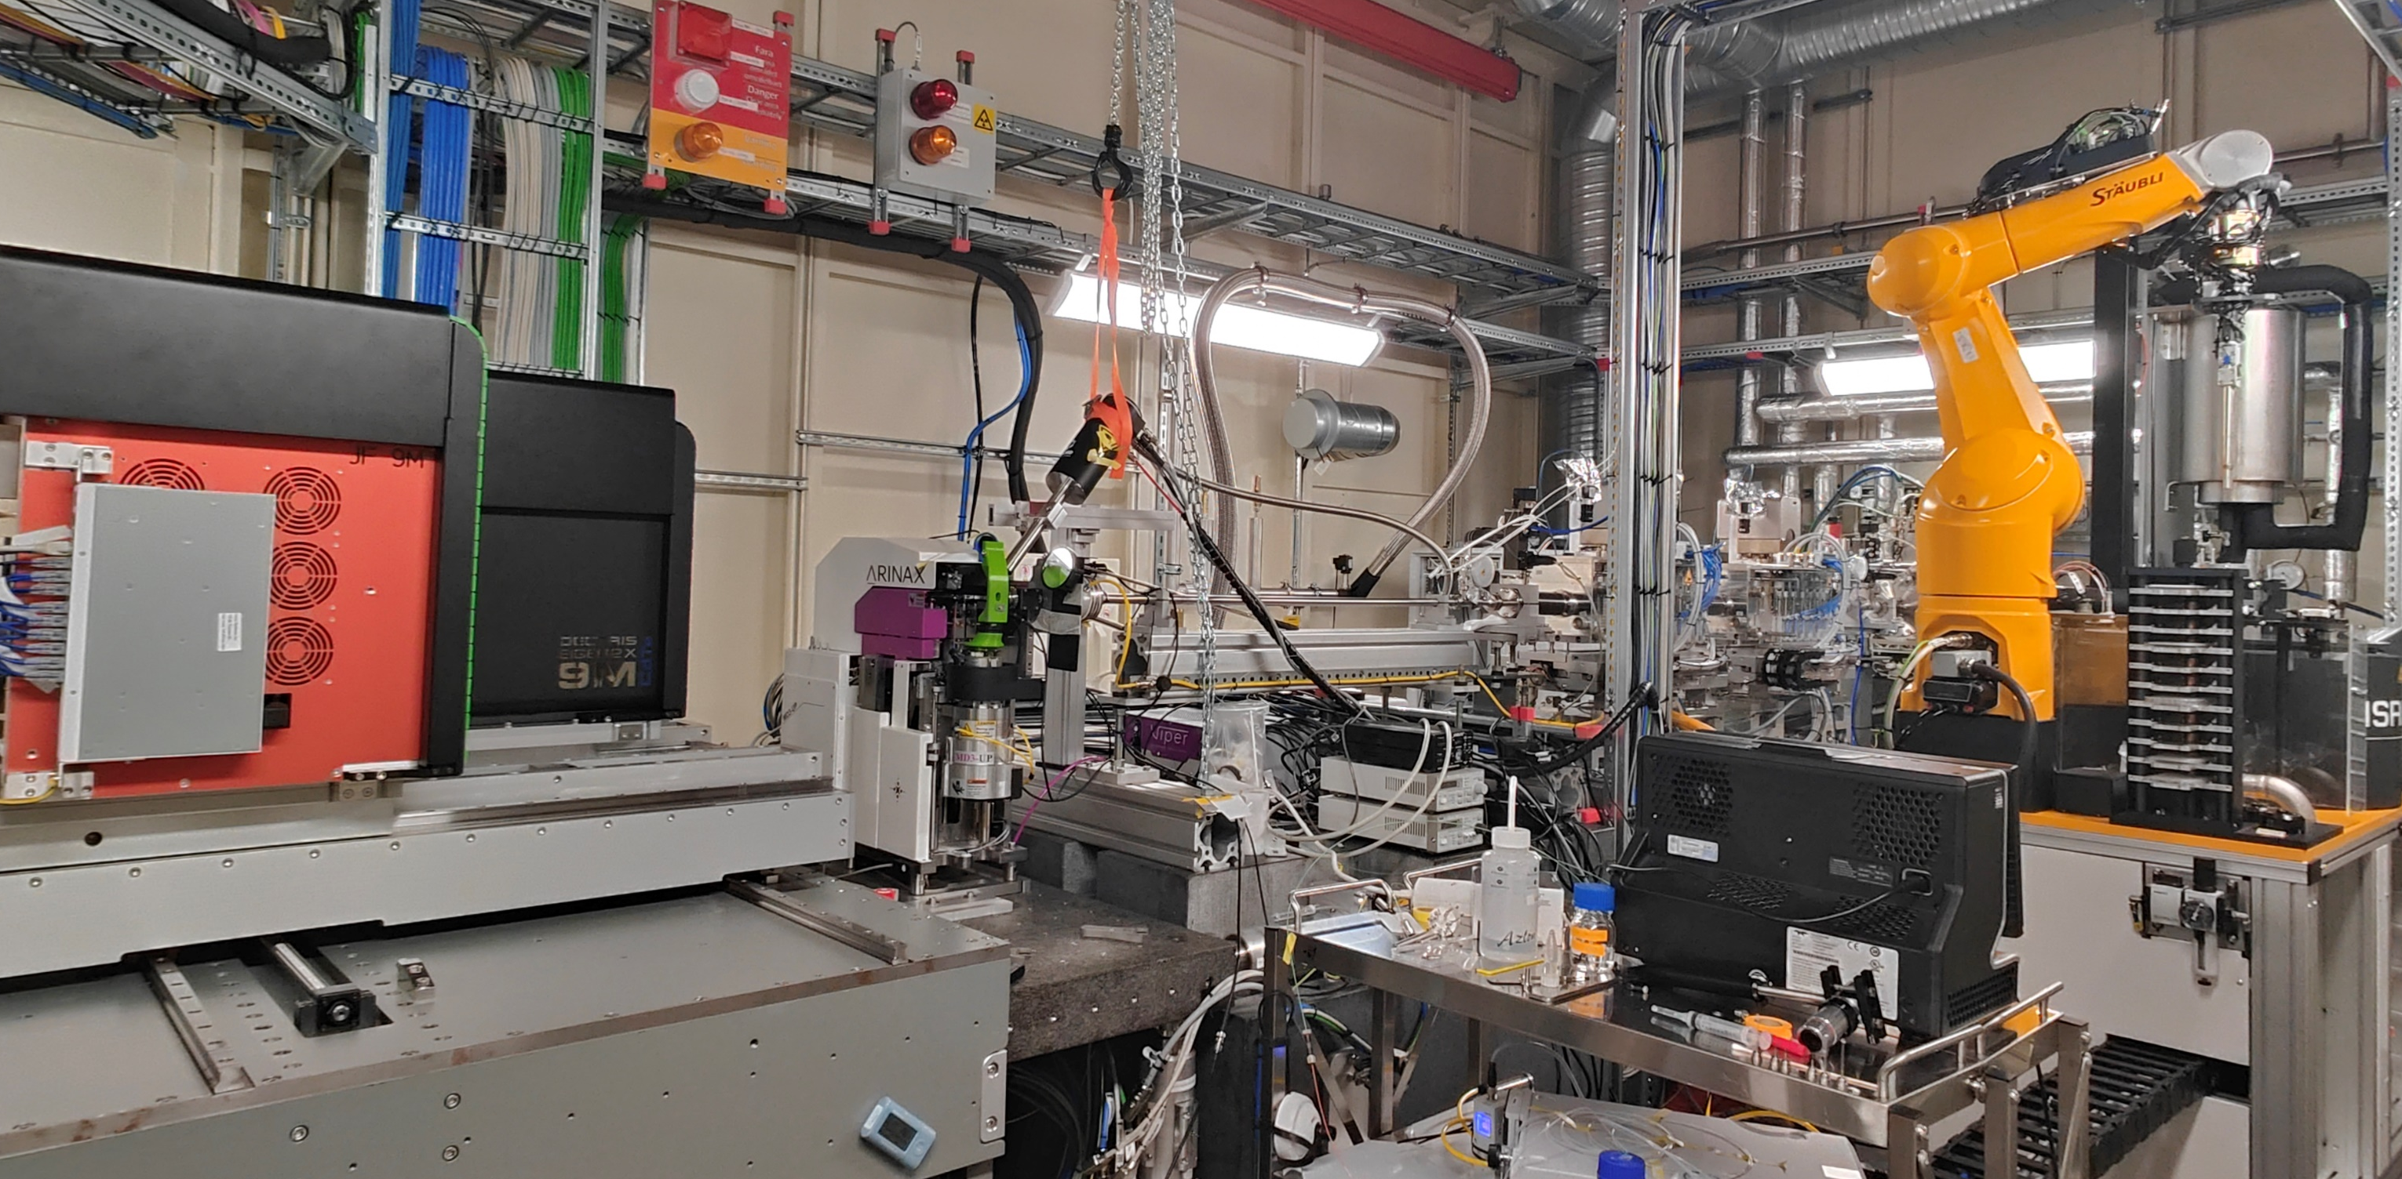
MX beamlines at MAX IV
BioMAX
MicroMAX
Tunable Energy (5-25keV)
hDCM, 10¹³ ph/s, now 14x4 μm² (1 μm with mirrors)
MLM, >10¹⁴ ph/s
Eiger2 CdTe 9M
Jungfrau 9M
MD3-up
ISARA2
Cryostream 1000
Tunable Energy (6-24keV)
hDCM, 10¹³ ph/s, 20x5 μm²
Eiger2 CdTe 16M XE
MD3-down
ISARA
Amptek fluorescence detector
REX, Cryojet5, HC-lab
MXCuBE3 v3.0
hwobj v2.2
MXCuBE-web latest
mxcubecore develop
1
MAX IV MXCuBE Status Report @ MAX IV meeting, 2024/5/29

Slide 3
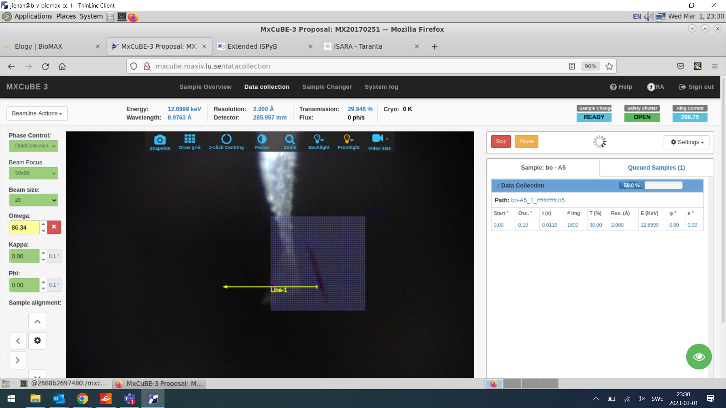
BioMAX
MXCuBE, web3.0, HWR 2.2
Freeze
Upgrade to mxcubecore /mxcube-web latest
2
MAX IV MXCuBE Status Report @ MAX IV meeting, 2024/5/29

Slide 4
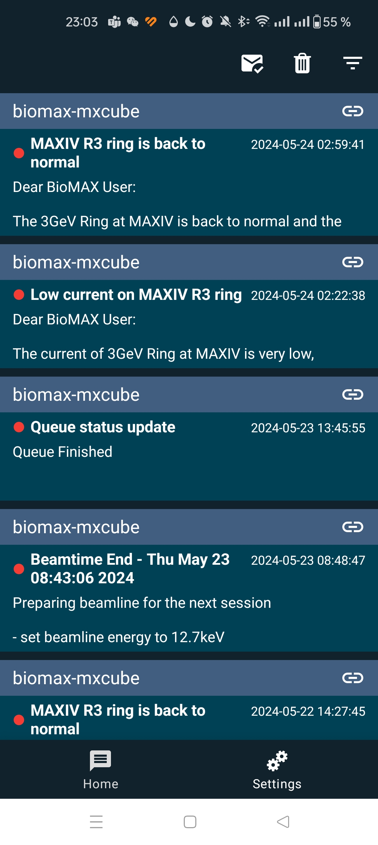
BioMAX - recent development (MXCuBE3)
Improvements of automatic data collection (Ana’s talk)
Import data collection plan from ISPyB
Enhanced notificaiton to users and staff
Inform users of queue change by email (automatic collection only)
Notification emails to users are also sent to MAXIV notify app
3
MAX IV MXCuBE Status Report @ MAX IV meeting, 2024/5/29

Slide 5
BioMAX – Eiger2 CdTe 16M XE
In operation since 2024 April
Transition from Eiger 16M
Some minor modification of tango server and MXCuBE
We stay with Filewriter1 and Stream1, (Filewriter2 and Stream2 available)
Planning to have 17keV as default energy for operation
4
MAX IV MXCuBE Status Report @ MAX IV meeting, 2024/5/29

Slide 6
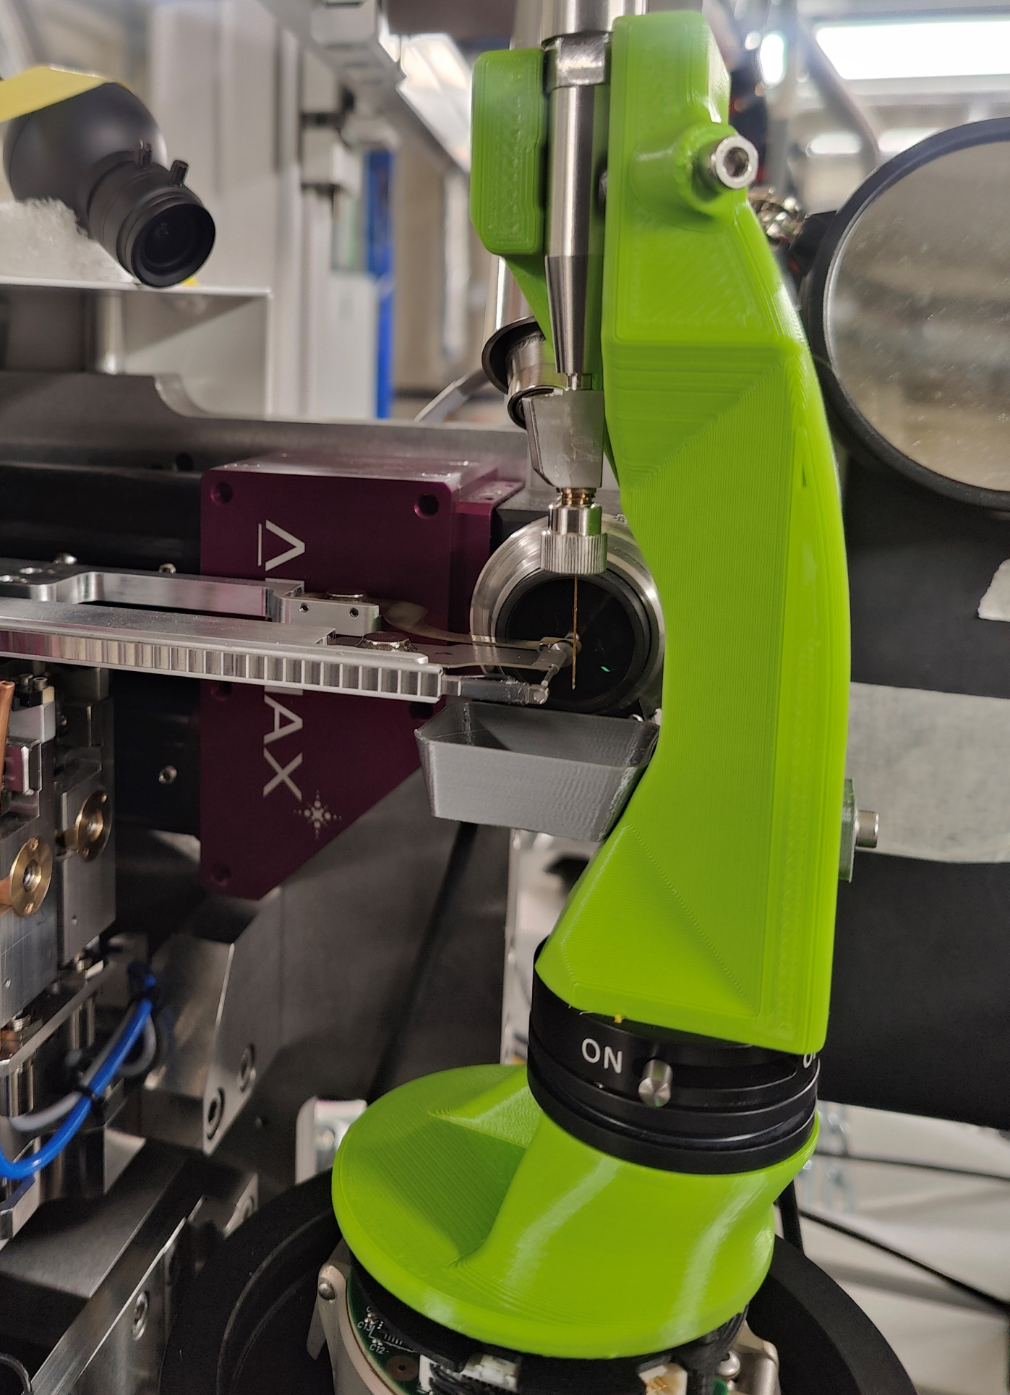
MicroMAX
X-ray delivery system
DCM and MLM are in operation, which give 1e13 and 1.5e14 ph / s respectively
Beam focusing currently with X-ray lenses; X-ray chopper available in the autumn, KB-mirrors planned for 2025
Experiment setup
MD3-up, an empty goino base is used for injector-based experiment
Jungfrau 9M (on loan from PSI)
Laser diode installed
PandABox for timing and trigger control
See Oskar’s talk
5
MAX IV MXCuBE Status Report @ MAX IV meeting, 2024/5/29

Slide 7
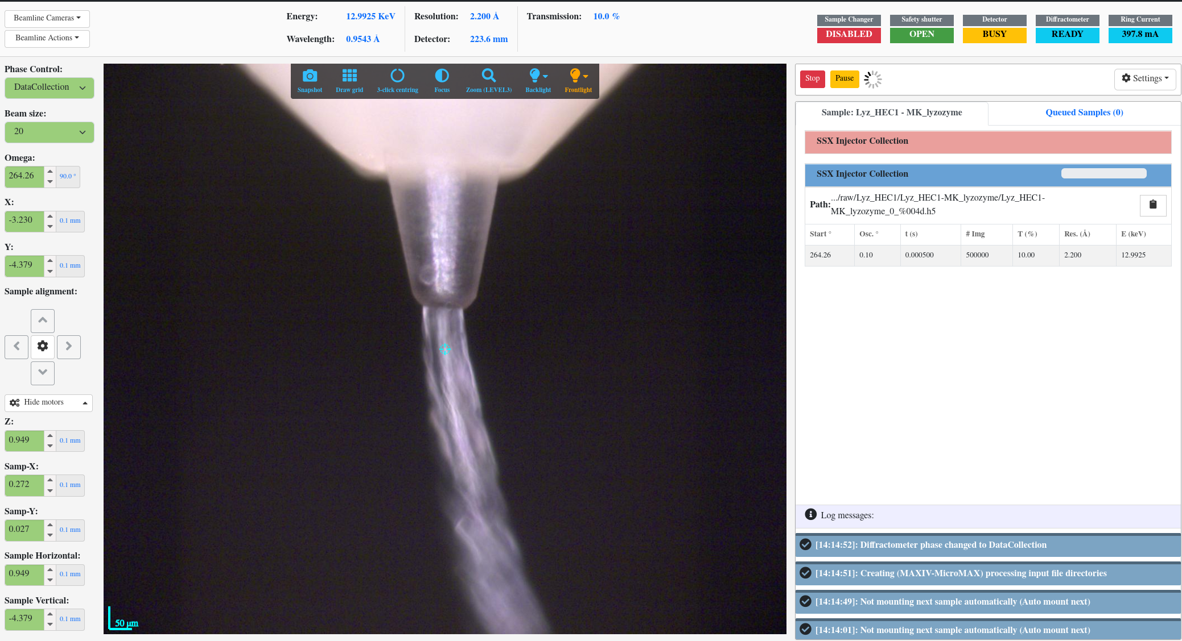
MicroMAX – Recent development (mxcubecore/web)
Hutch view
Integration with Jungfrau detector operation
injector-based (time-resolved) collection
Phase control for MD3 injector head
Flux measurement
6
MAX IV MXCuBE Status Report @ MAX IV meeting, 2024/5/29

Slide 8
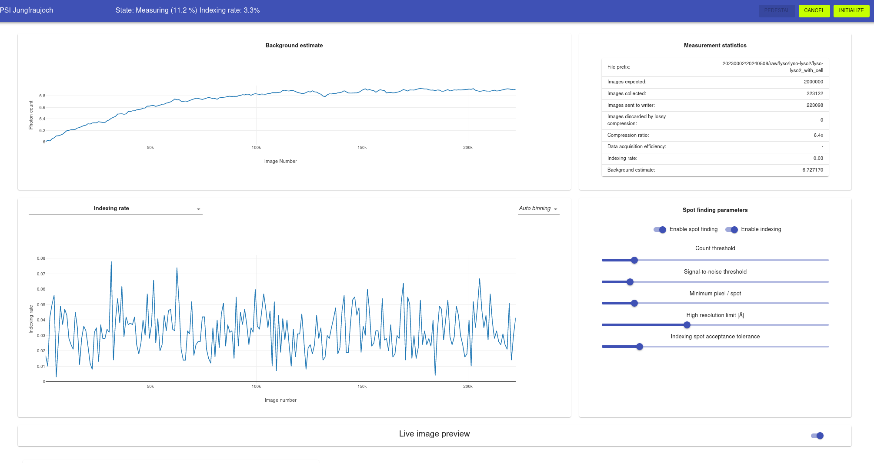
Jungfrau detector
MXCuBE
Jungfrau tango
openAPI
DCU
Jungfraujoch
Jungfraujoch Web Manager
7
MAX IV MXCuBE Status Report @ ALBA meeting, 2023/11/29

Slide 9
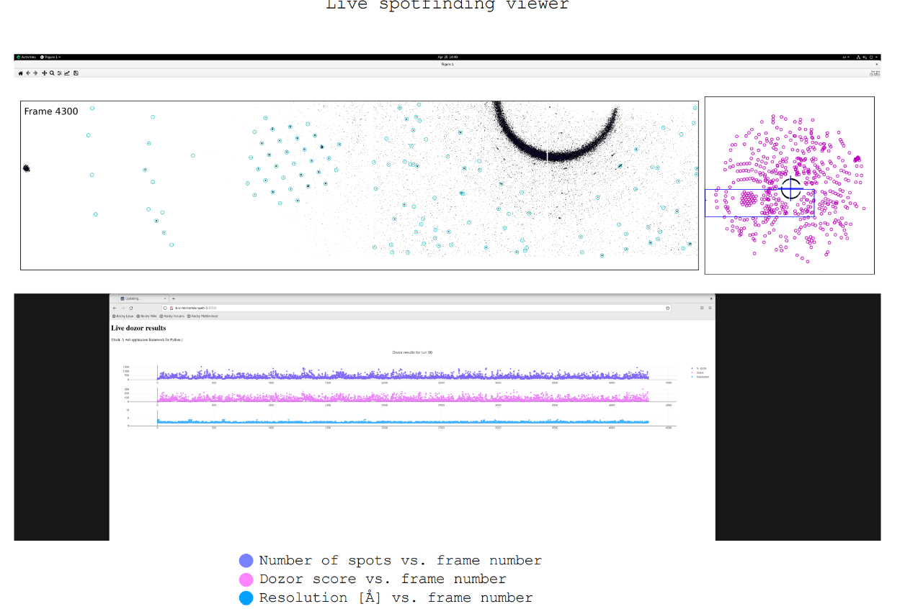
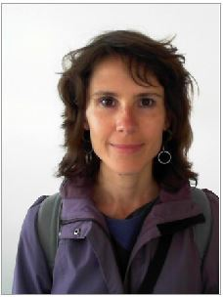
MXSuite - ongoing
Slurm job per collection → Service
Stream for all types of collections
Results to ISPyB
web-based Live Viewer
Cecilia Casadei
8
MAX IV MXCuBE Status Report @ MAX IV meeting, 2024/5/29

Slide 10
Multi Factor Authentication
All external access to MAX IV resources requires 2-factor authentication
Time-Based one-time password (TOTP)
mobile application, no SMS since 2024-01-15
Keycloak
9
MAX IV MXCuBE Status Report @ MAX IV meeting, 2024/5/29

Slide 11
Plans for the next six months
mxubecore / mxcubeweb at BiomMAX
Include all features in mxcube3
Integrate Global Phasing workflow
Same mxcube version at both BioMAX and MicroMAX
Continue to develop the SSX features at MicroMAX
Fast and easy switch between different setups, including detectors
10
MAX IV MXCuBE Status Report @ MAX IV meeting, 2024/5/29

Slide 12
Acknowledgements
MAX IV​
MX group​
Software group
Mikel Eguiraun
Elmir Jagudin
Fabien Coronis
Dominika Trojanowska (S2 innovation)
Scientific software group
Zdenek Matej
Felix Engelmann
Isak Lindhé
Many others
Global Phasing Ltd.
Gérard Bricogne
Rasmus Fogh
Claus Flensburg
Peter Keller
PSI
Meitian Wang
Filip Leonarski
Dawn (Jiaxin) Duan
Michal Kepa
MAX IV MXCuBE Status Report @ ALBA meeting, 2023/11/29

