Slide 1
SOLEIL status update
Dan Costin & Martin Savko
{costin, savko}@synchrotron-soleil.fr
MXCuBE/ISPyB meeting at MAX IV May 29 2024

Slide 2
Synchrotron SOLEIL
energy: 2.75 GeV
current: 500 mA
electron beam lifetime: ~10 hours
circumference: 354 m
emittance (horizontal, vertical): 3.7x10⁻⁹, 11x10⁻¹² m.rad
brilliance: 10²⁰ ph.s⁻¹.mrad⁻¹.mm⁻² @ 0.1% bandwidth
founded in 2001, in operation since 2006
funded jointly by CNRS (72%) and CEA (28%)
350 employees

Slide 3
Proxima 1
Proxima 2A
Source: U20 in vacuum undulator
Focussing: KB, CRL, 20x40 μm, project for new KB mirrors
Tunable: Si 111 CCM, 5.5 - 15.5 keV
Flux: 2.0e12 ph/s @ 500mA @ 12.65keV
Area Detector: Eiger X 16M
XRF Detector: Ketek AXAS-M2 H150 (XIA)
OAV Camera: Prosilica GC 1350 (4.65um, 1360x1024)
Goniometer: SmarGon
Sample Changer: CATS (48 cryo, 16 ambient) Looking into getting a bigger dewar !
MXCuBE: Qt4 v 2.3 (CentOS 7), HardwareRepository, Python 2.7
Source: U24 in vacuum undulator
Focussing: KB, horizontal PFM, 5x10 μm
Tunable: Si 111 CCM, 5.5 - 18.5 keV
Flux: 1.6e12 ph/s @ 500mA @ 12.65keV
Area Detector: Eiger X 9M
XRF Detector: Ketek AXAS-M2 H80 (XIA, Xpress3)
OAV Camera: MAKO G-192C (4.50um, 1600x1200)
Goniometer: MD2 with minikappa (MK3), Plate Screener, HC/REX installed, MD3 coming next December !
Sample Changer: CATS (144 cryo, 48 ambient)
MXCuBE: Qt5 (Ubuntu 20.04), mxcubecore, Python 3.8

Slide 4
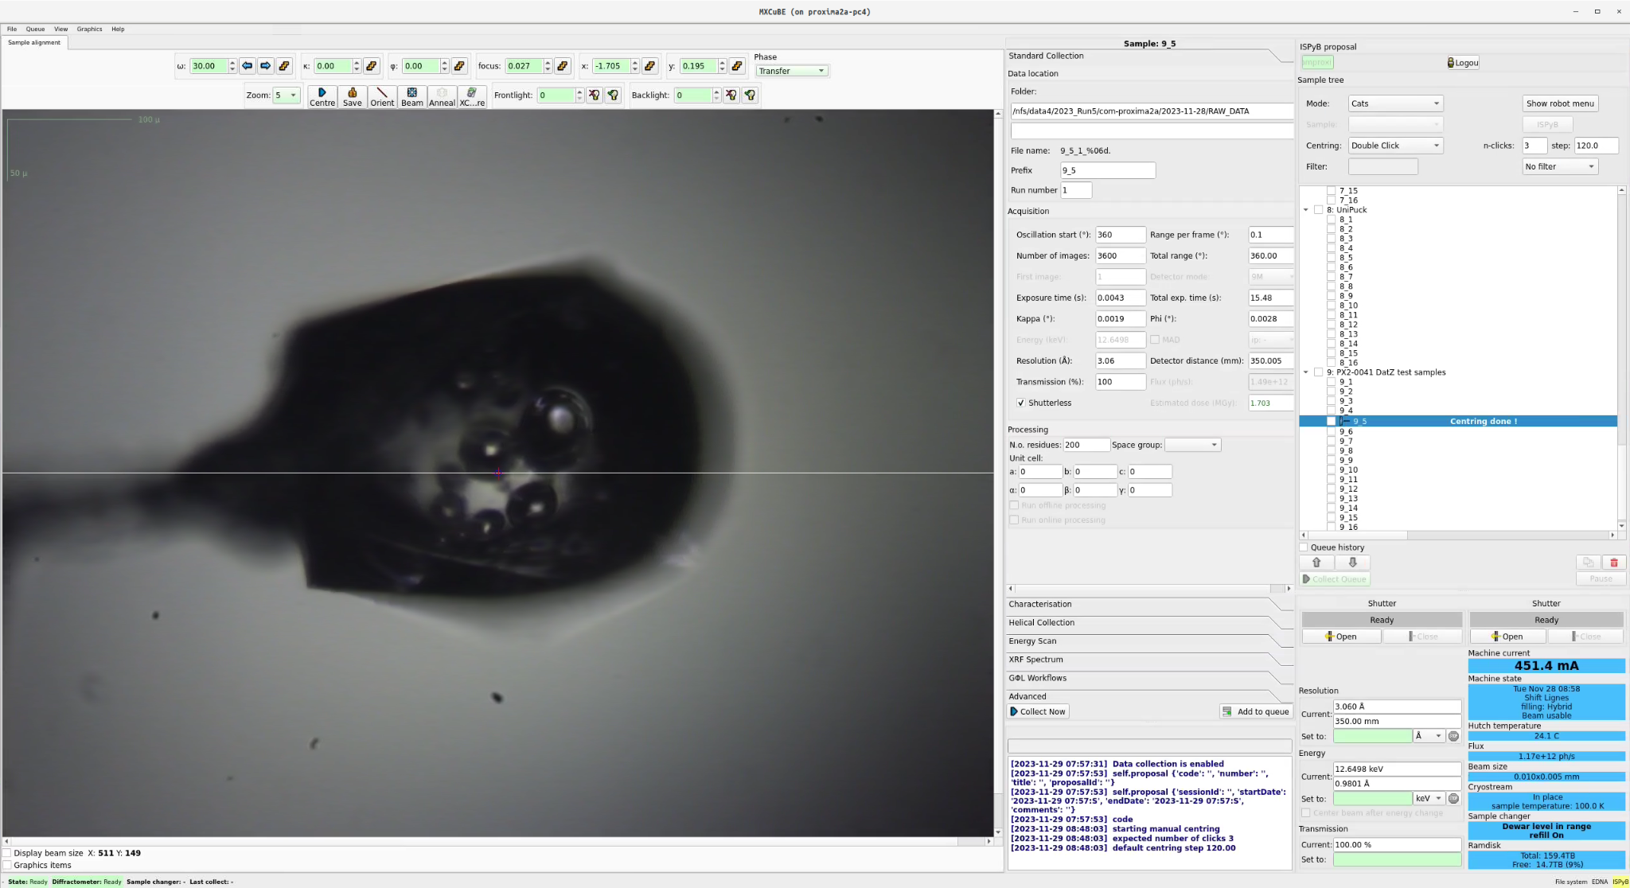

Slide 5
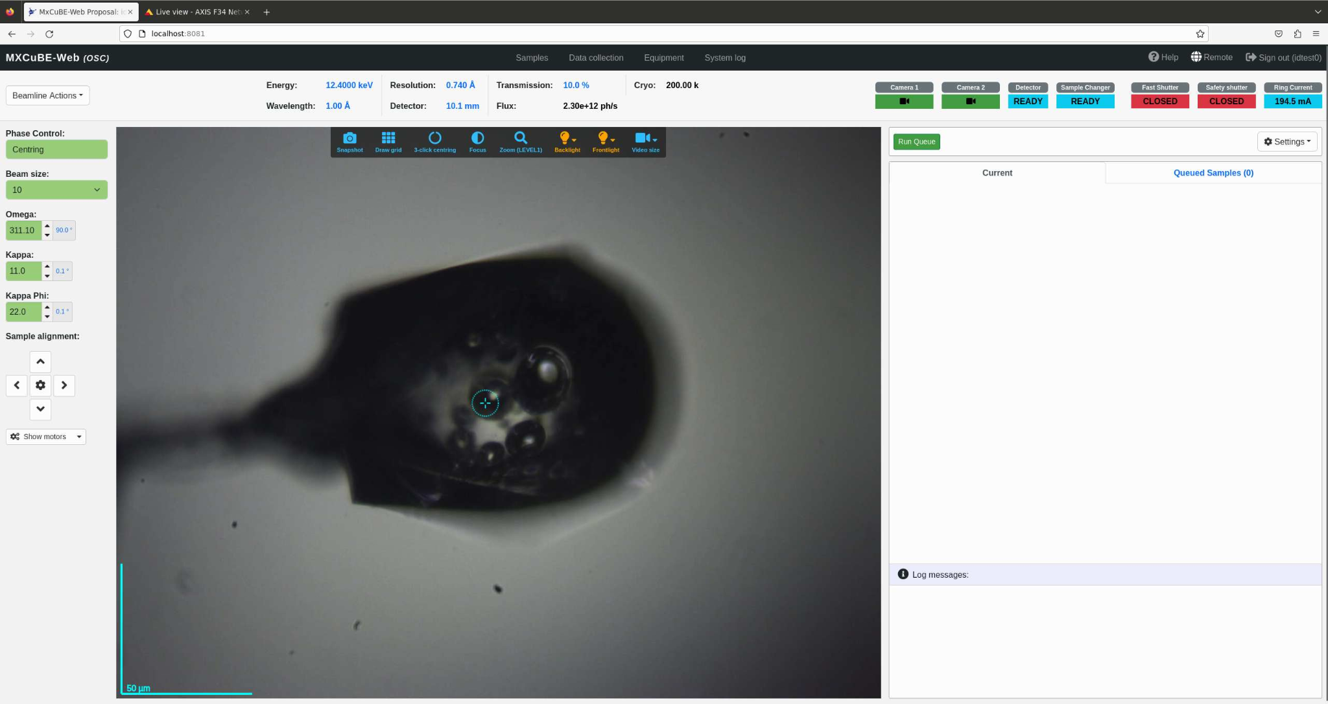

Slide 6
mxcubeweb adaptation updates
MXCUBE WEB in development
First iteration is complete but still buggy
Few contributions to classes
BaseHardwareObjectNode
TangoShutter
VideoStreamer (Redis camera adaptation)
Several improvement points identified for future discussion
New server configured Ubuntu 24.04, Python 3.10

Slide 7
mxcubeweb @ SOLEIL
SampleView
Uses a Redis camera
Working to replace the many camera classes in the video streamer with a single Camera class that takes the camera type as parameter
Sample Changer
Uses Cats90 and CatsCryotong (locally developed Tango device)
debugging issues regarding the Cats state
Diffractometer
Uses a custom Smargon Tango device to control the diffractometer
debugging the zoom motor
Goniometer motors errors also impact the UI display via the SampleView HO

Slide 8
With a little help from my friends …
Dan’s visit to ESRF at the end of April
Thanks to Antonia Bateva, Marcus Oskarsson and Vicente Ray Bakaikoa for their help !

Slide 9
GPhL workflows updates
Available in qt version on Proxima 2A
tests 2023-11-19 & 2023-12-03
very smooth adaptation
from checkout to full fledged run in a single morning
Resolving issue with py4j connection
Full set of workflows supported !
Data formats
HDF5 from DECTRIS FileWriter
CBF from TIOGA TINE server
thanks to Gleb Bourenkov and Marina Novikova, EMBL Hamburg
Non interleaved experiments supported with both HDF5 and CBF format
Interleaved experiments supported with CBFs
the updated branch 20240426 tests pending

Slide 10
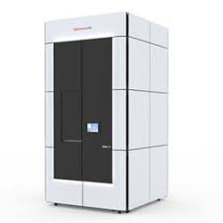
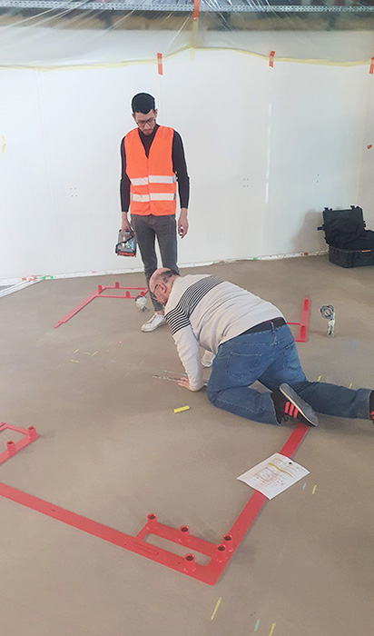
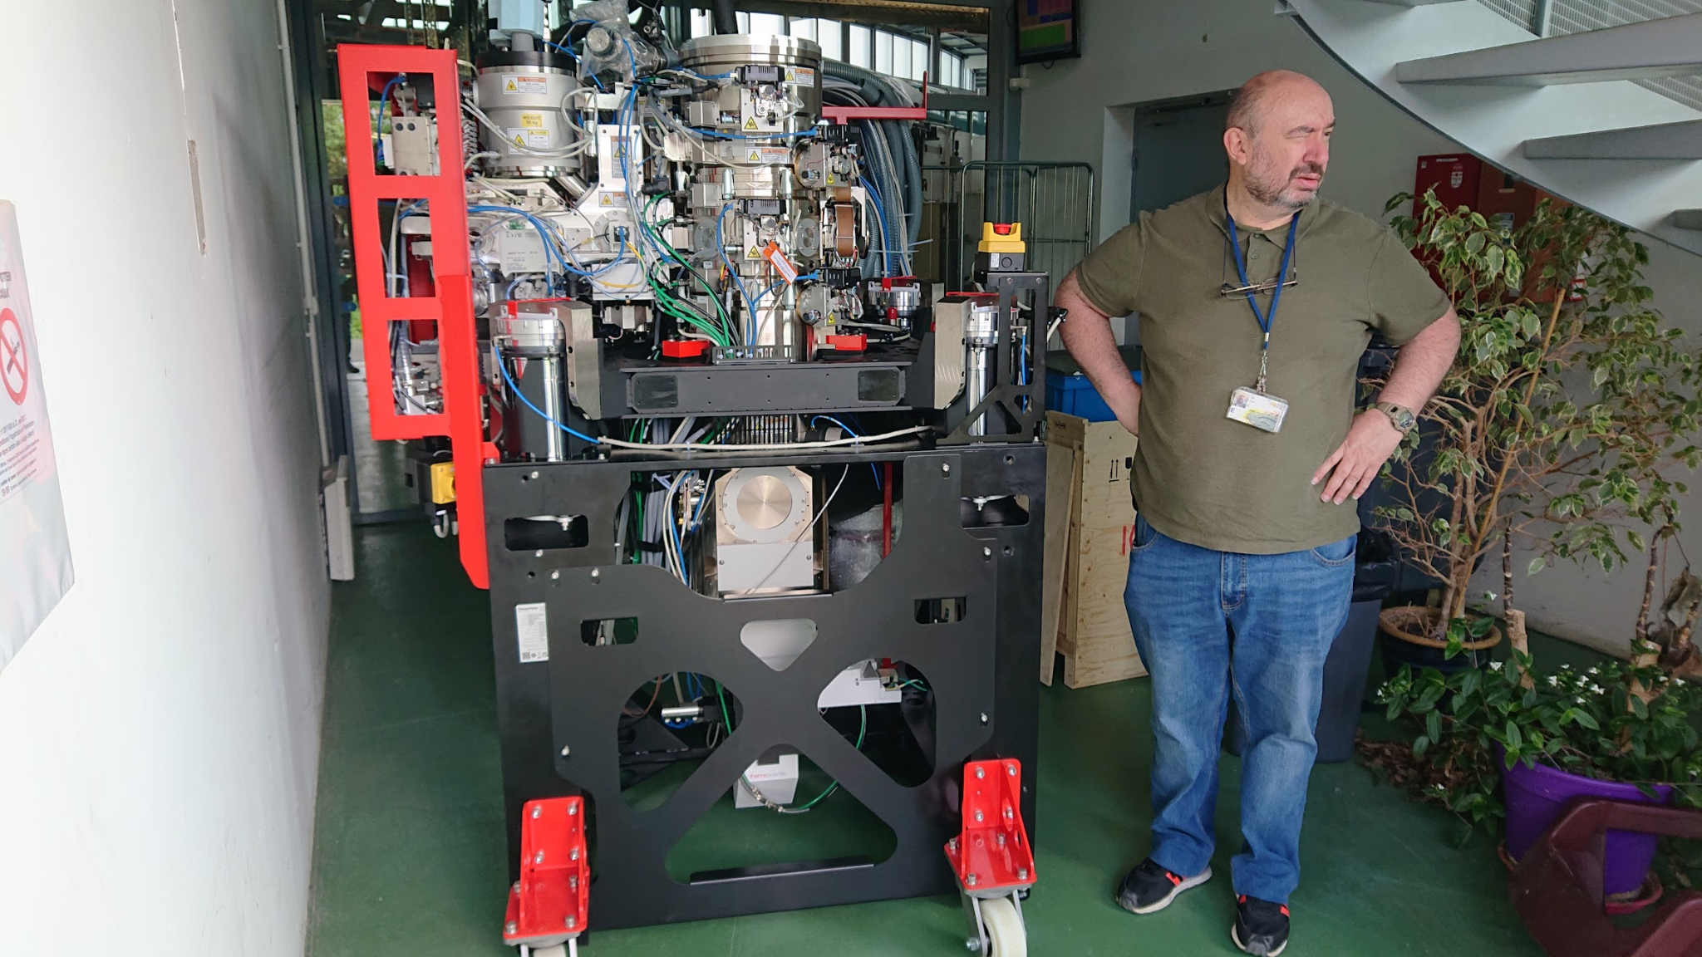
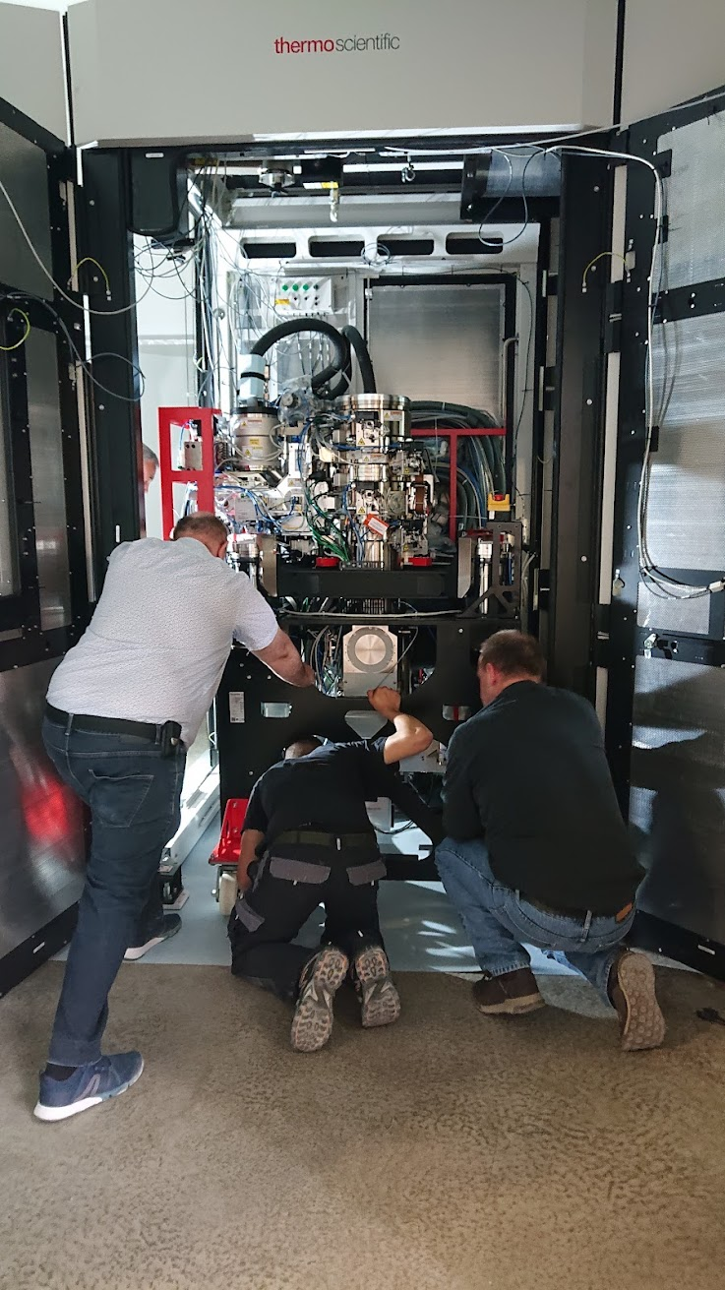
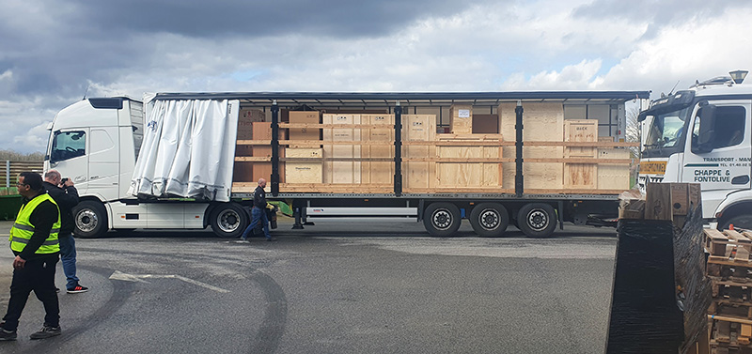
CryoEM@Paris Saclay
ThermoFisher Scientific Titan KRIOS G4
Eric Larquet, Pierre Legrand, Andy Thompson

Slide 11
Other updates
Avoiding top-up for smoother scaling
predictable time of the top-up
long electronic beam lifteme ~10 hours, 0.5 % threshold ~ top-up period ~180 seconds
Recording sample videos during experiments

Slide 12
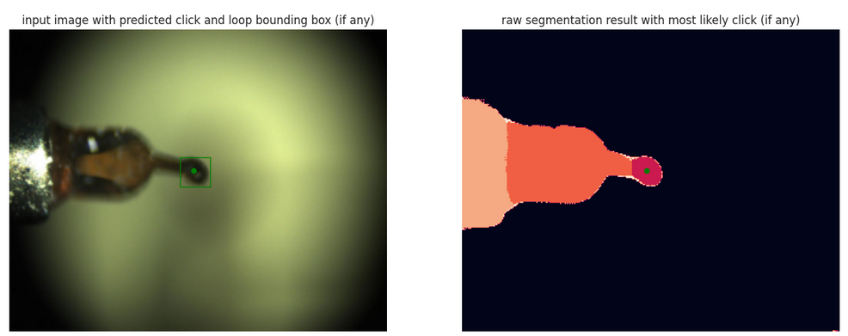
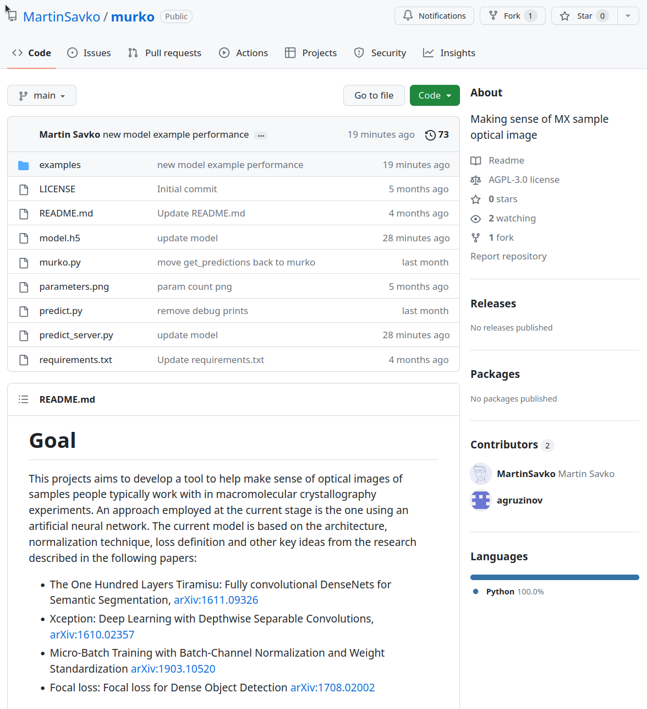
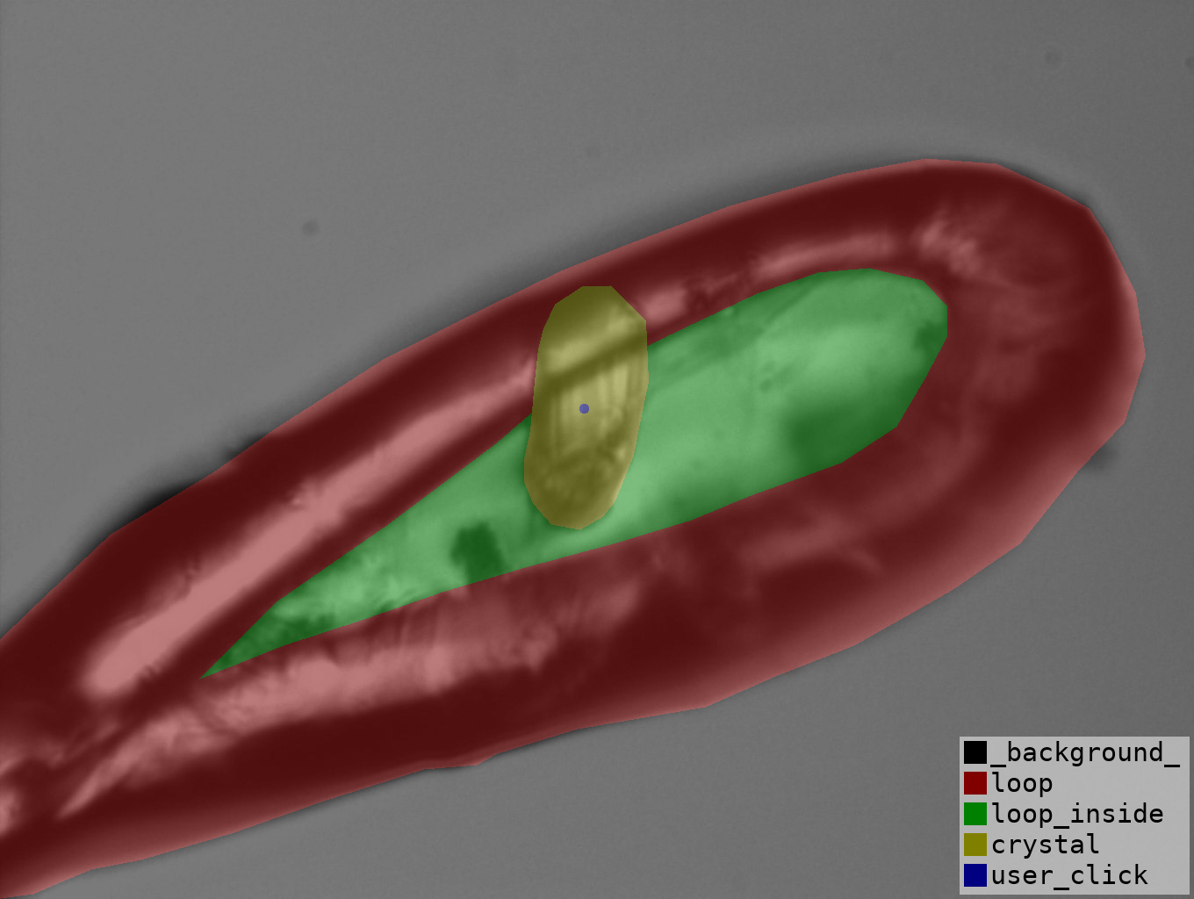
Murko updates
Artificial neural network based model
https://github.com/MartinSavko/murko
103 convolutional layers, 3M parameters
inference time
~65 ms per single image
~15 ms in batch mode
Deployment
0MQ server receives images
returns segmentation maps
New branches
develop, develop_keras_v3, gpu_docker
Collaborations
DESY, SLS, DLS, EMBL, MAX IV

Slide 13
Murko update

Slide 14
Plans for the next 6 months
Finalizing mxcubeweb adaptation
Murko
diffraction raster scans prediction head: learn crystals and ice!
bounding box and key points in-network inference
Volume aware experiments
sample shape reconstruction + 3d sample shape registration
expressing points, lines, planes and volumes in intrinsic coordinate system
fully automated sample realignment
Concerted push for unattended data collection capability
first simple experimental protocol gradually employing more thorough e.g. using GPhL workflows

Slide 15
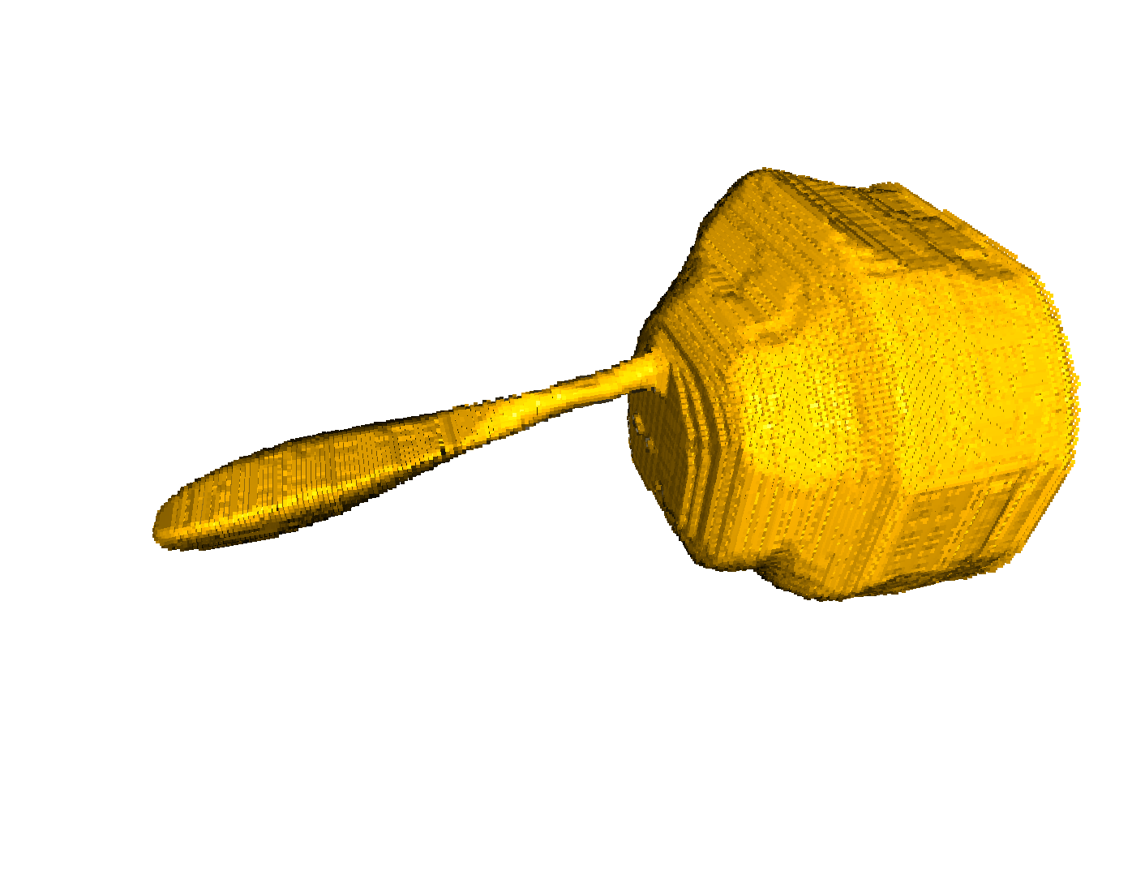
Reconstructed sample shape

Slide 16
Reconstructed crystal shape (slice)

Slide 17
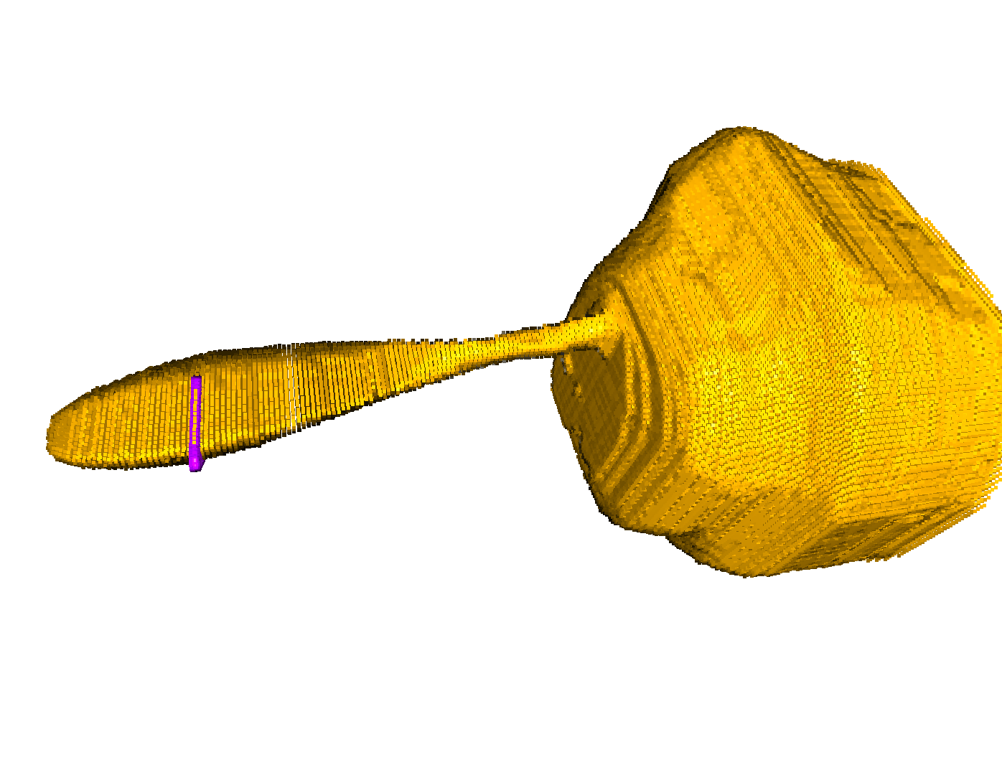
Solution
Merging optical and X-ray information
Combining optical and diffraction contrast tomography then expressing the coordinates of objects in the sample’s intrinsic frame of reference

Slide 18
Outlook
Merging optical and X-ray information
Combining optical and diffraction contrast tomography then expressing the coordinates of objects in the sample’s intrinsic frame of reference
κ=0°; 𝜑=0°
measured 0;0 (yellow)
calibration (magenta)
measured 95; 50 (blue)
using calibration
transforming to eigen basis
no calibration
κ=95°; 𝜑=50°

Slide 19
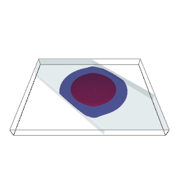
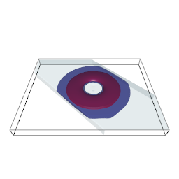
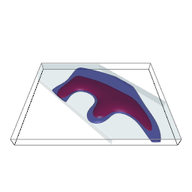
Rational dose distribution
better use of homogeneous parts of crystal, defocusing, omega offset, helical, using advanced features in raddose3d …
reconstructed crystal volume
single point acquisition*
omega offset*
helical acquisition*
*dose profiles calculated using raddose3d and experimentally determined crystal volume

Slide 20
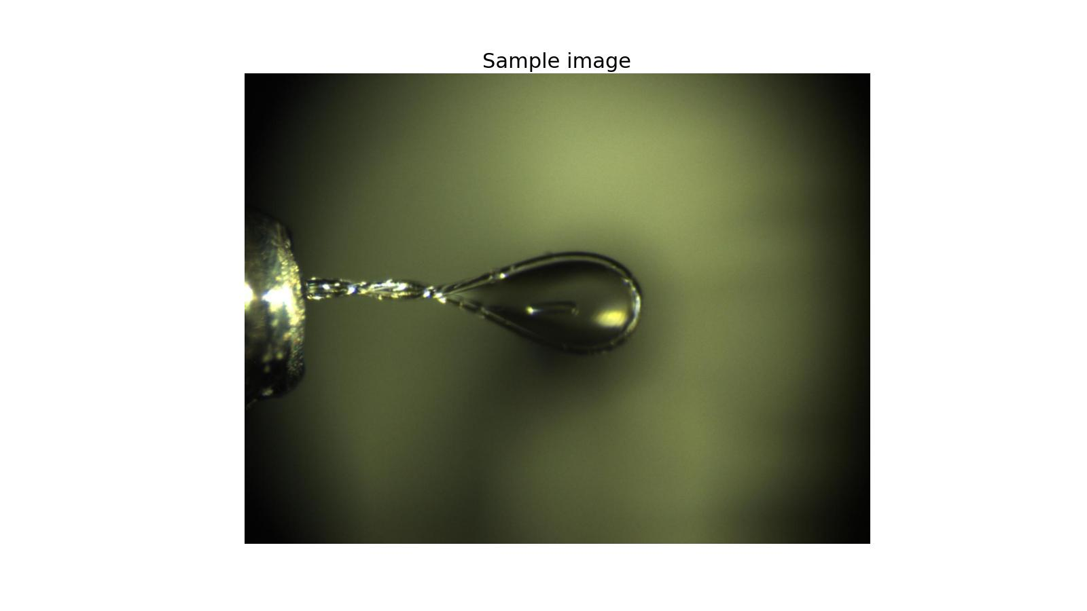
Outlook

Slide 21
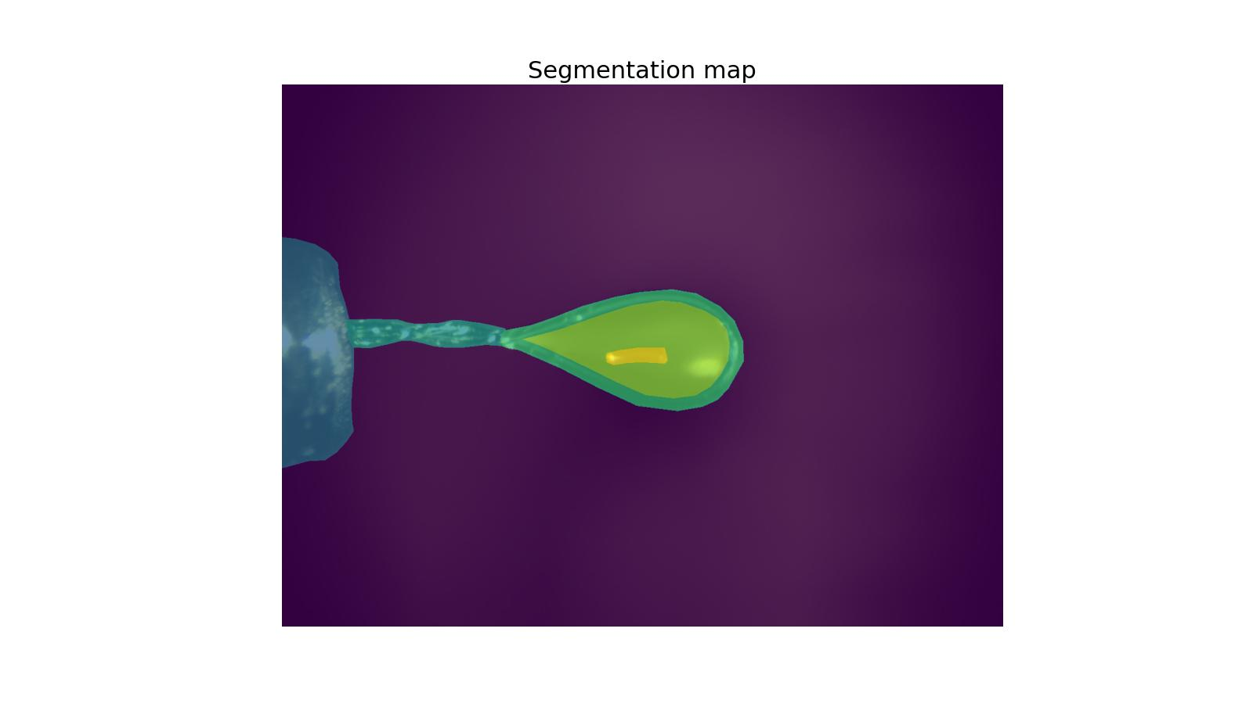
Outlook

Slide 22
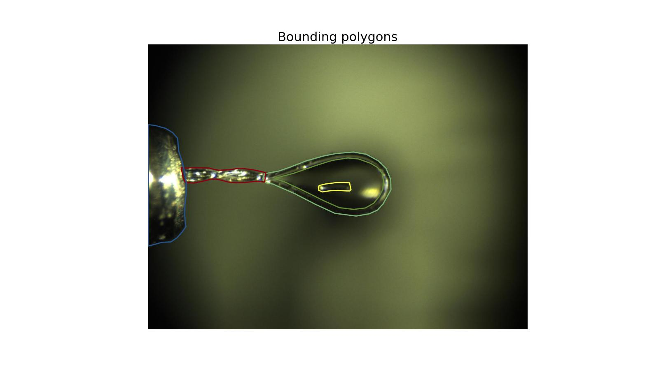
Outlook

Slide 23
Outlook

Slide 24
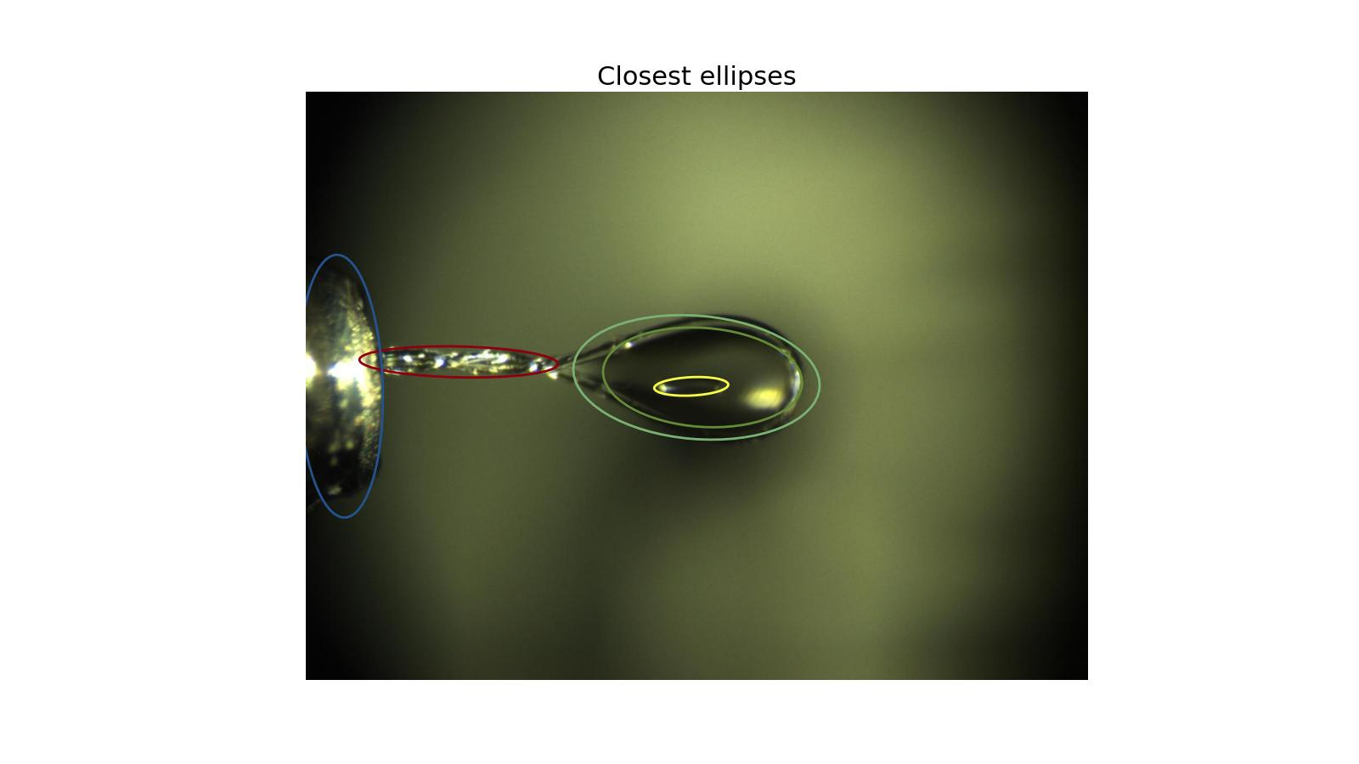
Outlook

Slide 25
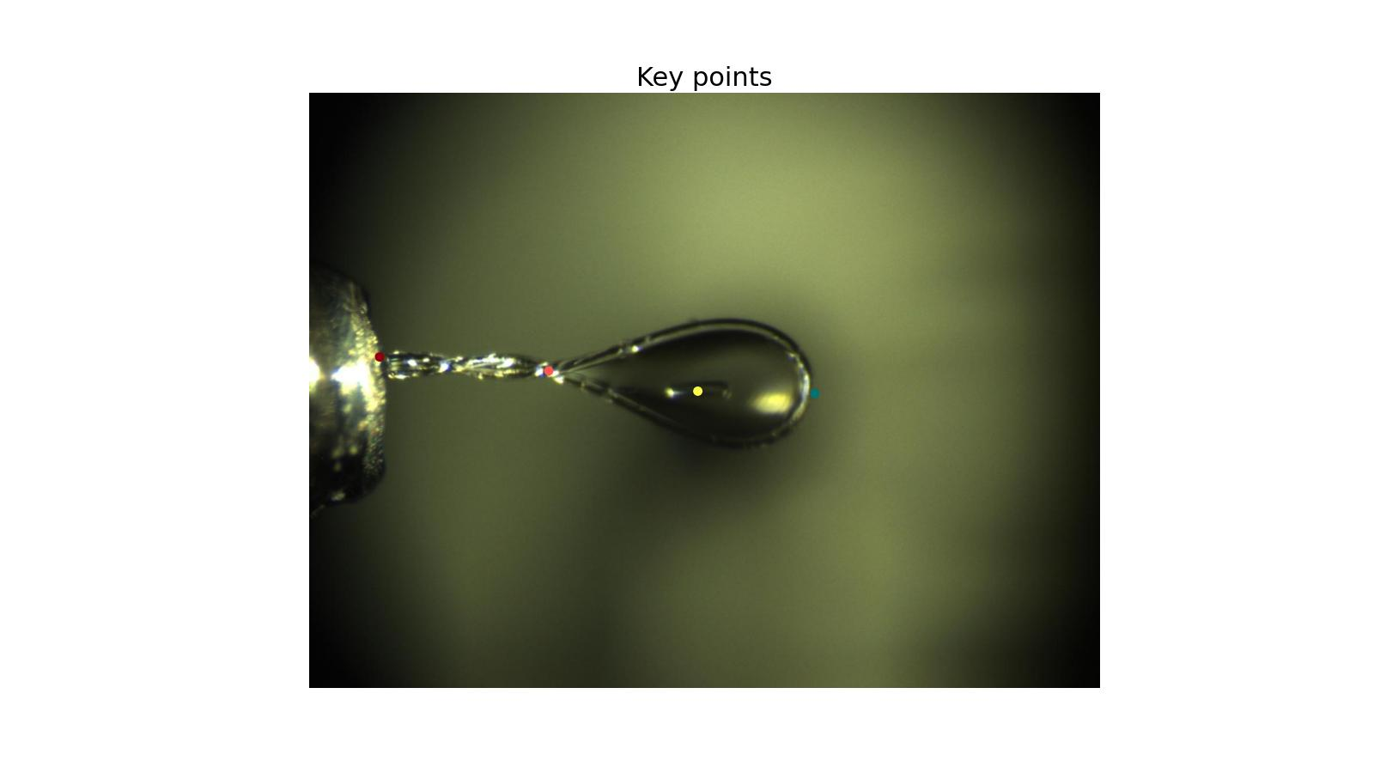
Outlook

Slide 26
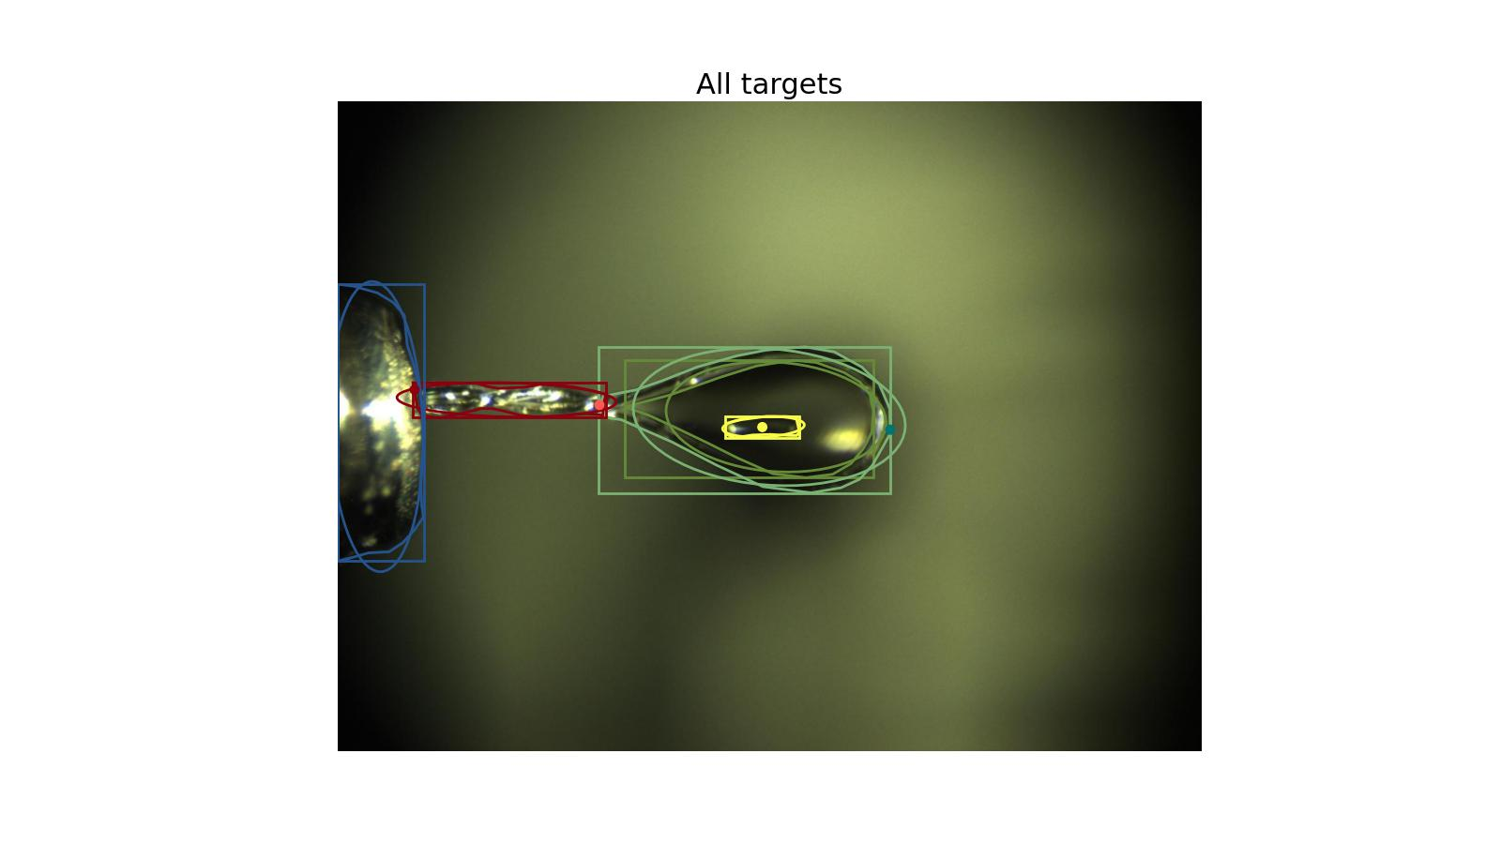
Outlook

Slide 27
We sometimes need more accurate models of sample image movement …
although sample moves on a circle as omega axis changes, its image almost never does (only if there is just material of refractive index of 1 around it). It follows much stranger law. Law nonetheless -- one just needs more parameters to model it …

Slide 28
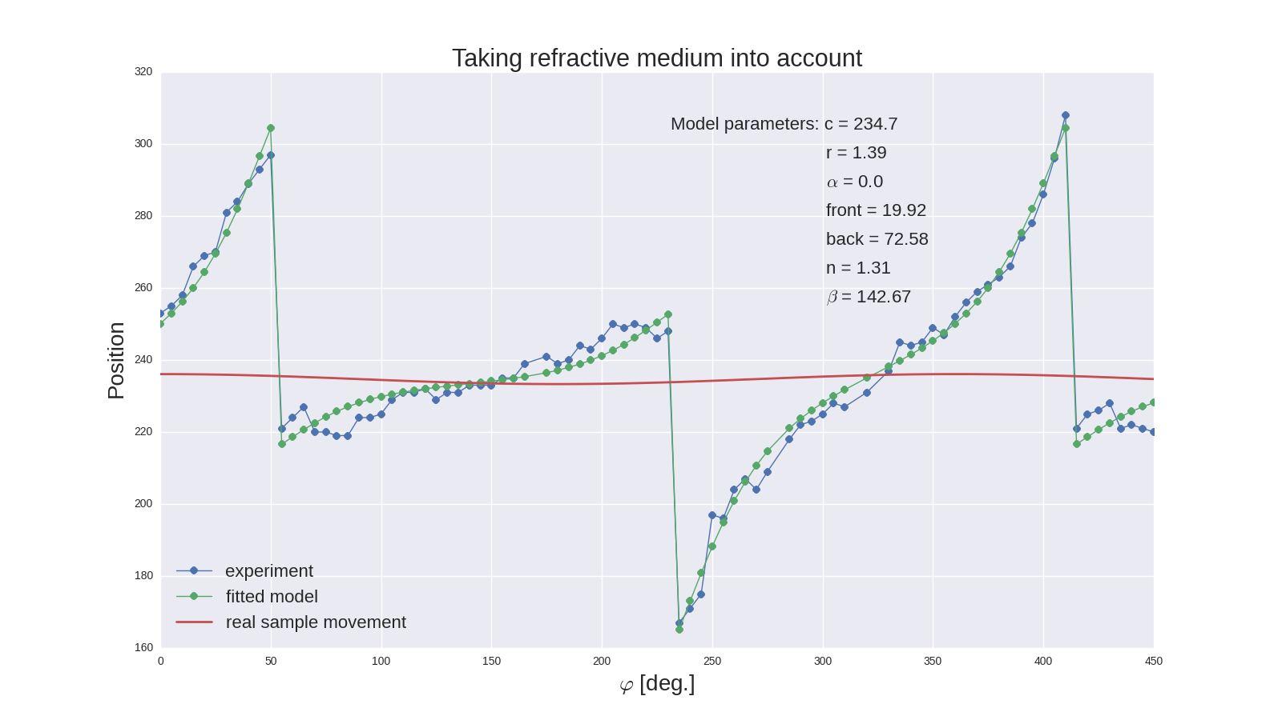
This is example of a sample aligned almost perfectly. It’s image is moving across many microns … it is important to model it well ...

Slide 29
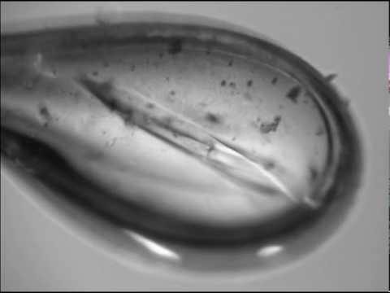

Slide 30
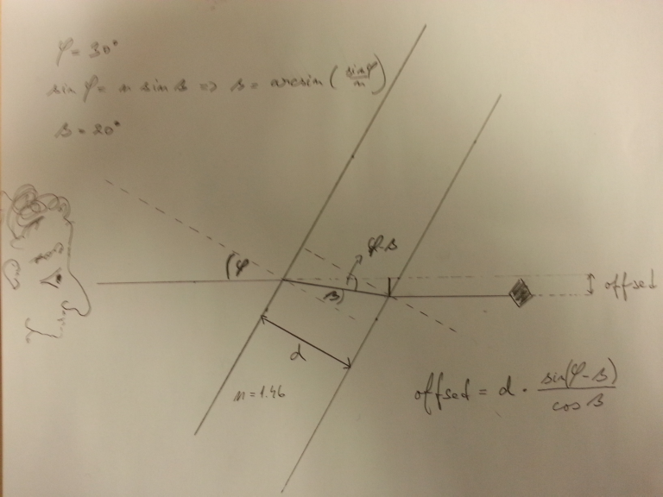

Slide 31
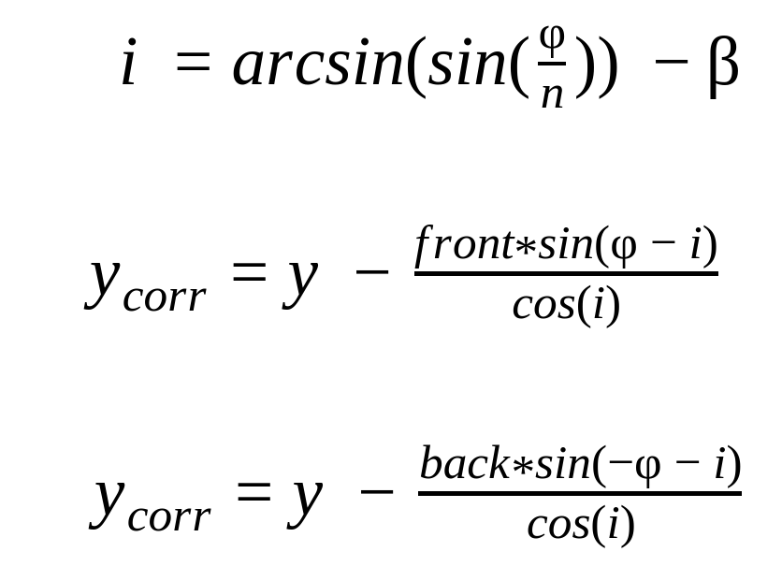
Slab model

Slide 32
Acknowledgements
GPhL team: Rasmus Fogh, Peter Keller, Clemens Vonrhein, Claus Flensburg and Gérard Bricogne
EMBL HH team: Marina Novikova and Gleb Bourenkov
Murko collaboration: Kate Smith and Ezequiel Panepucci (SLS), David Aragao and Ralf Fleig (DLS), Annie Heroux (Elettra), Jie Nan and Isak Lindé (Max IV), Andrey Gruzinov and Thomas White (Desy), Roeland Boer (Alba)
SOLEIL team: Bill Shepard, Serena Sirigu, Damien Jeangerard, Eric Larquet, Pierre Legrand, Tatiana Isabet, Robin Lener, Andrew Thompson

