Slide 1
Automated data collection at MAX IV: current status and
future plans
Joint MXCuBE/ISPyB Meeting May 28-30th 2024
Ana Gonzalez & MAX IV MX group

Slide 2
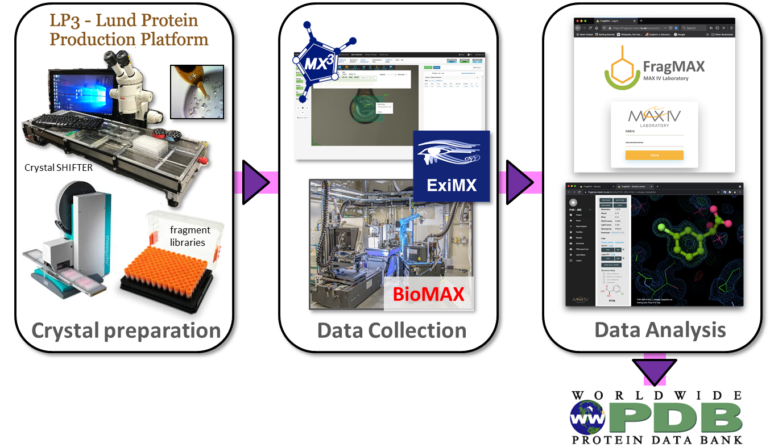
Rationale for automating data collection at MAX IV
The user community is dominated by fragment drug discovery and other high throughput projects that tend to involve very repetitive data collection.
An increasing number of users do not know what to do to optimize data collection even in relatively straightforward cases.
The success of automated data collection at other beamlines, showing that automation does not entail loss of quality.
FragMAX platform at MAX IV
Notes:
‹#›

Slide 3
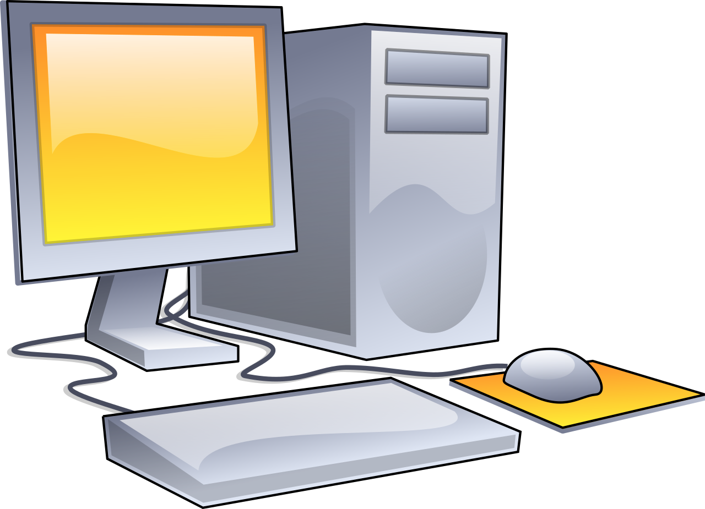
MXCuBE provides a framework for automating tasks
Detector
Diffractometer
GUI
Sample changer
Data processing
Optics
Notes:
‹#›

Slide 4
Approach to simple automated experiments
Sample information from ISPyB
Sample mounting & pre-centering
X-ray centering
Sample snapshots and data collection
Spot analysis
Autoprocessing
Adapt automated single tasks already implemented in MXCuBE
Notes:
‹#›

Slide 5
Approach to simple automated experiments
Sample information from ISPyB
Sample mounting & pre-centering
X-ray centering
Sample snapshots and data collection
Diffraction plan
Spot analysis
Autoprocessing
Eliminate user in between input between steps by using reasonable defaults or pre-loaded users’ preferences for data collection
Notes:
‹#›

Slide 6
Approach to simple automated experiments
Sample information from ISPyB
Sample mounting & pre-centering
X-ray centering
Sample snapshots and data collection
Diffraction plan
Spot analysis
Autoprocessing
Loop through all the samples
Notes:
‹#›

Slide 7
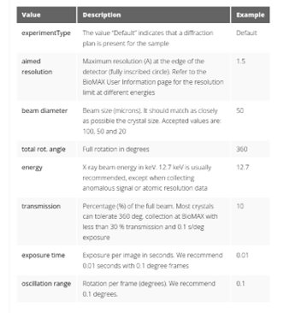
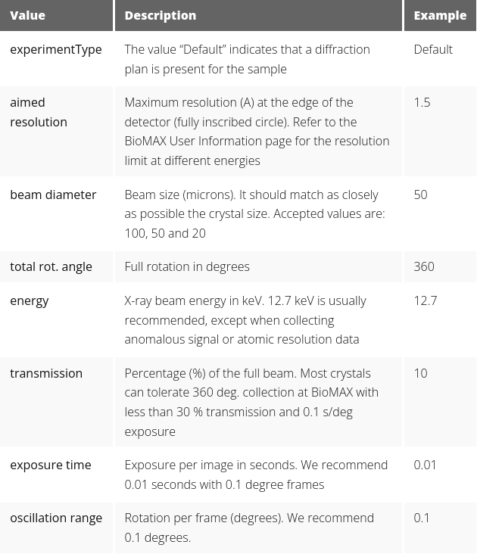
Diffraction plan
The user can enter the beam size (aperture closest match to the sample size), energy, transmission/exposure time, resolution (minimum inscribed circle), oscillation angle per image and number of images together with the sample in formation through ISPyB.
All parameters have defaults.
Users can also enter the diffraction plan in MXCuBE before starting the data collection.
Easier when the same parameters can be applied to all the samples.
Rapid feedback if wrong input is provided.
Notes:
‹#›

Slide 8
Diffraction plan in the sample spreadsheet
Users can use an Excel template with input validation to ensure that only valid parameters are given. MXCuBE will skip samples with invalid data collection parameters
If ExperimentType = “Default”, MXCuBE reads and applies the data collection parameters
Notes:
‹#›

Slide 9
Sample centering
Replaced Lucid with in-house procedure to locate the tip of the loop and detect fast sample drift. It requires collecting background reference images periodically. Work ongoing to further improve this step.
Sample snapshots are collected before X-ray centering as a visual check
X-ray centering consists in a grid scan at one orientation and a line scan at 90 degrees.
Dozor used to analyze images; the center position is decided on the diffraction image score and beam size given by users.
Not done yet: Estimate the sample size and map the crystal volume. Override the user choice for the beam size if they differ substantially (TBD), enable helical scans.
Notes:
‹#›

Slide 10
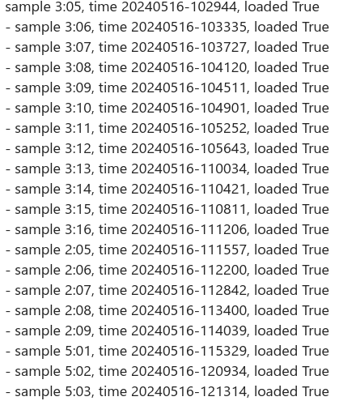
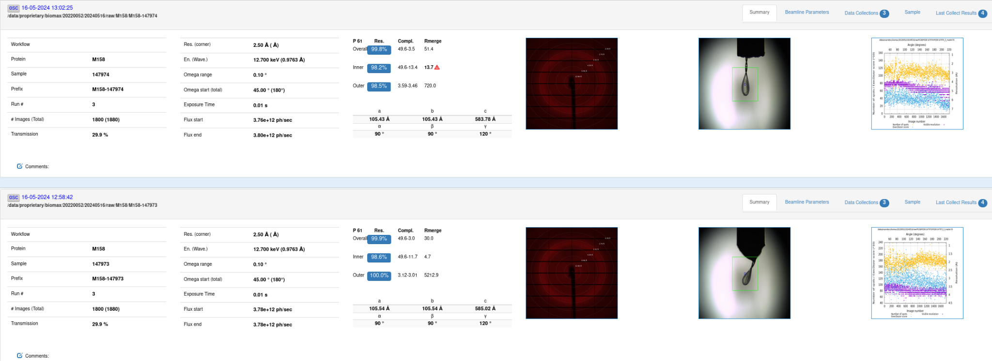
Monitoring results
In case of a single step failure (non-serious instrument issues, time-out in communications, no spots measured, multiple samples) skip the step and move to the next sample.
Serious or “uncaught” errors stop the queue.
A report is sent to the user every 20th sample. Email is also sent when the queue finishes or if it stops, updates, if no sample is detected on the gonio (“empt mount”) or there is a beam dump.
The results are shown in EXI.
Notes:
‹#›

Slide 11
Current status
Implemented end of 2022 in a separate MXCuBE3 branch.
Tested and improved continuously. Used almost weekly/biweekly by FragMAX projects and some proprietary proposals. The first standard proposal was 2024.
Maximum throughput of 3-4 minutes per sample (comparable or better than the fastest users).
The data quality is often better because automated centering outperforms manual centering.
To do list
Implementation in MXCuBE-web, merging with the “normal” branch.
Smart automated data collection: Adoption of the Global Phasing strategy (including sample characterization) for optimizing data quality and making automated experiments useful for a wider range of experiments and samples.
Truly autonomous “unattended” data collection: Users would not need to log in to MXCuBE to authenticate and initiate data collection. The purpose is to make a more efficient use of the available beamtime, particularly overnight shifts. No detailed plans yet, but probably will exploit the upgraded MXCuBE capability to switch proposals after log in.
Notes:
‹#›

Slide 12
Acknowledgements
MAX IV staff
Jie Nan
Mikel Eguiraun
Fabien Coronis
Alberto Nardella
Isak Lindhé
Tobias Krojer
Ana Gonzalez
Swati Aggarwal
Oskar Aurelius
Monika Bjelcic
Manoop Chenchilyan
Aaron Finke
Ishkhan Gorgisyan
Elmir Jagudin
Dean Lang
Mirko Milas
Thomas Ursby
SOLEIL
Robin Lener
Martin Savko
Global Phasing Inc
Gerard Bricogne
Rasmus Fogh
Peter Keller
Claus Vonrhein
MXCuBE Collaboration

Slide 13
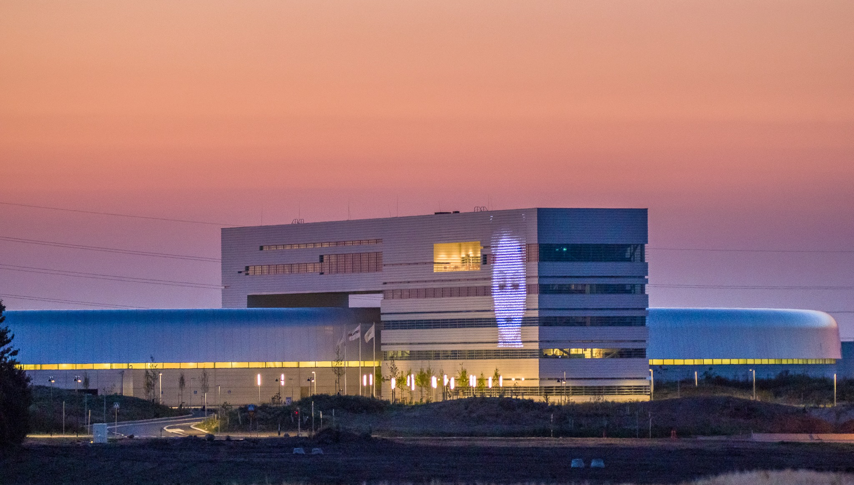
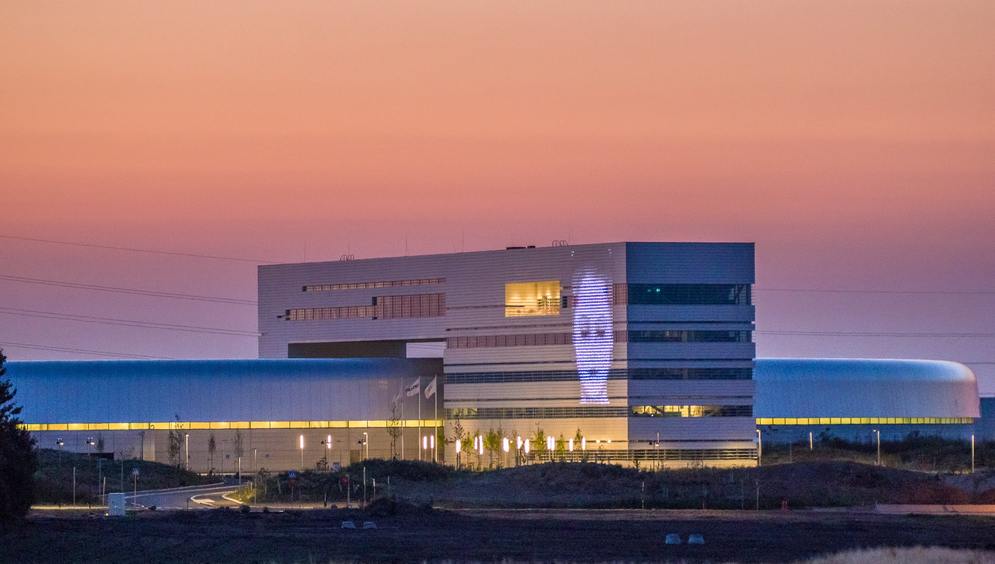
Thank you for your attention!
Questions?
Thank you for your attention!
Thank you for your attention!
Leif Jansson

