Slide 1
CrystalDirect Harvester at MASSIF-1 The ESRF Fully automated beamline
Jean Baptiste Florial
Software Engineer
McCarthy Team
jflorial@embl.fr
29/05/2024

Slide 2
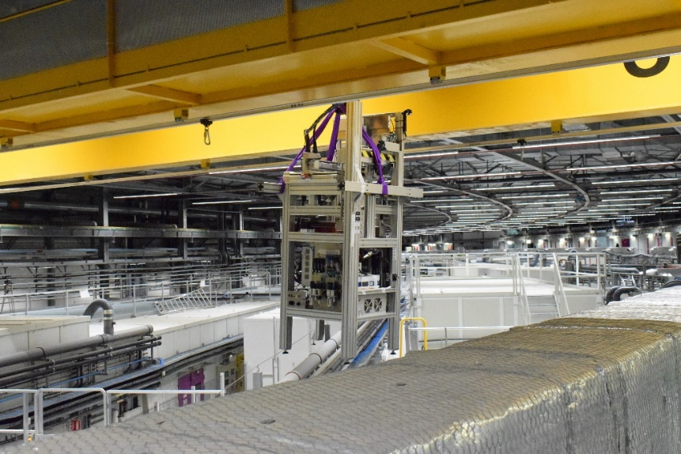
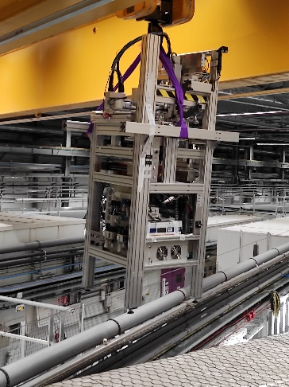
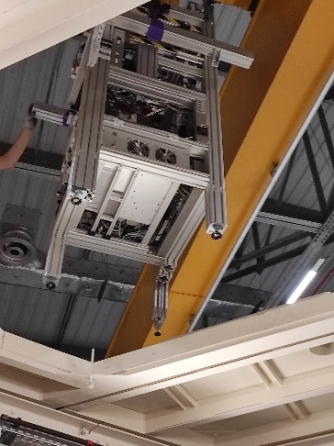
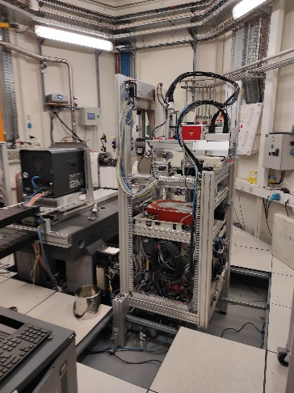
harvester Installation in Massif -1
An automatized robot dedicated to protein crystal harvesting with a very high efficiency rate.
Developed AT the EMBL Grenoble.
Instrumentation Team and the High Throughput Crystallography (HTX) teams
From crystals grown on plates to data collection and structural determination at the beamline

Slide 3
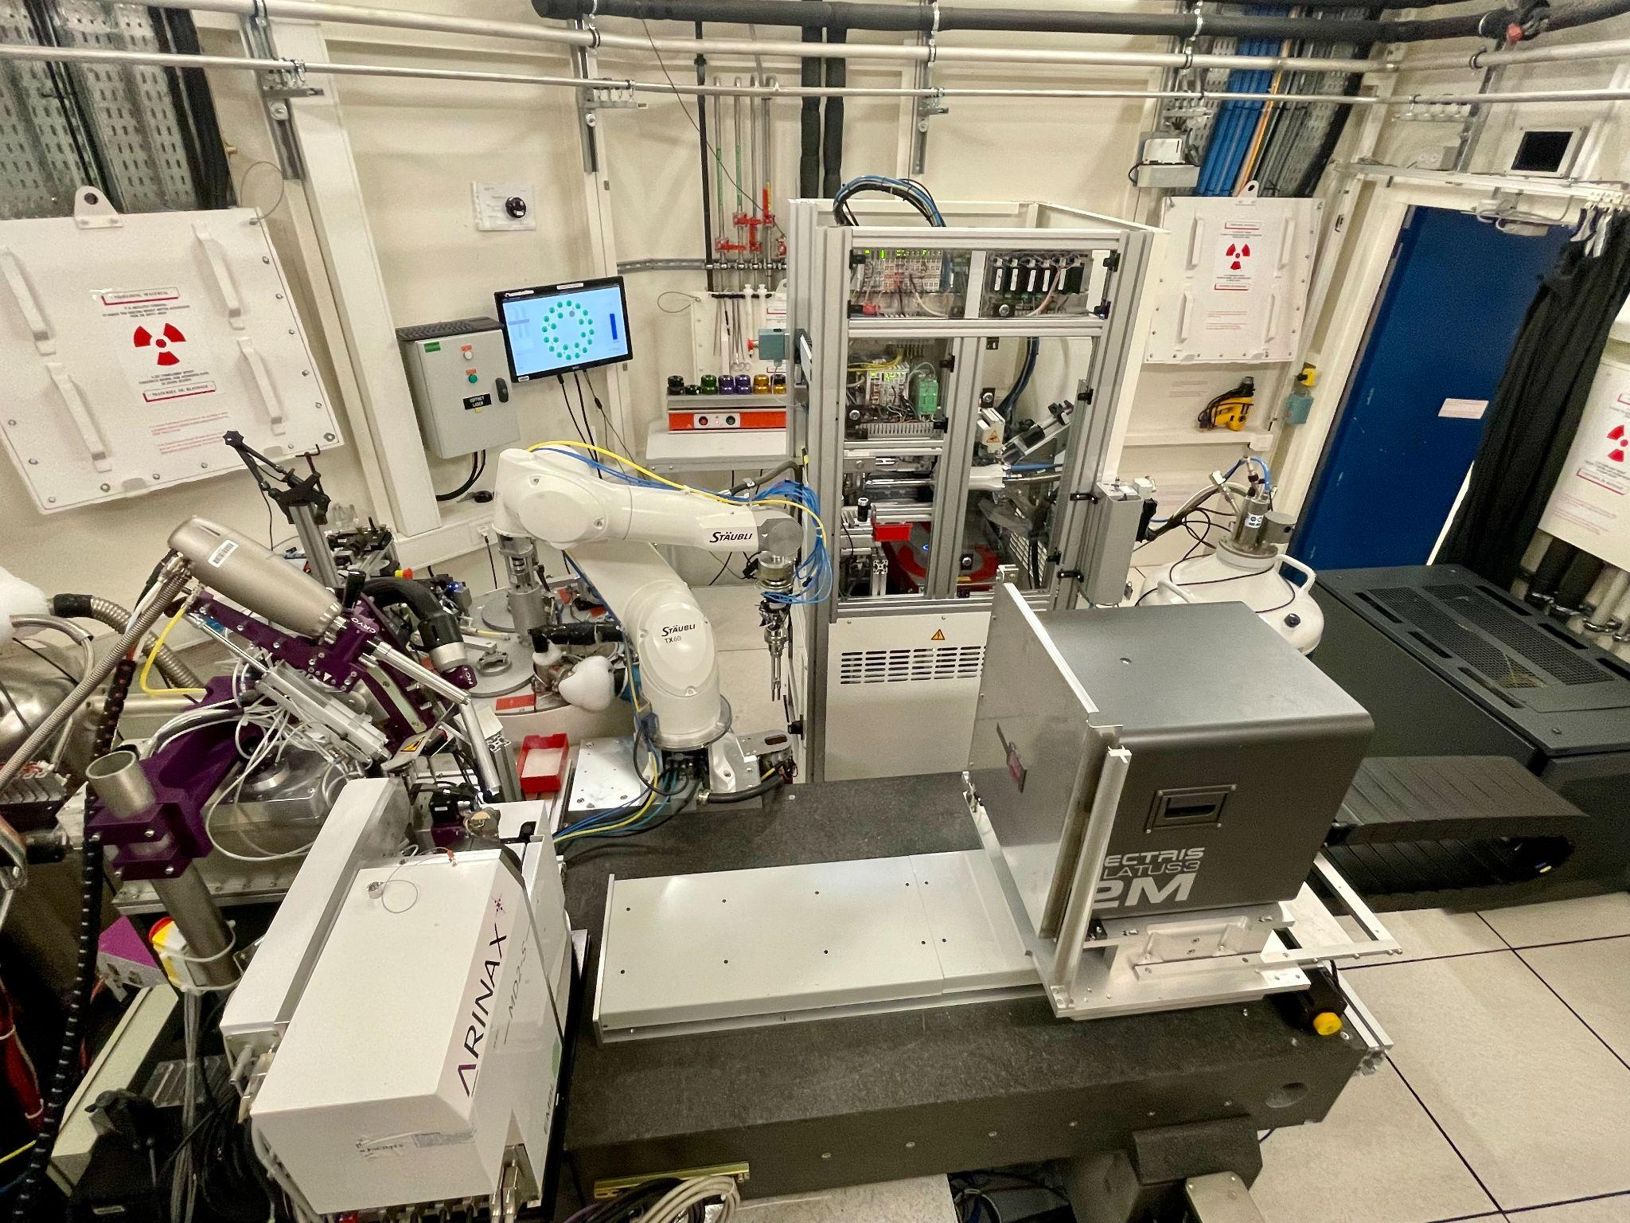
Massif -1 experimental hutch
fully automated ‘plate-to-beam’ service for crystals.
Unique facility for high throughput data collection of macromolecular crystals
data collection optimized for every sample
Arinax MD2s diffractometer
Flex HCD – 368 samples capacity
Pilatus3 2M
CrystalDirect Harvester
Cryostream and humidity control device
rocchio@embl.fr mbowler@embl.fr jsinoir@embl.fr

Slide 4
CrystalDirect harvester at MASSIF-1
Project overview
Increase efficiency for high throughput applications
Develop automated and target-based data collection modalities
Cryogenic temperature
Room temperature
Harvester installation in beamline environment
Validation of the harvester operational mode
Software integration: MxCuBEWeb / MxCuBEcore
Feasibility studies on different data collection modalities
Process optimization with multiple targets
rocchio@embl.fr mbowler@embl.fr jsinoir@embl.fr

Slide 5
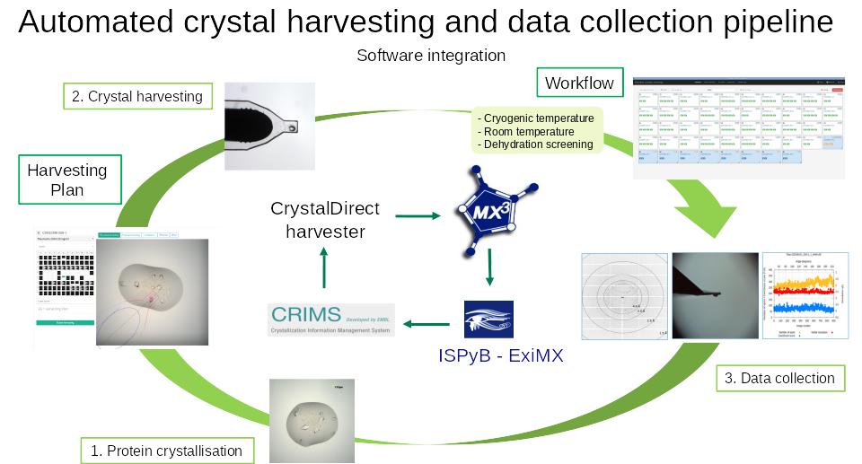
Automated crystal harvesting and data collection pipeline

Slide 6
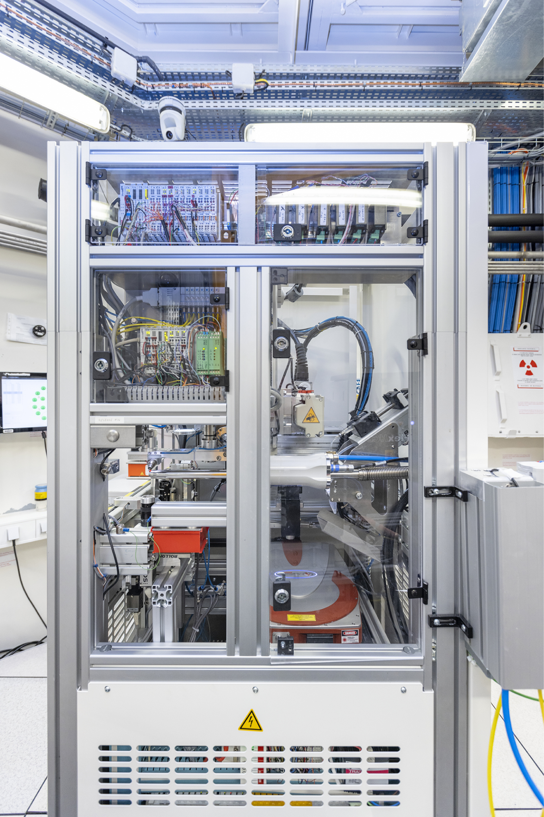
CrystalDirect harvester & MxCUBE

Slide 7
Integration of the Crystal Direct harvester in MxCUBE Web
Harvester.jsx GUI
harvester.py component
GUI .
def get_initial_state():
def get_crystal_list():
crystal_list = []
def get_harvester_contents():
harvester.py rest api routes
@server.route("/mxcube/api/v0.1/harvester/crystal_list", methods=["GET"])
@server.restrict
def get_crystal_list():
harvester.get_crystal_list()
return jsonify(limsutils.sample_list_get())
@server.route("/mxcube/api/v0.1/harvester/harvester_state", methods=["GET"])
@server.restrict
def get_harvester_state():
state = blcontrol.beamline.harvester.get_status().upper()
return jsonify({"state": state})
Harvester.py
Hardware object
class HarvesterMaintenance(HardwareObject):
__TYPE__ = "HarvesterMaintenance"
"""
Actual implementation of the Harvester MAINTENANCE,
COMMANDS, Actions and Calibration procedure, and Centering.
"""
def __init__(self, *args, **kwargs):
super().__init__(*args, **kwargs)
def init(self):
self._harvester = self.get_object_by_role("harvester")
class Harvester(HardwareObject):
"""
The Harvester Class consists of methods that execute exporter commands this class communicate with the Crystal Direct Harvester Machine
"""
__TYPE__ = "Harvester"
def __init__(self, name):
super().__init__(name)
self.timeout = 3 # default
self.calibration_state = False
def init(self):
"""Init"""
self.exporter_addr = self.get_property("exporter_address")
HarvesterMaintenance.py
Maintenance Hardware object

Slide 8
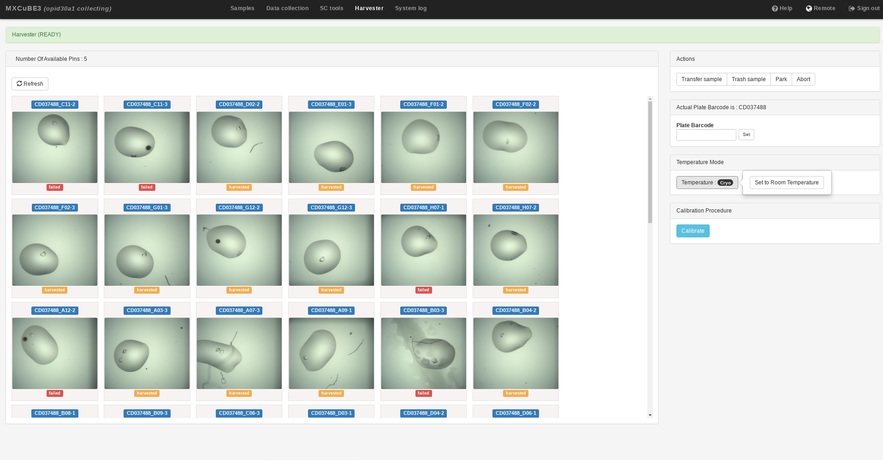
MxCUBE 3 - Harvester Sample View

Slide 9
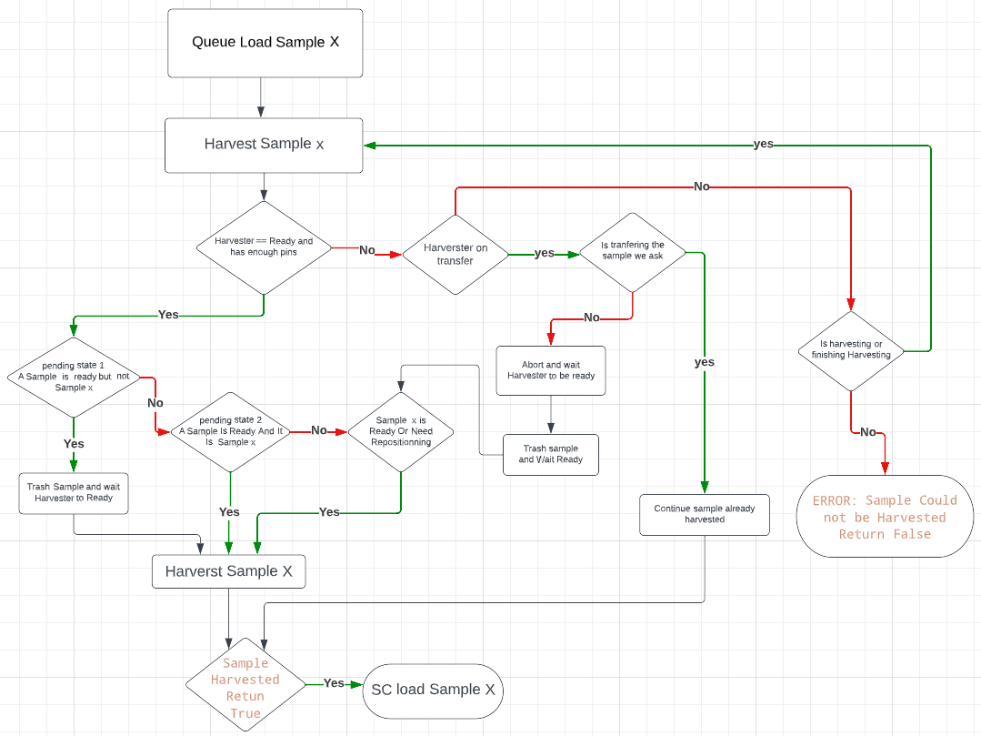
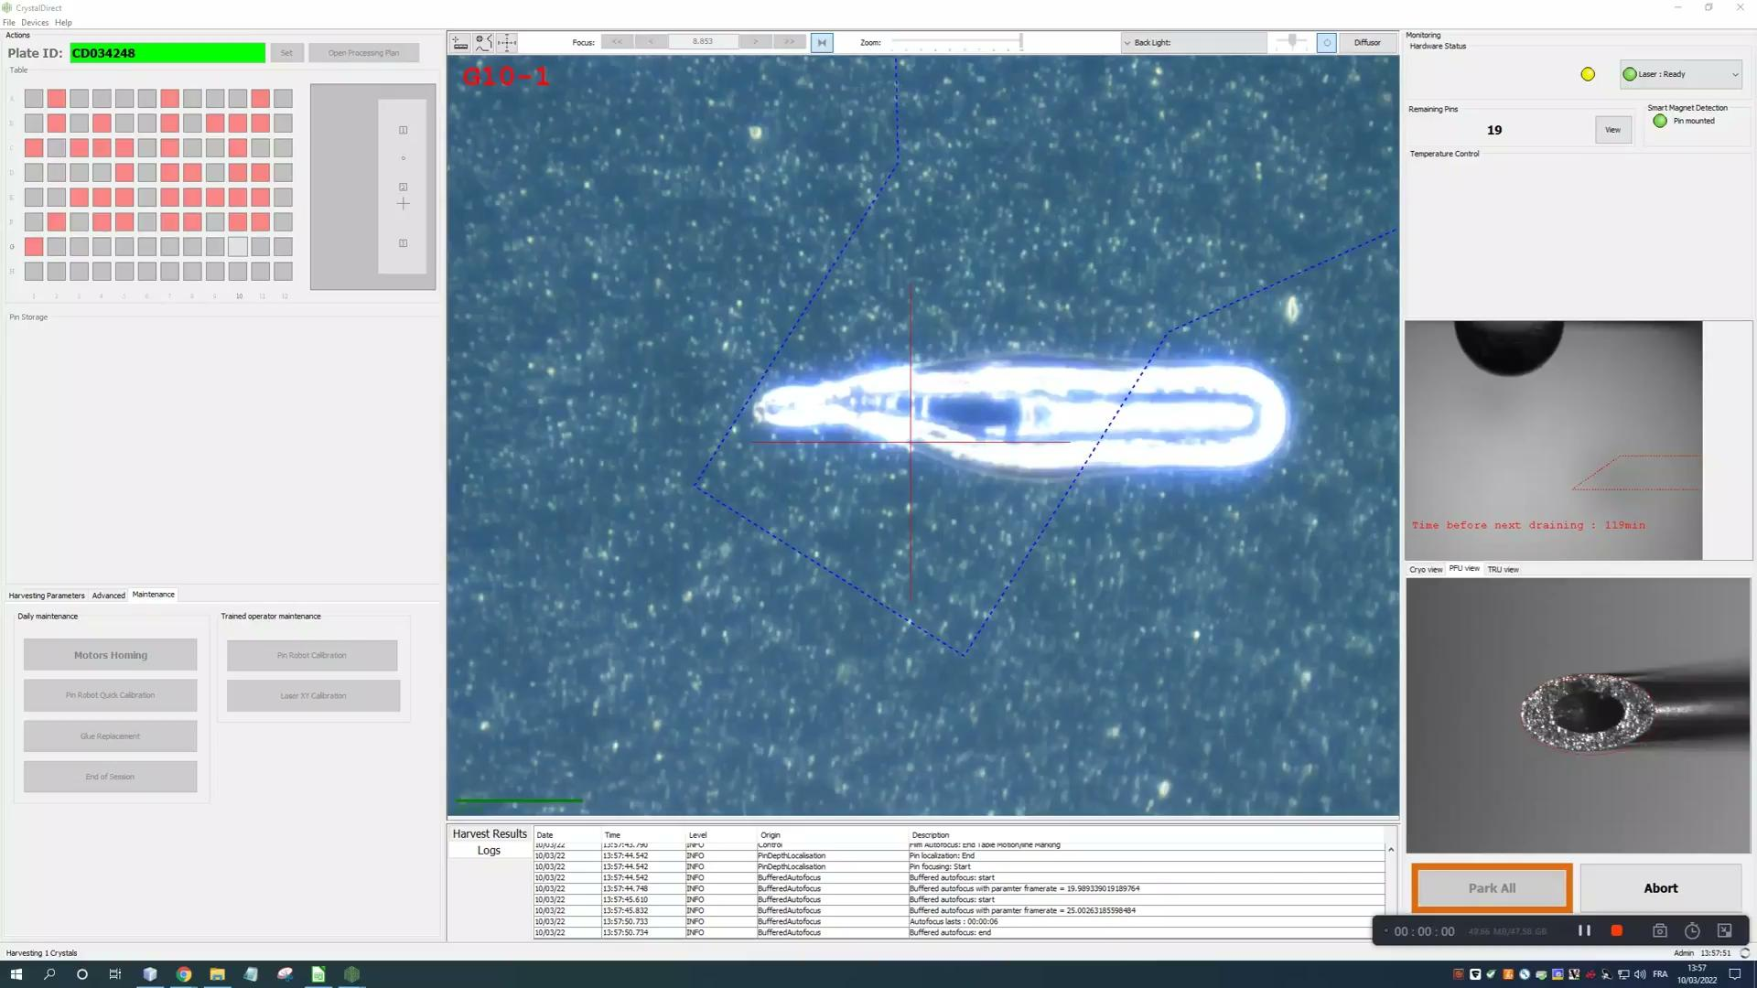
MxCUBE 3 - Harvest Sample AND SC load

Slide 10
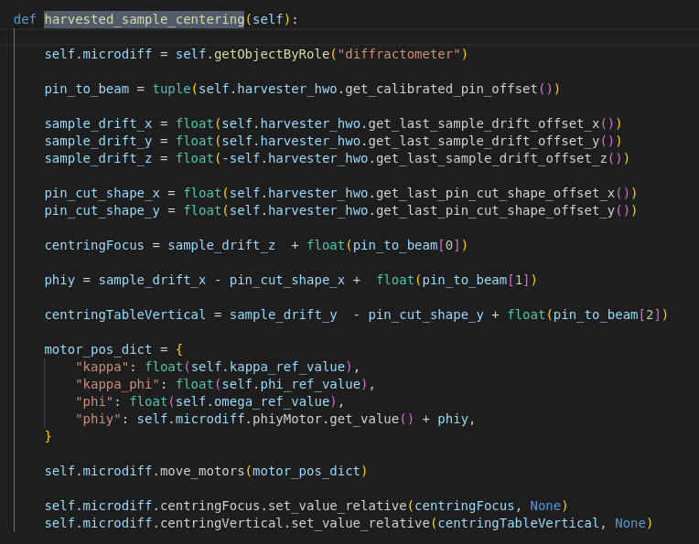
Crystal repositioning on MD for automated beam centering
Pin Calibration Procedure
load_calibrated_pin
sample_mount_device.single_load()
Move Motors Kappa, Phi, phiy to references value save Motor Position like old_motorpos
Perform a Manual 3 click Centering
save new motor position
new_motor_pos - old_motorpos = new_motor_offset

Slide 11
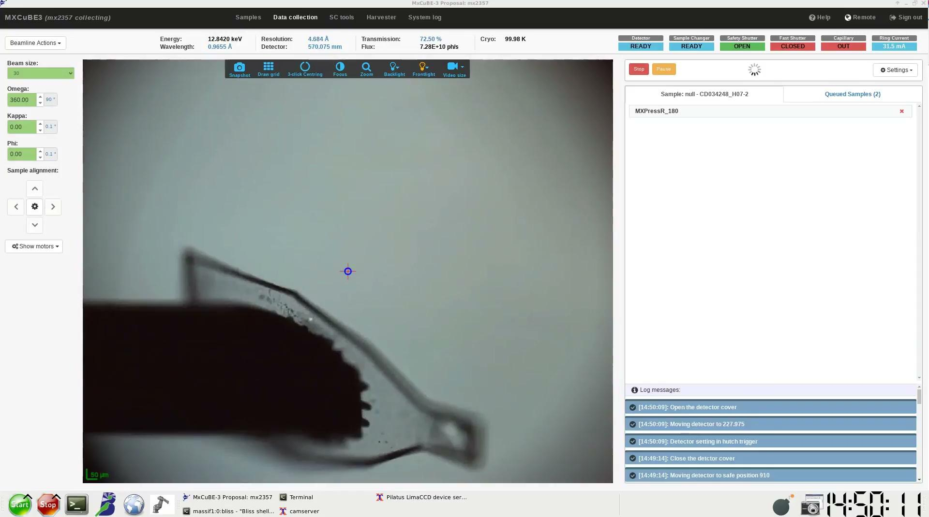
Crystal repositioning on MD for automated beam centering
Pin Calibration Procedure
load_calibrated_pin
sample_mount_device.single_load()
Move Motors Kappa, Phi, phiy to references value save Motor Position like old_motorpos
Perform a Manual 3 click Centering
save new motor position
new_motor_pos - old_motorpos = new_motor_offset

Slide 12
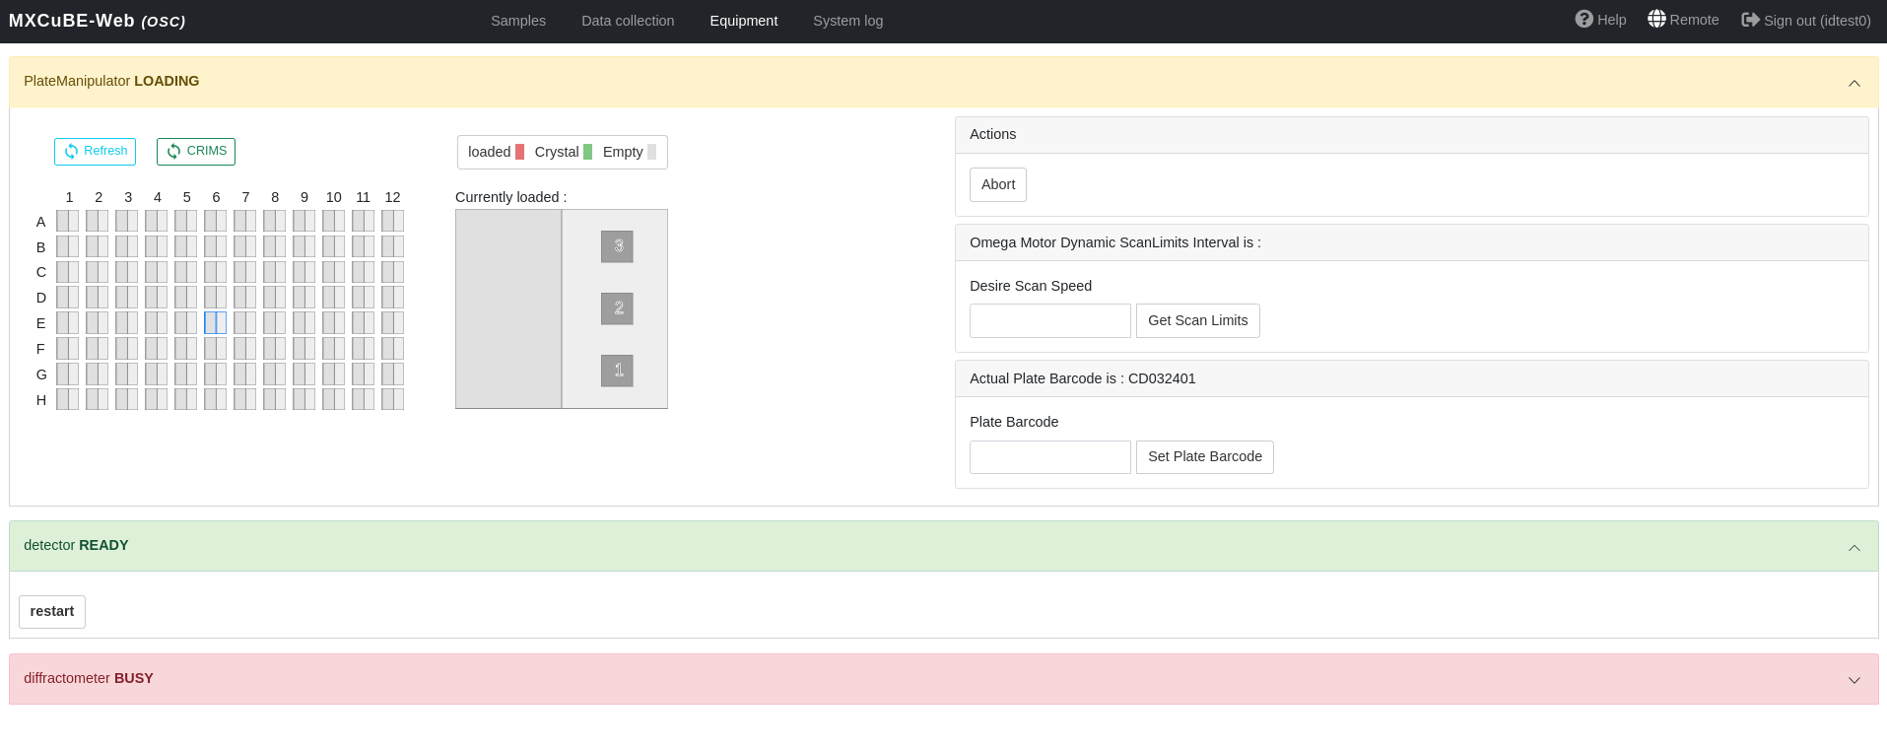
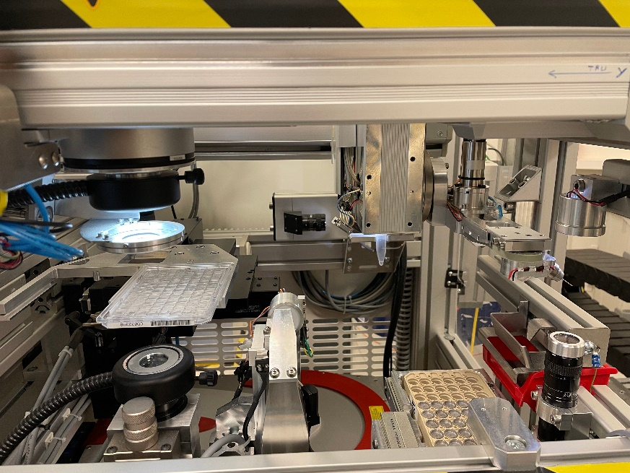
Conclusion and Future Plans
Possibility to automatically load plate from Harvester to MD

Slide 13
THANK YOU !
Synchrotron Crystallography team
HTX Team
Andrew McCarthy
Matthew Bowler
Nicolas Foos
Shibom Basu
Mathias Eymery
EMBL Grenoble – Instrumentation Team
Gergely Papp
Jeremy Sinoir
Raphael Cohen
Franck felisaz
ESRF
Didier Nurizzo
Marcus Oskarson
Antonia Beteva
Daniele De Sanctis
Peter Murphy
Serena Rocchio
Marcos Lopez Marrero

